Slide 1


Atomic and Molecular research activities of Data Center for Plasma Properties (NFRI)
October 7 , 2011
ADAS WORKSHOP
Mi-Young Song

Slide 2

Data Center for Plasma Properties

Slide 3
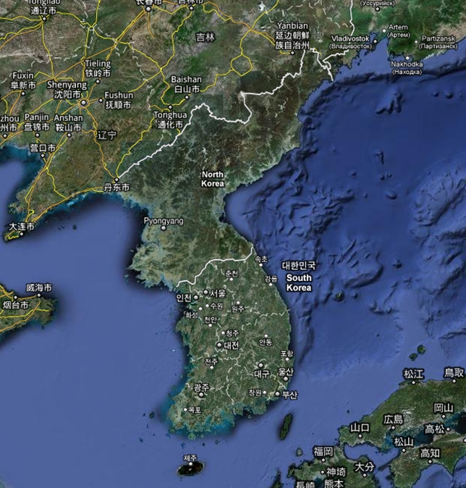
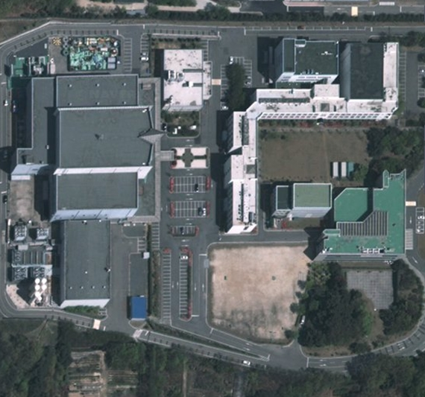
Location
NFRI

Slide 4
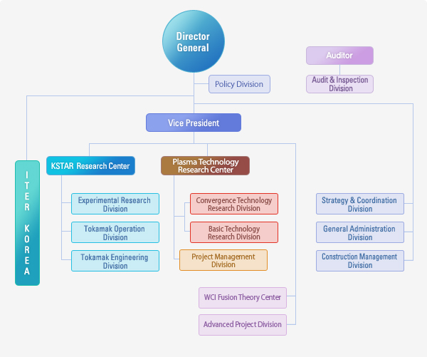
Organization of NFRI
Data center for plasma properties (DCPP)
- Plasma Simulation
- A+M data research
- Basic research for plasma processing

Slide 5
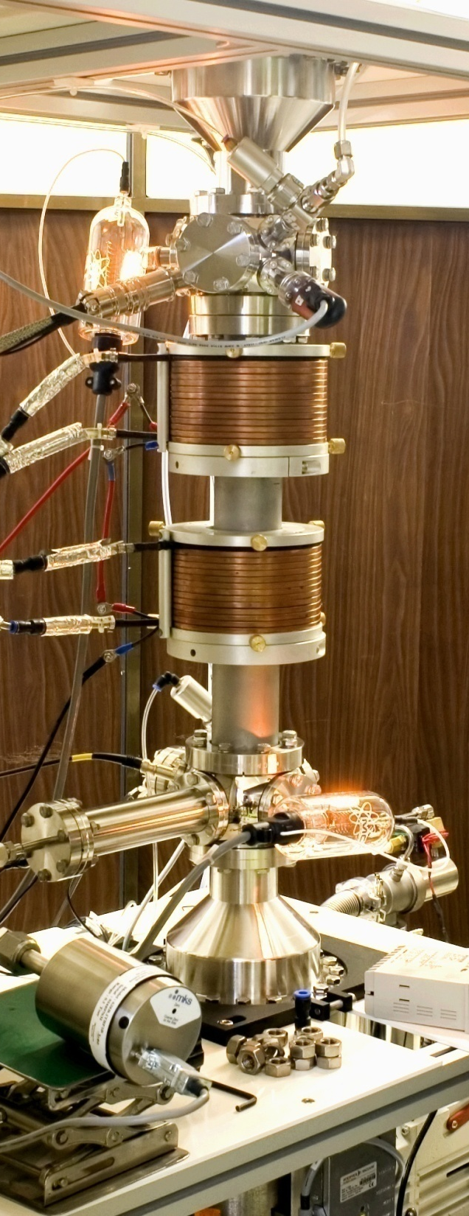
A+M Data Center for Plasma Applications
2003.
01. Plasma Properties Information System
- with KISTI (Korea Institute of Science, Technology and Information)
- A+M DB for Industrial Plasma Applications
2006.
12. Launch of DCPP Project
- Supported by Ministry of Knowledge Economy
- making Standard Reference Data for Low Temperature Plasmas
- making USER Network
- ISO 9001:2000 / KSA 9001:2001 (Quality Management System)
2008.
09. Construction of APAN Network
- APAN : Asia-Pacific Atomic data Network
- Korea, Japan, Australia, India, China
2010.
06. Construction of Data User Network
- 3 major Company join DUN, 30 small and medium company
- University-Industry-Institute value chain for Data Business
- 2 Technology Transfer

Slide 6
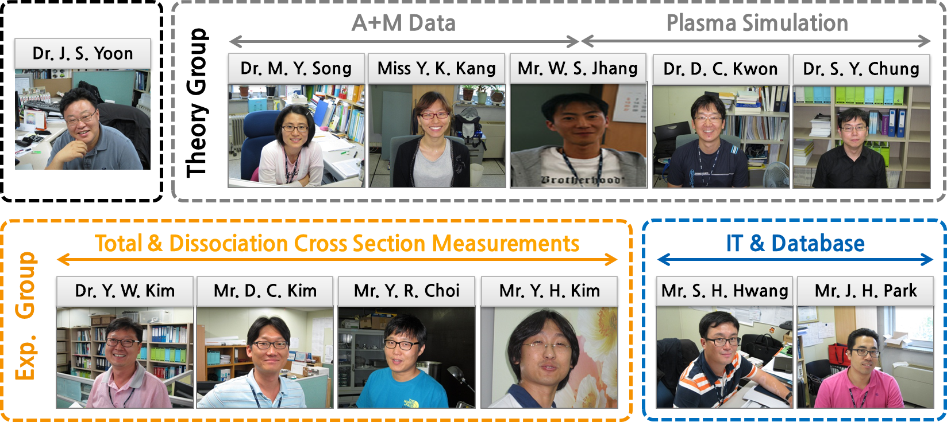
Members in DCPP
6 Theoretician, 4 Experimentalist and 2 IT people
A+M Data research for development(simulation), evaluation and dissemination
International collaboration using APAN platform

Slide 7
Research Activities

Slide 8
Experiment
Theory
.
Data Evaluation
Simulation
Dissemination
Data validation
Preceding test
.
.
Virtual laboratory
DB Service
Web base simulator

Slide 9
Atomic and Molecular Data Research
Theory
Ion-neutral atom collision : V.P. Shevelko (Russia)
Electron-Ion collision : Y.D. Jung(Korea)
Molecular structure : Y. S. Lee (Korea)
Atomic structure : Y. J. RLee
Data Analysis for Plasma : T. Kato (Japan)
Data Evaluation : Y. Itikawa(Japan)
E. Krishinakumar(India)
Experiment
Electron collision :H. Cho(Korea), S. J. Buckman, M. J. Burunger
(Australia), H. Tanaka (Japan)
Ion beam, neutral beam collision: NFRI
Swarm method : B. H. Jeon (Korea)
Dissociation processes : H. Toyoda (Japan)
Surface interaction : Y.H. Im (Korea)

Slide 10
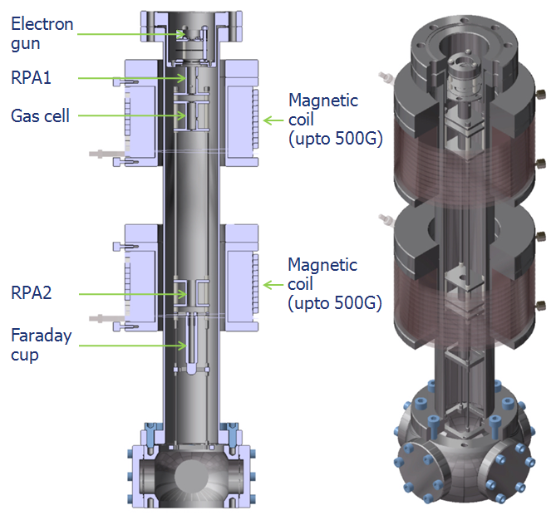
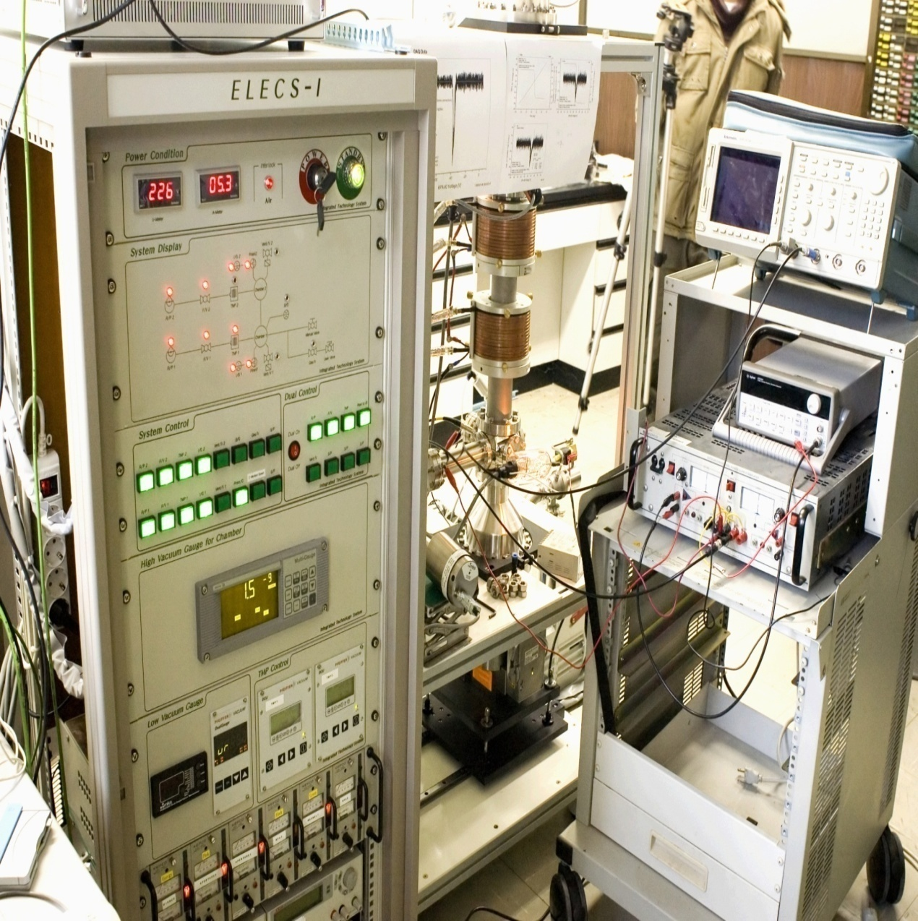
ELECS-1 for total cross section measurements
with CNU, ANU

Slide 11
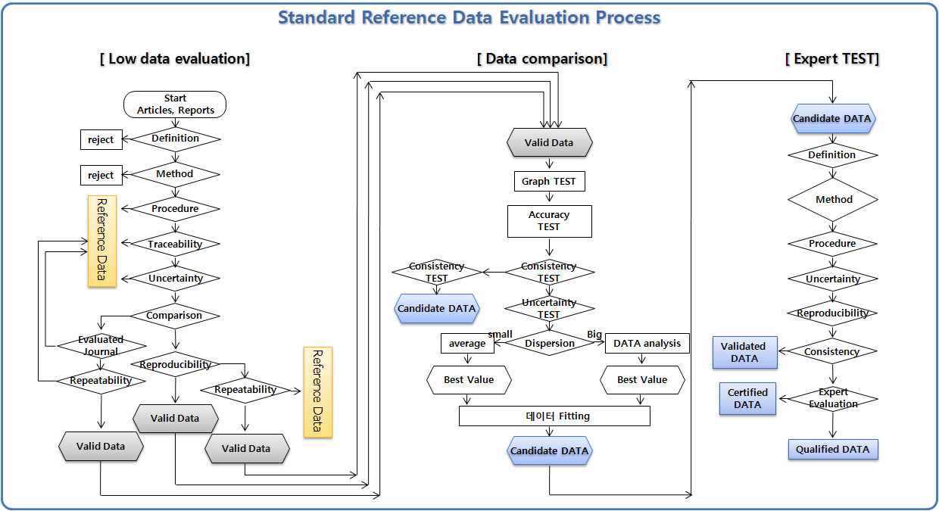
Data Evaluation
Synthesis
Evaluation
Compilation
Standardization
Maintenance
Notes:
참조포준 :
플라즈마 소스, etching, DEPOSITION GAS, 26개의 분자 데이터에 대한 데이터 평가를 4년 동안 하였음.
We can evaluate 26 molecules collision data using industry field for 4 year
Period: 2006-2009
DB record: 145,517 record
Number of A&M : 475
Journal : 30
Electron impact: 85992
Photon impact:
Heavy particle impact:
H2,N2,O2,Ar,Xe, CF4, C2F6, C3F8, C4F8, CF3I, CH3F, CCl2F2, SF6, SiH4,Si2H6, SIF4

Slide 12
Atomic and Molecular Physics Society
Collection of data without quality judgment is not useful
- only BETTER data should replace existing ones
Quality judgment (=critical evaluation) of data is crucial for users
Evaluation must be done by scientists with appropriate experience
Critical evaluation requires a wide network of competent and dedicated scientists
This is the most expensive part of maintaining a database
Three data evaluation principles
→ How well is the data generation described
How do the data follow the known physical laws
How do the data compare to other measurements or calculations of the same phenomena

Slide 13
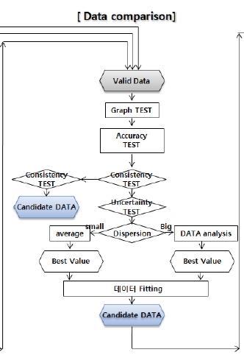
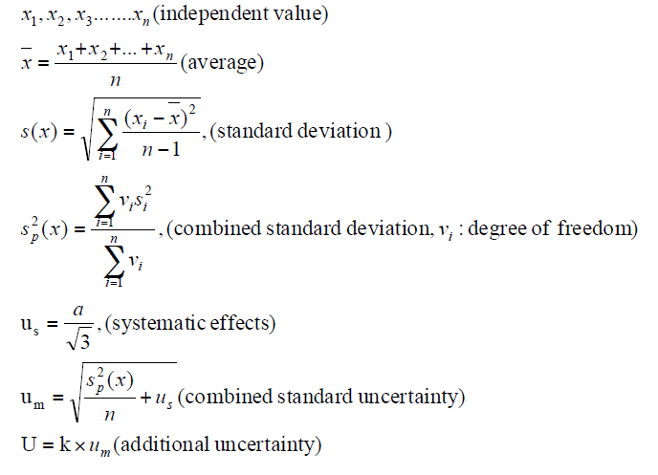
Value Evaluation
Electron energy (eV) | Cross section (10⁻¹⁶cm²) | 불확도 (10⁻¹⁶cm²)
0.4 | 10.2 | 1.02
0.5 | 11.1 | 1.11
0.65 | 12.1 | 1.21
0.8 | 12.7 | 1.27
0.9 | 13.3 | 1.33
1 | 14 | 1.4
1.1 | 15.1 | 1.51
1.2 | 16.2 | 1.62
1.3 | 18.1 | 1.81
. . . . . | . . . . . | . . . . .
Uncertainty Evaluation

Slide 14
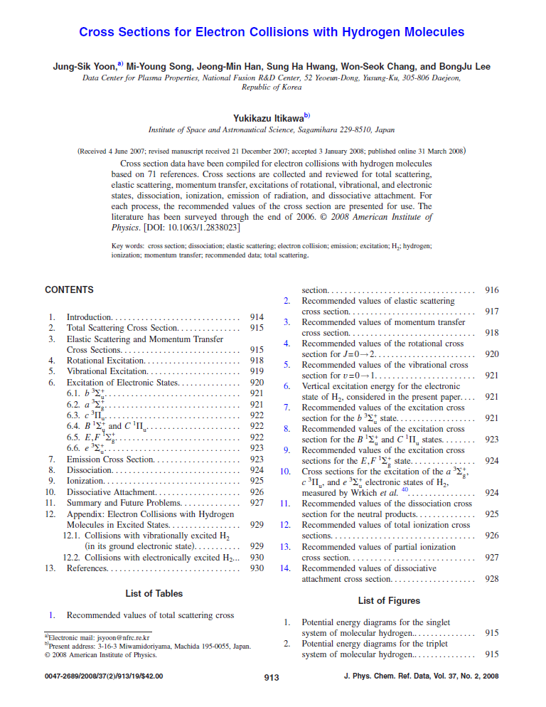
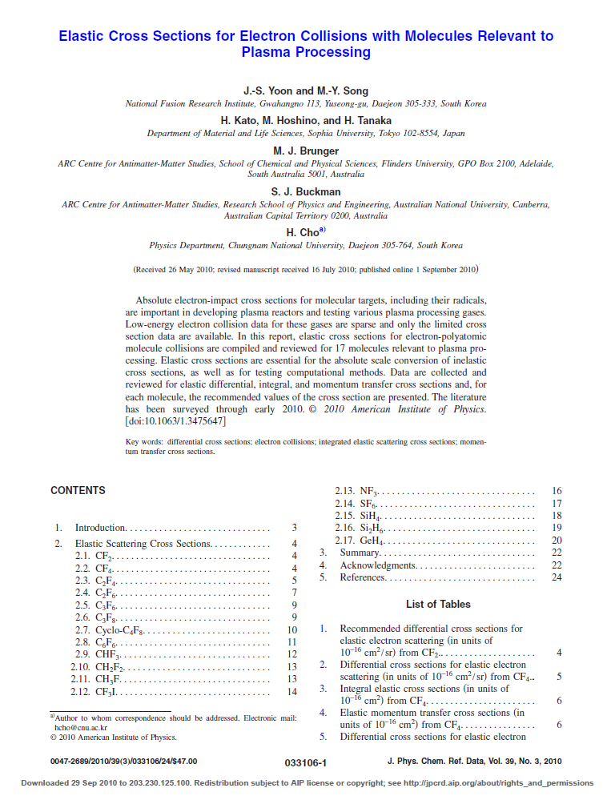
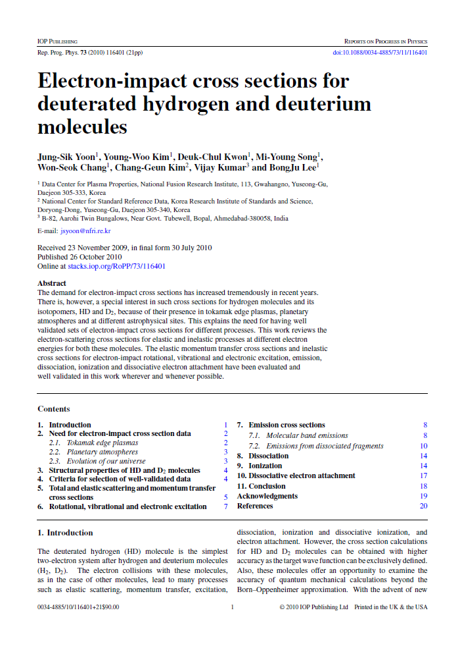
① Cross sections for electron collisions with hydrogen molecules
Journal of Physical and Chemical Reference Data, 37 (2), 913 (2008)
② Elastic cross sections for electron collisions with molecules relevant to plasma
processing
Journal of Physical and Chemical Reference Data, 39 (3), 913 (2010)
③ Electron-impact cross sections for deuterated hydrogen and deuterium molecules
Report on Progress in Physics, 73, 116401 (2010)

Slide 15
Experiment
Theory
.
Data Evaluation
Simulation
Dissemination
Data validation
Preceding test
.
.
Virtual laboratory
DB Service
Web base simulator

Slide 16
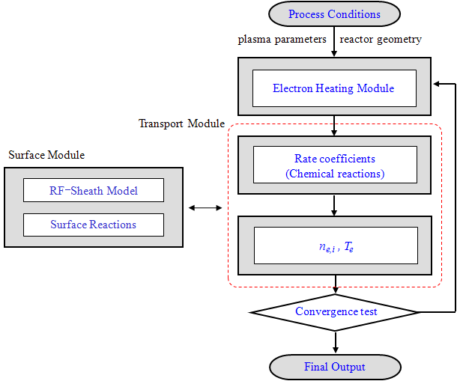
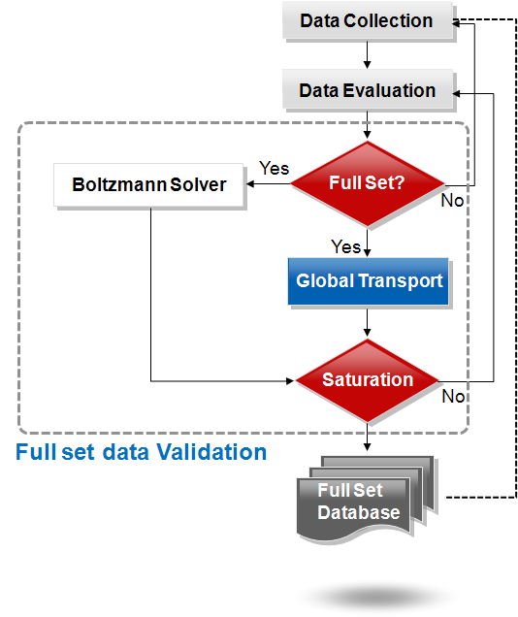




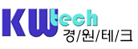

Production of Data set
Verification of full set using Reference Cell

Slide 17
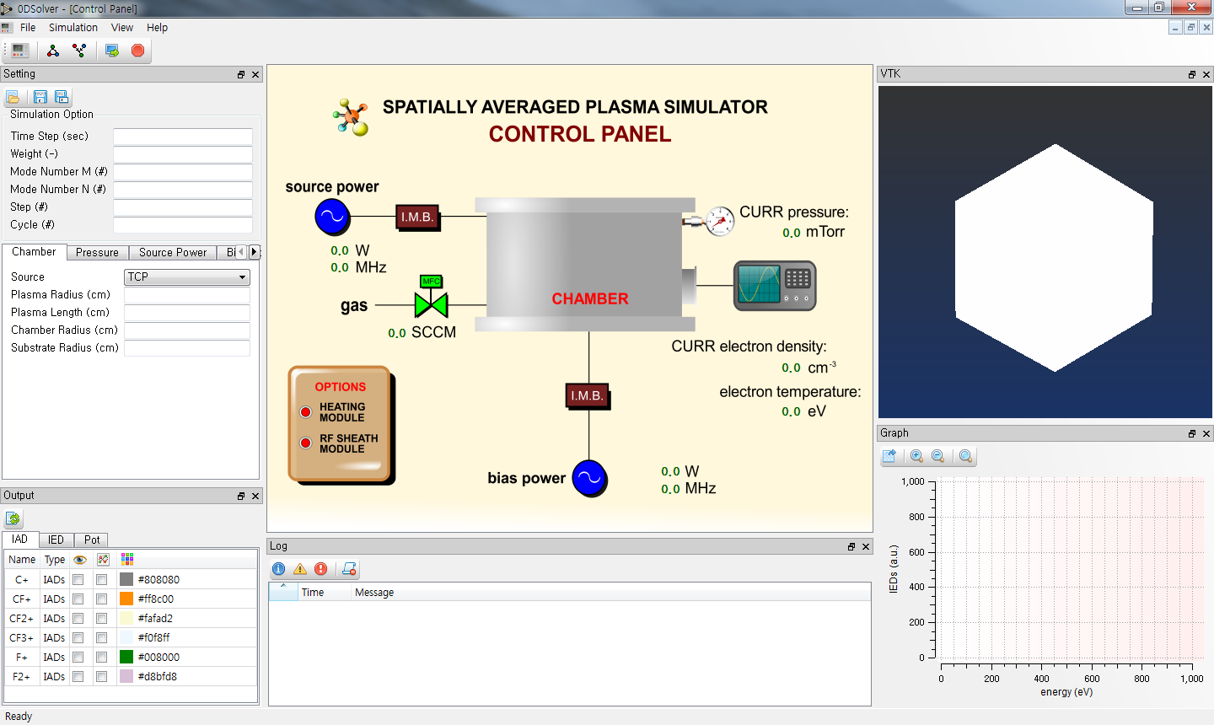
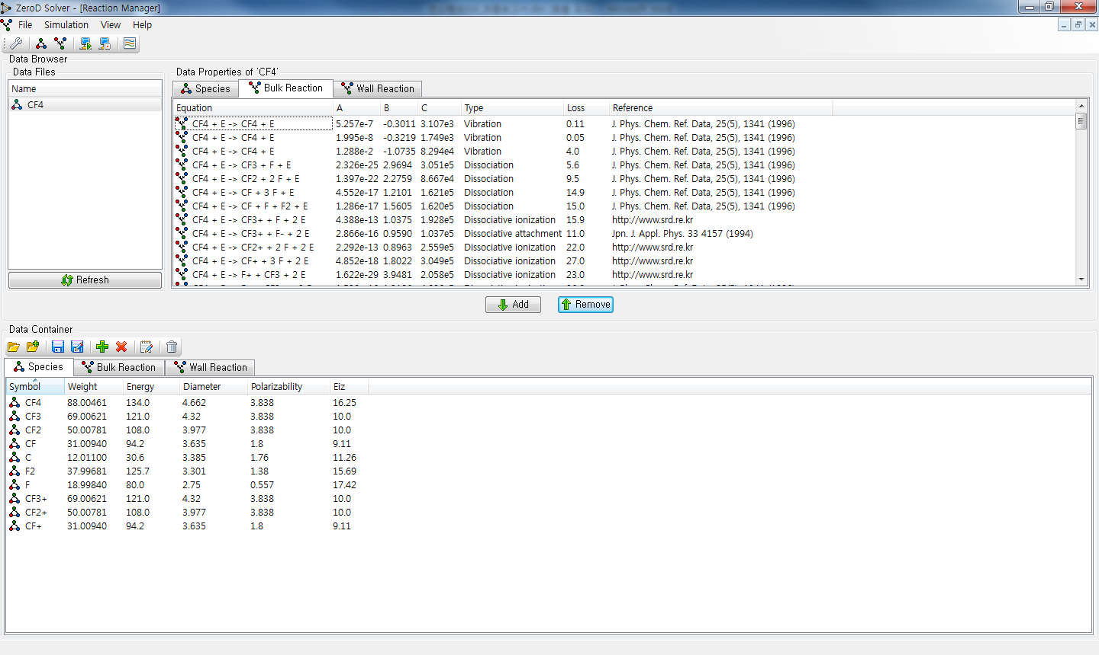
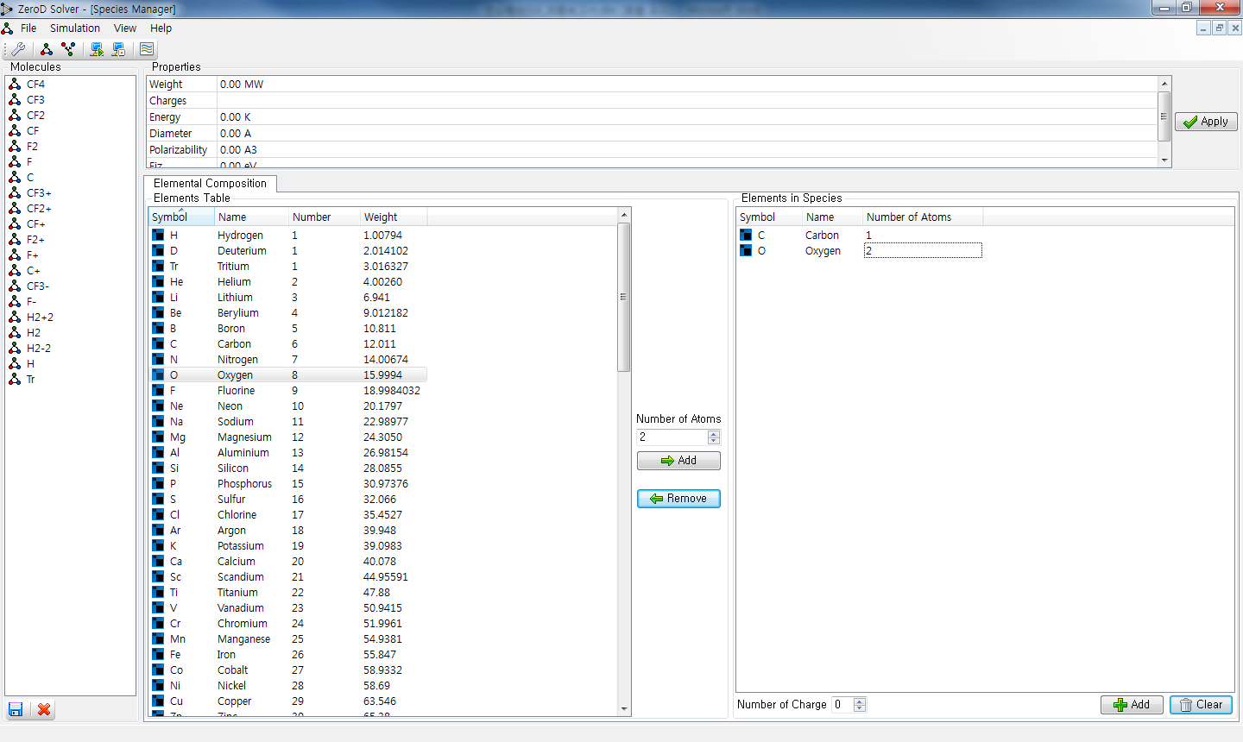
Development of Simulator
세계 최초로 Reaction manager 탑재

Slide 18
Experiment
Theory
.
Data Evaluation
Simulation
Dissemination
Data validation
Preceding test
.
.
Virtual laboratory
DB Service
Web base simulator

Slide 19

http://dcpp.nfri.re.kr/

Slide 20
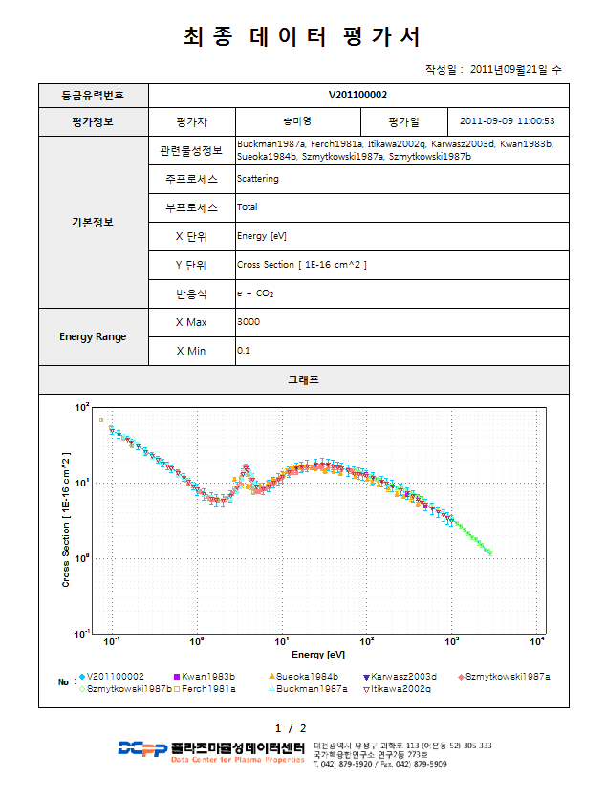
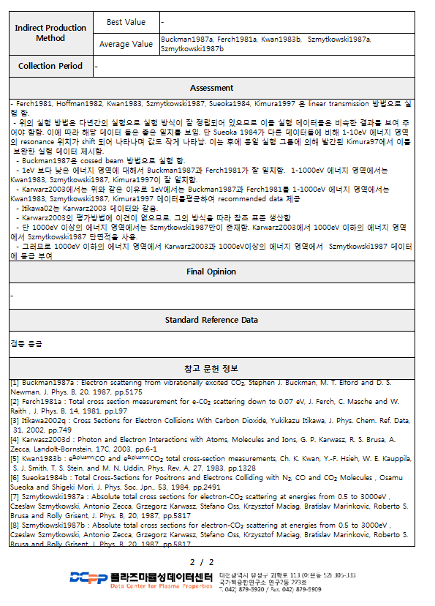
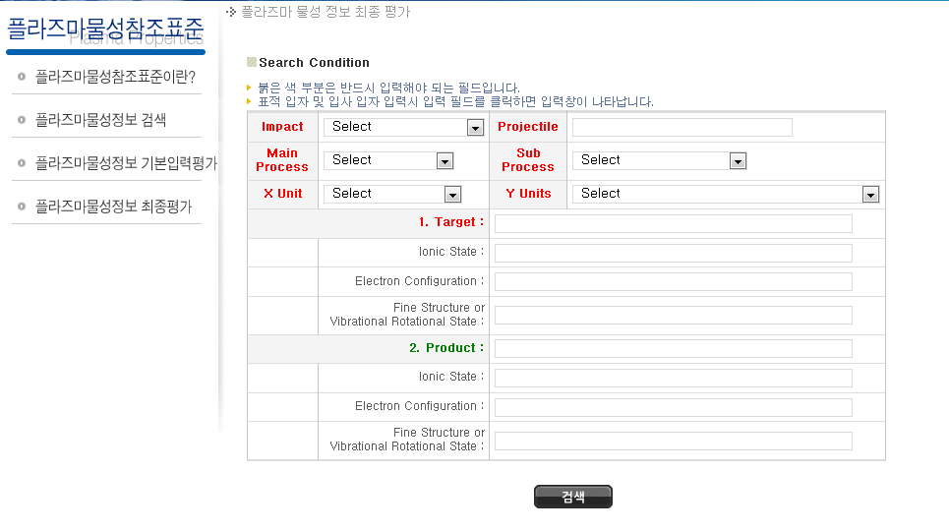
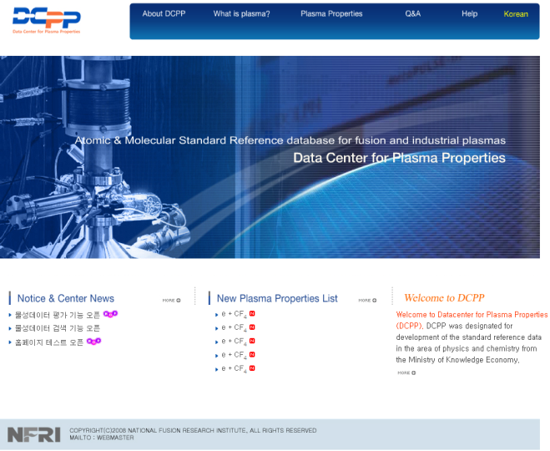
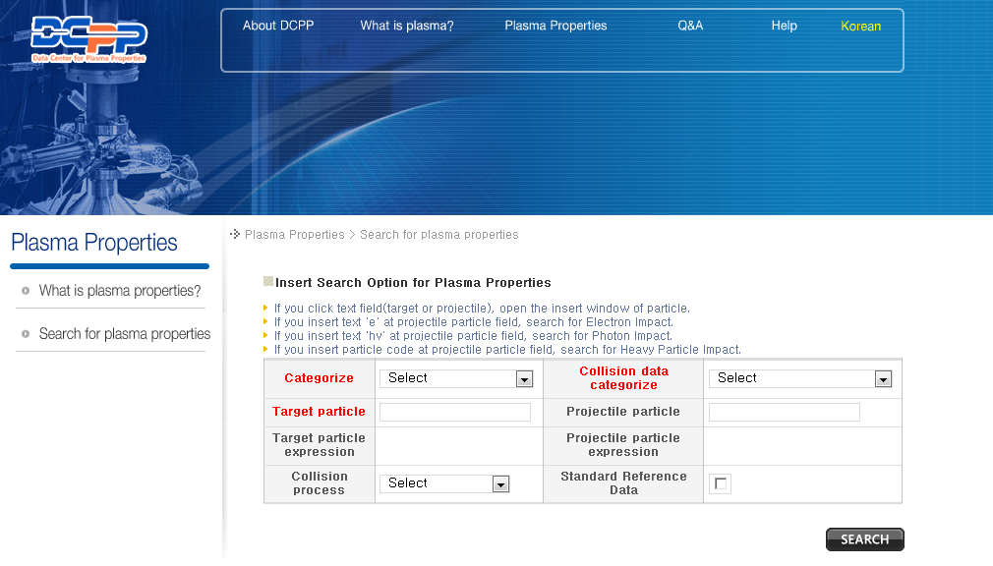

Slide 21
Future plan

Slide 22
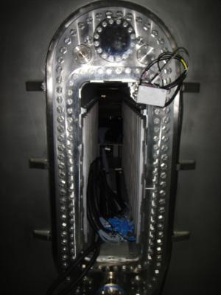
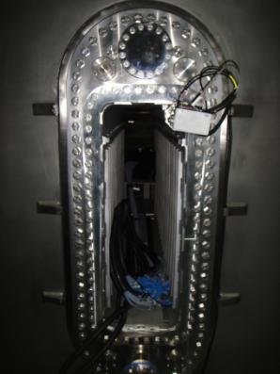
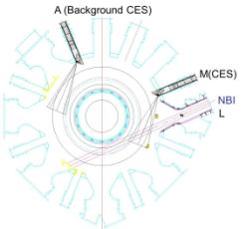
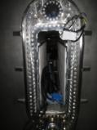
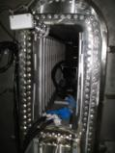
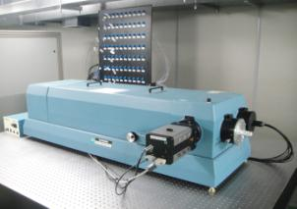
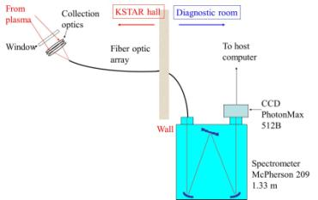
Data analysis of KSTAR CES SYSTEM- 2011
KSTAR CES System
Active CES
on M cassette
Background CES
on A cassette
Spectroscopy system for KSTAR CES
KSTAR CES system layout
To distinguish species inside measured spectrum .
KSTAR CES will use background methods to measuring the ion temperature and toroidal rotation velocity profiles
The wavelength (CVI 5292Å(n=8-7)) and intensity calibration for each radial position were finished.
KSTAR CES data acquisition system

Slide 23
MIST code for impurity transport study in ITER plasmas
Data Analysis for Plasma (POSTECH)
An impurity transport code, multiple ionization state transport (MIST) developed in PPPL, calculates the time evolution of impurity densities in each ionization state and their line emissions.
The line emission calculations provide the design parameters for development of the ITER VUV spectrometers, and will be used to study impurity transport in ITER plasmas.
Excitation rate coefficient for line emission calculation
energy level and transition probability:
Li II (Li1+), Ar XV (Ar14+), CrXXII (Cr 21+), Fe XXIV (Fe23+), Ni XVII (Ni16+), and Ni XXVI (Ni25+)
2. excitation rate coefficient (cm3/s):
He II (1-7)
Be IV (3-13, 2-8, 3-9)
C IV (1-11, 2-12, 2-8)
C V (4-15, 5-16, 4-9, 5-10)
N IV (2-39, 2-29, 2-11, 4-25, 4-24)
O V (1-9, 2-11, 4-24, 4-22, 3-12, 4-13, 3-8)
Cu XVII (2-6, 3-7, 3-6, 4-8, 4-7, 5-9)
He II (1-4), Li II (1-2), C IV (1-4), Ar XV (1-2), Cr XXII (1-2), Fe XXIV (1-2), Ni XVII (1-2),
Ni XXVI (1-2)
>

Slide 24


