Slide 1



Progress in the description of Motional Stark Effect in fusion plasmas
O. Marchuk¹, Yu. Ralchenko², D.R. Schultz³, E. Delabie⁴, A.M. Urnov⁵,
W. Biel¹, R.K. Janev¹ and T. Schlummer¹
¹- Institute for Climate and Energy Research, Forschungszentrum Jülich GmbH, 52425, Jülich, Germany
²- Atomic Physics Division, NIST, Gaithersburg, MD 20886, USA
³- Physics Division, Oak Ridge National Laboratory, Oak Ridge, Tennessee 37831-6373
⁴- F.O.M. Institute for Plasma Physics "Rijnhuizen", P.O.Box 1207, 3430 BE Nieuwegein, Netherlands
⁵- P. N. Lebedev Institute of RAS, Leninskii pr 53, Moscow, 119991, Russia

Slide 2
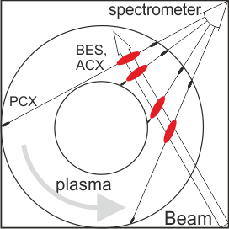
Principles of active plasma spectroscopy
H₀ + {e,H⁺,X_{z}} → H∗ + {e,H⁺,X_{z}} → ћω (1)
H₀ + X_{z+1} → H⁺ + X*_{z}(nl) → ћω (2)
H⁺ + H₀ → H∗ + H⁺ → ћω (3)
beam-emission spectroscopy (BES)
source of charge-exchange diagnostic
source of fast ion diagnostic and main ion ratio measurements (ACX- active charge-exchange, PCX- passive charge-exchange)
Plasma parameters:
Density = 10¹³… 10¹⁴ cm⁻³
Beam energy = 20 .. 200 keV/u
Temperature = 1..15 keV
Magnetic field = 1.. 5 T

Slide 3
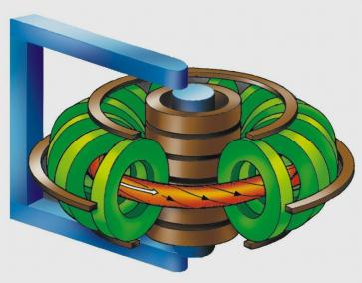

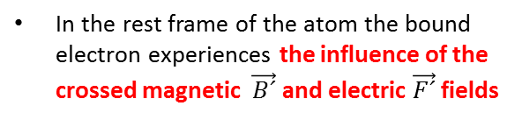

Fields „observed“ by the atom
B
y
y´
Lorentz transformation for the field:
$$\vec{F´}=\vec{F}+\frac{1}{c}\vec{v}×\vec{B}$$
$$\vec{B´}=\vec{B}−\frac{1}{c}\vec{v}×\vec{F}$$
x
x´
z
z´
v
(cgs)
Beam atom
In the rest frame of the atom the bound electron experiences the influence of the crossed magnetic $\vec{B´}$ and electric $\vec{F´}$ fields
(xyz) is the laboratory coordinate
system
(x´y´z´) is the coordinate system in the rest frame of hydrogen atom
Example: B = 1 T, E = 100 keV/u → v = 4.4·10⁸ cm/s → F = 44 kV/cm
Strong electric and magnetic field in the rest frame of the atom is experienced by the bound electron
External fields are usually considered as perturbation applied to the field-free solution

Slide 4
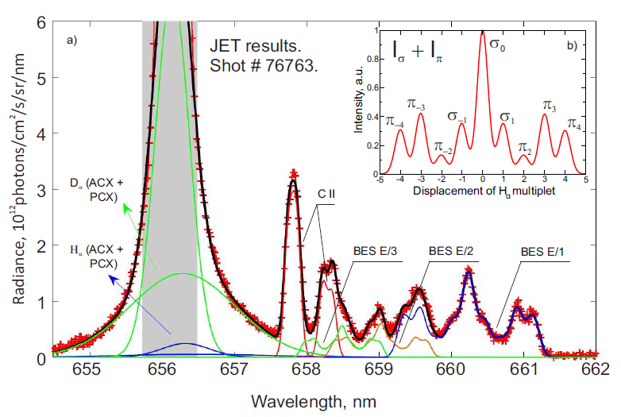
Beam emission spectra measured at JET H_{α}(n=3 → n=2)
Delabie E. et al. PPCF 52 125008 (2010)
3 components in the beam (E/1, E/2, E/3)
Passive light from the edge
Emission of thermal H⁺ and D⁺
Cold components of CII Zeeman multiplet
Overlapped components of Stark effect spectra
Intensity of MSE multiplet as a function of observation angle θ relative to the direction of electric field
$$I\left(θ\right)=I_{π}\sin^{2}(θ)+I_{σ}(1+\cos^{2}\left(θ\right))/2$$
Ratios among π-(Δm=0) and σ- (Δm=±1) lines within the multiplet are well defined and should be constant.

Slide 5
„Statistical“ description for the excited states
The first theoretical models for the excited states are solved only for the principal quantum number n
  Stark effect was ignored completely, namely it was observed in fusion a few years later, Levinton FM Phys. Rev. Lett. 63 2060 (1989)
  The population of the fine structure levels within Δn=0 is assumed to be proportional to their statistical weights, Isler RC and Olson RE Phys. Rev. A 37 3399 (1988)
The cross sections used in these CRM (Δn>0) are based on the reccomended data in spherical states from the collisional databases ALLADIN and ORNL, Summers HP 2004 The ADAS User Manual, version 2.6 http://adas.phys.strath.ac.uk
  The dominant excitation/ionization channels are collisions with ions
  For heavy particles collisions the data of TDSE, AOCC, DW, EI, … are used

Slide 6
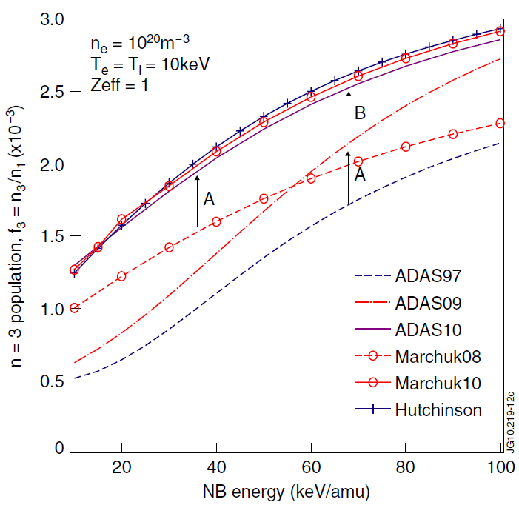
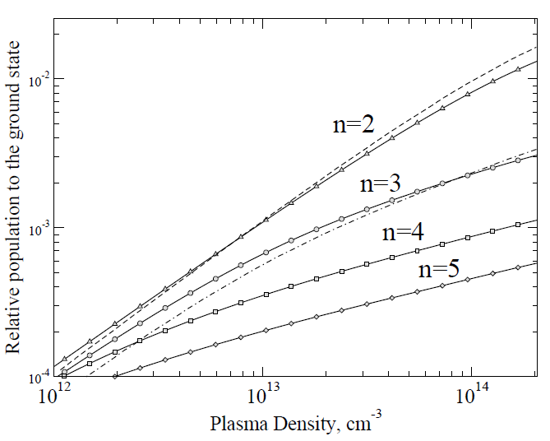
Current status of statistical models (2011)
For many years the different populations of excited states of n=2 and n=3 were reported from different models
E_{b} = 40 keV/u
T_{e}=T_{i}= 2 keV
Z_{eff}= 1
Solid lines with points – present calculations
Dashed line - Hutchinson I PPCF 44 71 (2002)
Delabie E. et al. PPCF 52 125008 (2010)
That is the first time that the population of excited states (n-states) of the beam agree within 20% for three different models in the density range of 10¹³-10¹⁴cm⁻³:
  Key component: ionization data from n=2 and n=3 states

Slide 7
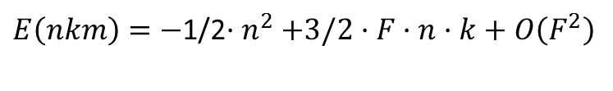
Linear Stark effect for the excited states
Hydrogen atom placed in electric field experiences Stark effect
Hamiltonian is diagonal in parabolic quantum numbers
Spherical symmetry of the atom is replaced by the axial symmetry around the direction of electric field.
The energy of the m –levels is not degenerated any
more in the presence of electric field (multiplet structure)
The unitary transformation between the spherical
wavefunctions |nlm> and parabolic wavefunctions |nkm> exists.
n k |m|
3 2 0
3 1 1
3 0 0
3-1 1
3-2 0
„Good“ quantum numbers:
n=n₁+n₂+|m|+1, n₁, n₂ >0 (nkm)
k=n₁-n₂ – electric quantum number
m – z-projection of magnetic moment
z
n=3
σ₀
π₄
2 1 0
2 0 1
2 -1 0
n=2
$E\left(nkm\right)=−$1/2${·n}^{2}+3/2·F·n·k+O\left(F^{2}\right)$
σ
π

Slide 8
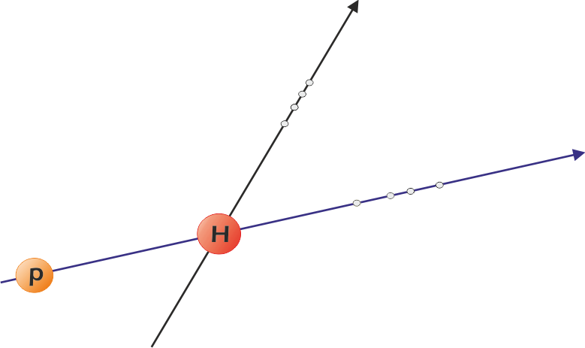

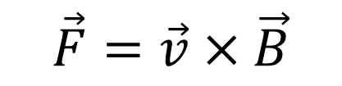

Calculation of the cross sections in parabolic states
$$\vec{F}(z)$$
$$\vec{F}=\vec{v}×\vec{B}$$
parabolic states n_{i}k_{i}m_{i}
$$\vec{v}(z′)$$
θ
n_{i}l_{i}m_{i} – spherical states
θ=π/2 for MSE
Calculations include two transformations of wavefunctions
Rotation of the collisional (z‘) frame on the angle θ to match z frame
Edmonds A R 1957 Angular Momentum in Quantum Mechanics
(Princeton, NJ: Princeton University Press)
Transformation between the spherical and parabolic states in the same frame z
Landau L D and Lifshitz E M 1976 Quantum Mechanics: Non-Relativistic Theory

Slide 9
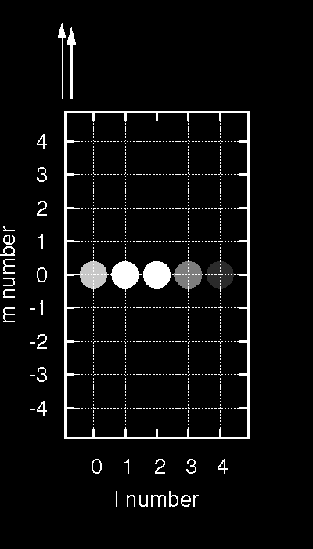
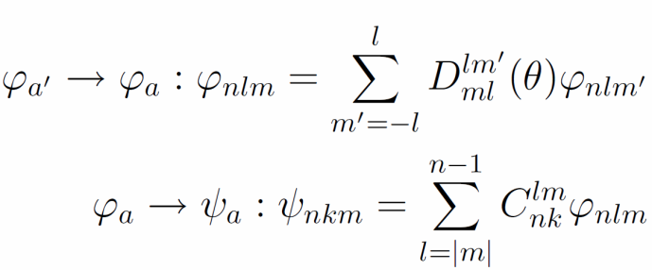
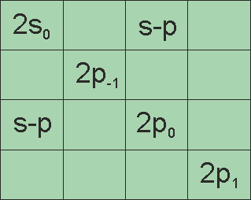
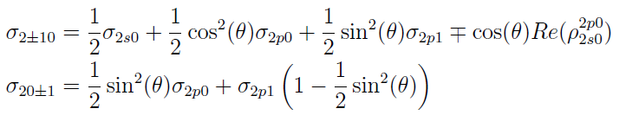

Calculation of the cross sections in parabolic states (2)
Transformation between the spherical and parabolic states
540
Final expression for the cross section can be written as:
The coefficients c_{i} and finally the cross section depend on the angle between the field and direction of the projectile
This effect was observed in the l - mixing collisions of high Rydberg states (Hickman A P 1983 Phys. Rev. A 28 111; de Prunele E 1985 Phys. Rev. A 31 3593)
For the excitation from the ground state the expressions are still simple:
$$ρ\left(n=2\right)=$$

Slide 10
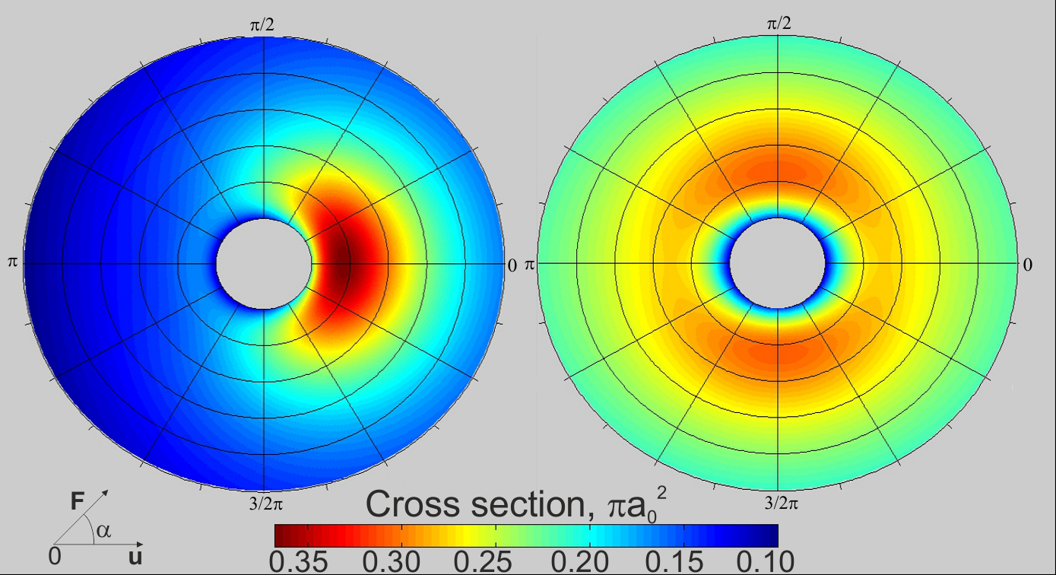
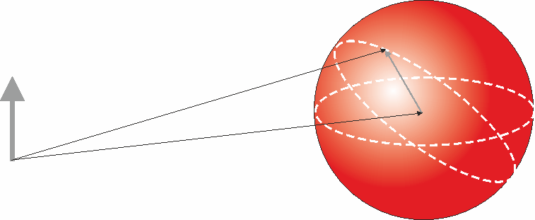




Influence of the orientation on the cross sections.
AOCC calculations.
210
201
Energy is varied in radial direction : 20…200 keV/u
Polar angle is the angle between the field direction and the projectile. (MSE – π/2)
$\vec{F}=\vec{v}×\vec{B}$ ?
Why do we need the angular dependence if
Cross section depends on the relative velocity between beam and plasma particles.
ITER Diagnostic beam:
T=20 keV, E=100 keV/u
F
relative velocity $\vec{u}$
-${\vec{v}}_{p}$
θ=π/2± π/6
The simple formulas for rate coefficients beam-Maxwellian plasma do not work any more.
π/2
Beam direction $\vec{v}$

Slide 11
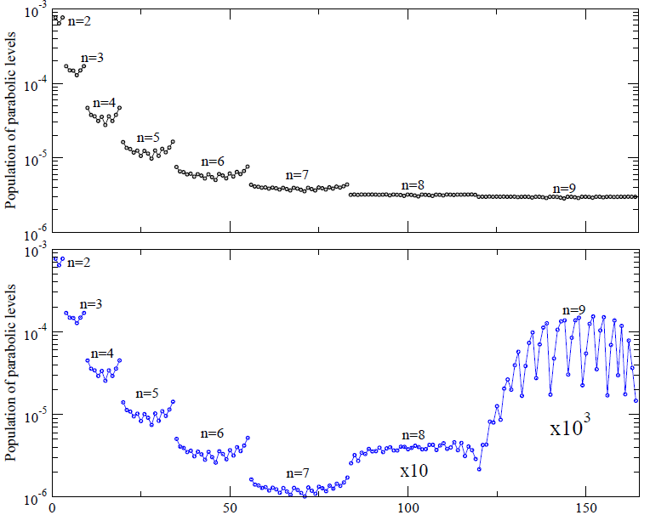
Populations of excited levels: p_{i} = N_{i}/g_{i}/N₀
statistical case means
Beam energy 50 keV/u
Plasma density 3·10¹³ cm⁻³
Magnetic field is 3 T
Ionization is excluded
Level-crossing +
Ionization by electric field
Index of excited levels

Slide 12
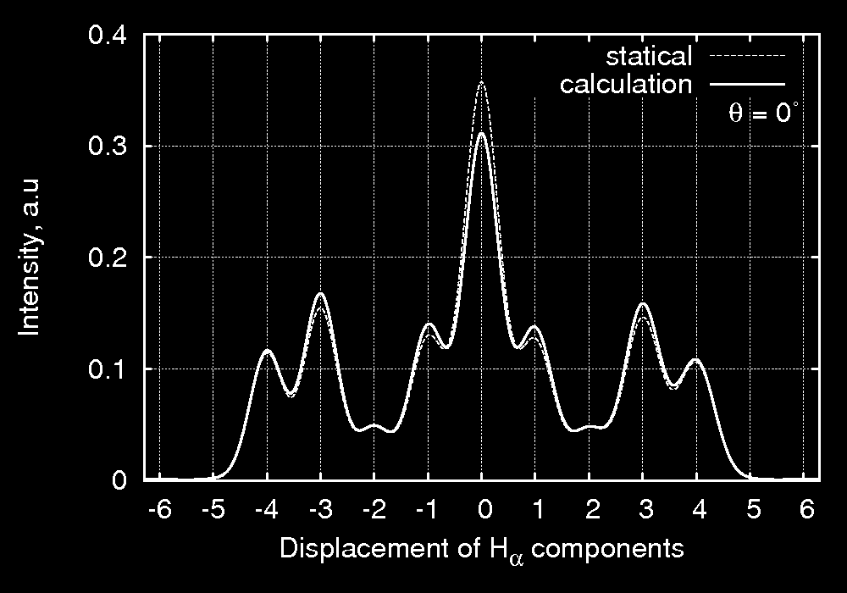
Influence of the orientation on the Stark multiplet emission
statistical
calculations
F
θ
v
The strongest deviation to the statistical case is observed for the conditions of Motional Stark effect
Increase of π and drop of σ components as a function of angle θ is observed

Slide 13
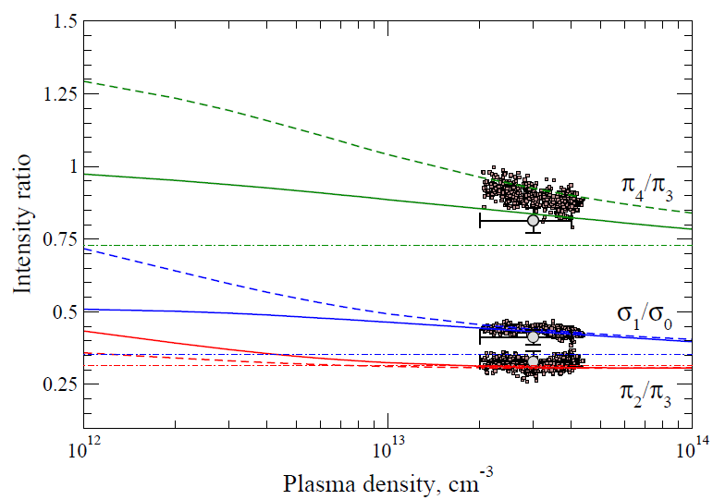
Comparison with experimental JET data
(1993) & (2010)
Points- experimental data E. Delabie et al. PPCF 52 125008 (2010)
Error bars- experimental data W. Mandl et al. PPCF 35 1373 (1993)
Dashed line GA O. Marchuk et al. JPB 43 011002 (2010)
Solid line present results , AOCC + GA
Dashed-point lines denote statistical values

Slide 14
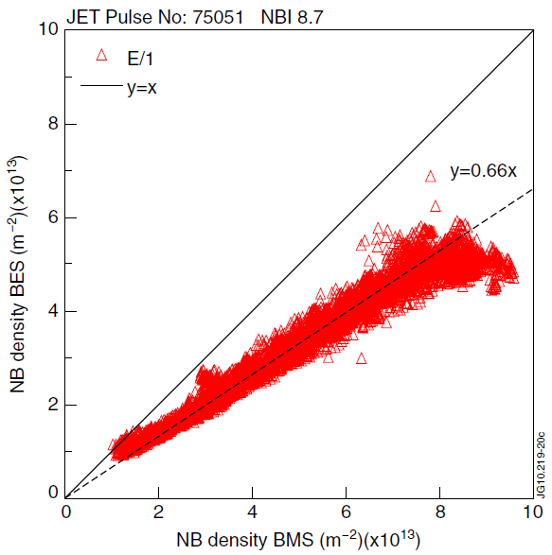
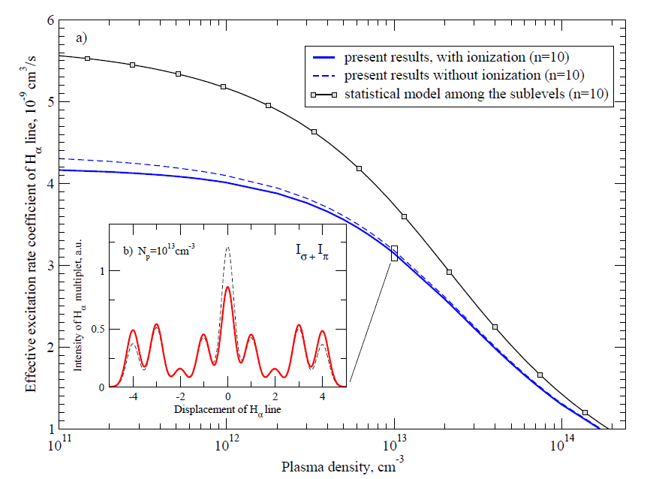
Reduction of the beam emission rate coefficients
Observation of long-standing discrepancy on the order of 20-30% between the measured (BES) and calculated density of hydrogen beam in the plasma using statistical models
Measured beam emission
Calculated beam attenuation
The non-statistical simulations demonstrate a reduction of the beam emission rate relative to the statistical model on the order of 15-30% at low and intermediate density.
E=100 keV/u
T=3 keV

Slide 15
Summary
The completely m-resolved model in parabolic state up to n=10 was developed. In contrast to the spherical states the parabolic states are the eigenstates of the hydrogen beam in the plasma. The model operates with arbitrary orientation between the field and projectile direction.
The collisional redistribution among the parabolic states was taken into account in CRM NOMAD
The systematic measurements on non-statistical populations of σ- and π – components were explained using the model in parabolic states. An excellent agreement with experimental data from JET was found.
The assumption on the statistical distribution of m-resolved states in the hydrogen beam is not valid in the plasma.

Slide 17
Non-LTE model in parabolic states
The experimental data from JET and other devices clearly demonstrate a need for an m-resolved collisional-radiative model in parabolic states for calculation of:
  Line intensities from m-resolved levels
  Populations of excited states
  Beam-emission data
  Beam attenuation in the plasma
The CRM model should include:
  Energy levels
  Radiative transition probabilities
  Cross sections among the m-resolved levels

Slide 18
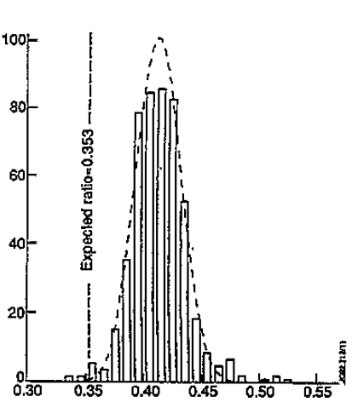

Statistical intensities of Stark effect
Are the observed intensities of MSE components proportional
to their statistical weights ?
I_{ij},a.u.
σ
π
E. Schrödinger, Ann d. Phys. 385(80), 437 (1926)
σ₁/σ₀=0.353
The experiments at JET give the answer „NO“
σ₁/σ₀
λ(H_{α})
Displacement of H_{α} line
$$The statistical model is relevant ?$$
W. Mandl et al. PPCF 35 1373 (1993)

Slide 19
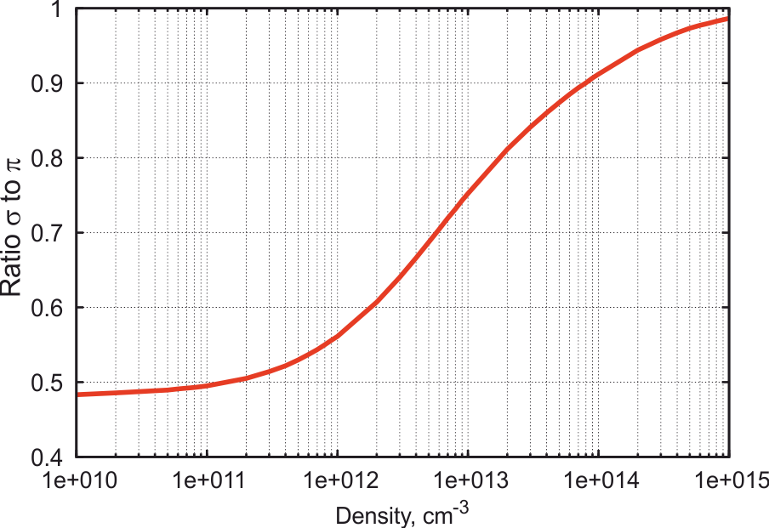
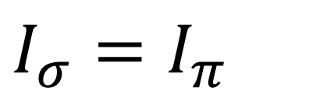
Ratio between the σ to π components
In statistical case the intensity of the σ and π components is the same
$I_{σ}=I_{π}$
The ratio is quite sensitive to the plasma density with the steep gradient in the density range of 10¹²-10¹⁴ cm⁻³
The values for the coronal limit are determined through the excitation cross section from the ground state

Slide 20
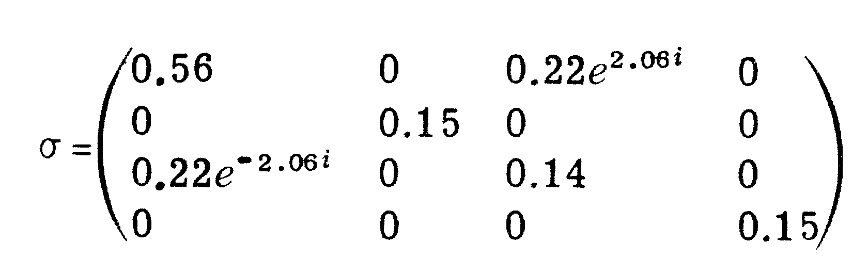
Calculation of the cross sections in parabolic states (3)
„The knowledge on the m-resolved data in spherical states is not enough“
Off-diagonal elements (coherence) were observed in quantum beats and polarization studies of H_{α} line (H⁺+He)
Density matrix for n=2 states
In order to achieve the same quality as in case of statistical models for the cross-sections in parabolic states we used the following methods:
AOCC calculations for the excitation to n=2 and n=3 states
Glauber approximation for excitation between all other states.
Born approximation was used only to control the calculations at high energies.
*
H⁺(E=210 keV/u) + Carbon foil → H(n=2)
Gaupp A. et al. Phys. Rev. Lett. 32 268 (1973)

Slide 21
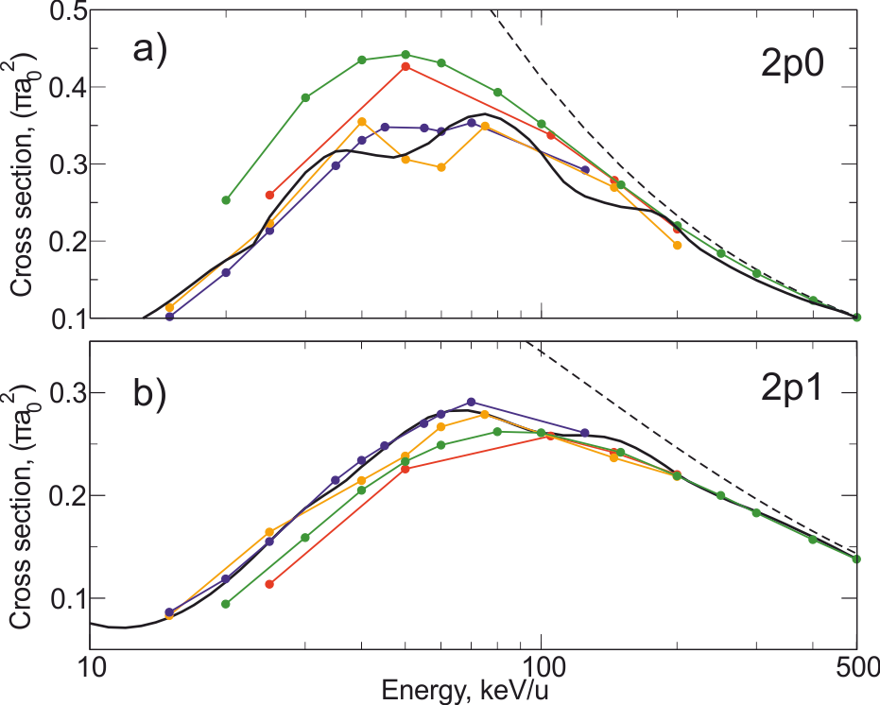
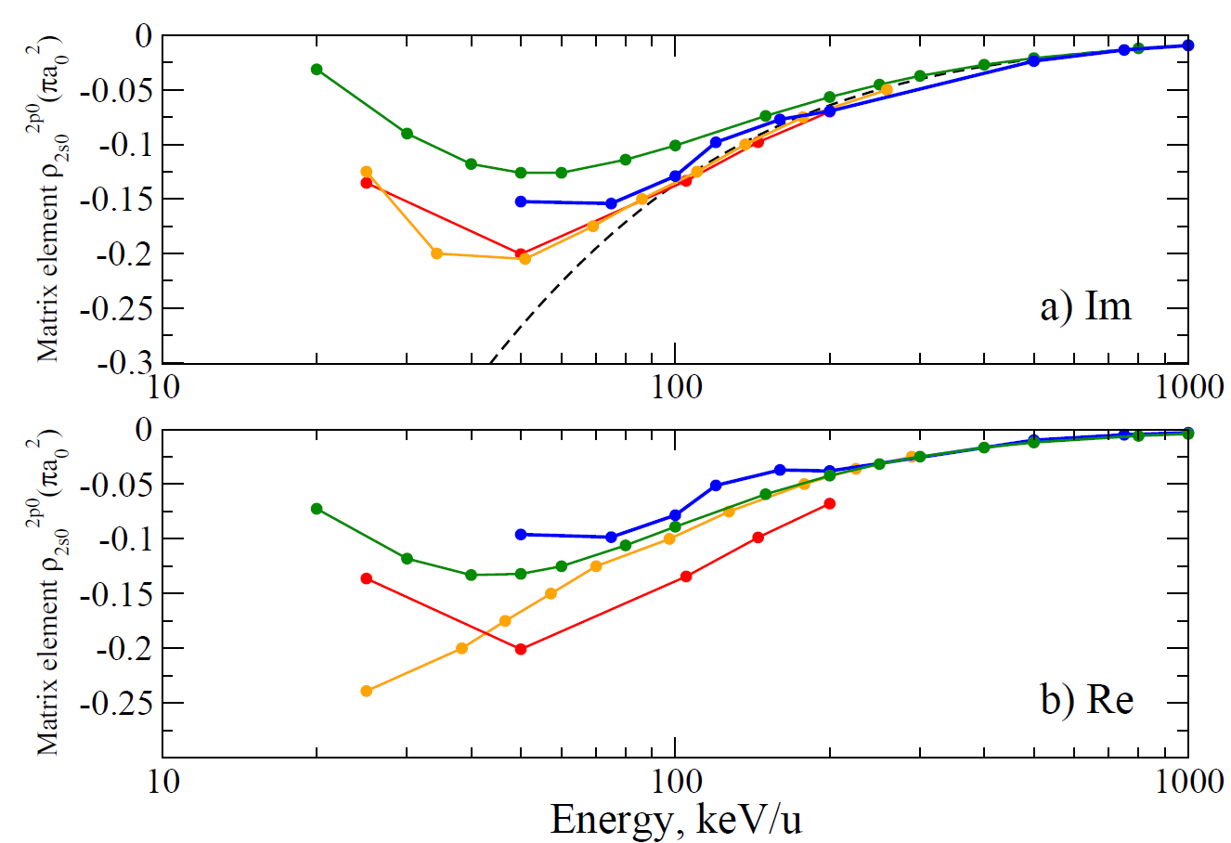
Calculation of the cross sections in parabolic states (4)
s-p
s-p
black - AOCC (present results)
blue - SAOCC Winter TG, Phys. Rev. A 2009 80 032701
green – Glauber approximation (present results)
dashed - Born approximation
orange - SAOCC Shakeshaft R Phys. Rev. A 1976 18 1930
red - EA Rodriguez VD and Miraglia JE J. Phys. B: At. Mol. Opt. Phys. 1992 25 2037
blue - AOCC (present results)
green - Glauber approximation (present results)
dashed - Born approximation
orange - CCC Schöller O et al. J. Phys B.: At. Mol. Opt. Phys. 19 2505 (1986)
red - EA Rodriguez VD and Miraglia JE J. Phys. B: At. Mol. Opt. Phys. 1992 25 2037
Up to now there were no urgent needs for s-p and s-d coherence of excitation

Slide 22
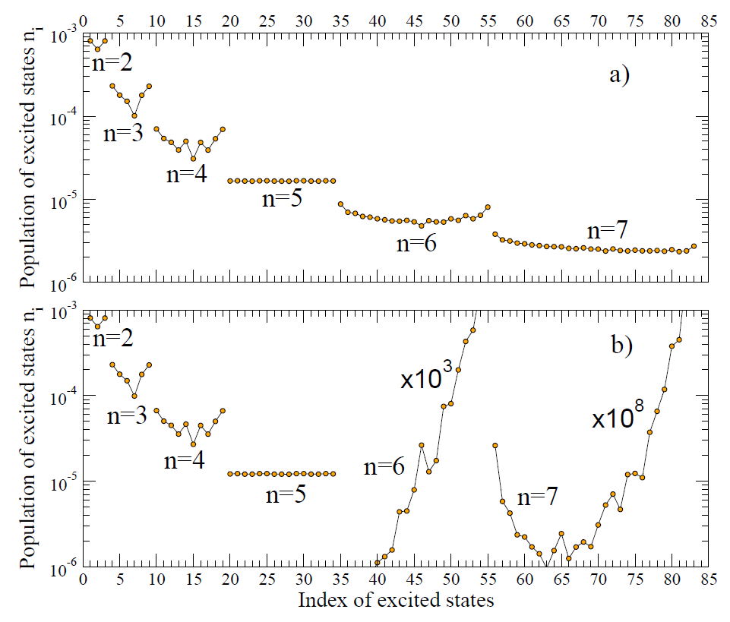
Example of the influence of ionization on the population of excited states.
ITER Heating beam
*For n=5 the statistical assumption was assumed

Slide 23
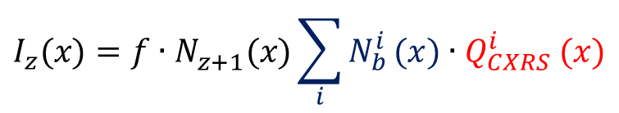
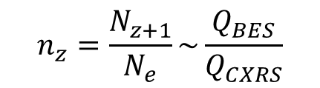
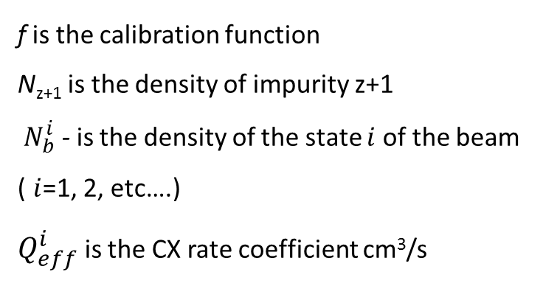
Intensity of CXRS spectral lines provides:
Plasma temperature (Doppler broadening of spectral lines)
Plasma rotation (Doppler shift)
Density of impurity ions
(poster by T. Schlummer, this conference)
In order to obtain the density of impurity ions one needs to know the density of excited states of the beam:
f is the calibration function
N_{z+1} is the density of impurity z+1
$N_{b}^{i}$ - is the density of the state $i$ of the beam ($i$=1, 2, etc….)
$Q_{eff}^{i}$ is the CX rate coefficient cm³/s
$$I_{z}(x)={f∙N}_{z+1}^{}(x)\sum_{i}{N_{b}^{i}}(x){∙Q}_{CXRS}^{i}(x)$$
$$n_{z}=\frac{N_{z+1}}{N_{e}}\sim \frac{Q_{BES}}{Q_{CXRS}}$$

Slide 24

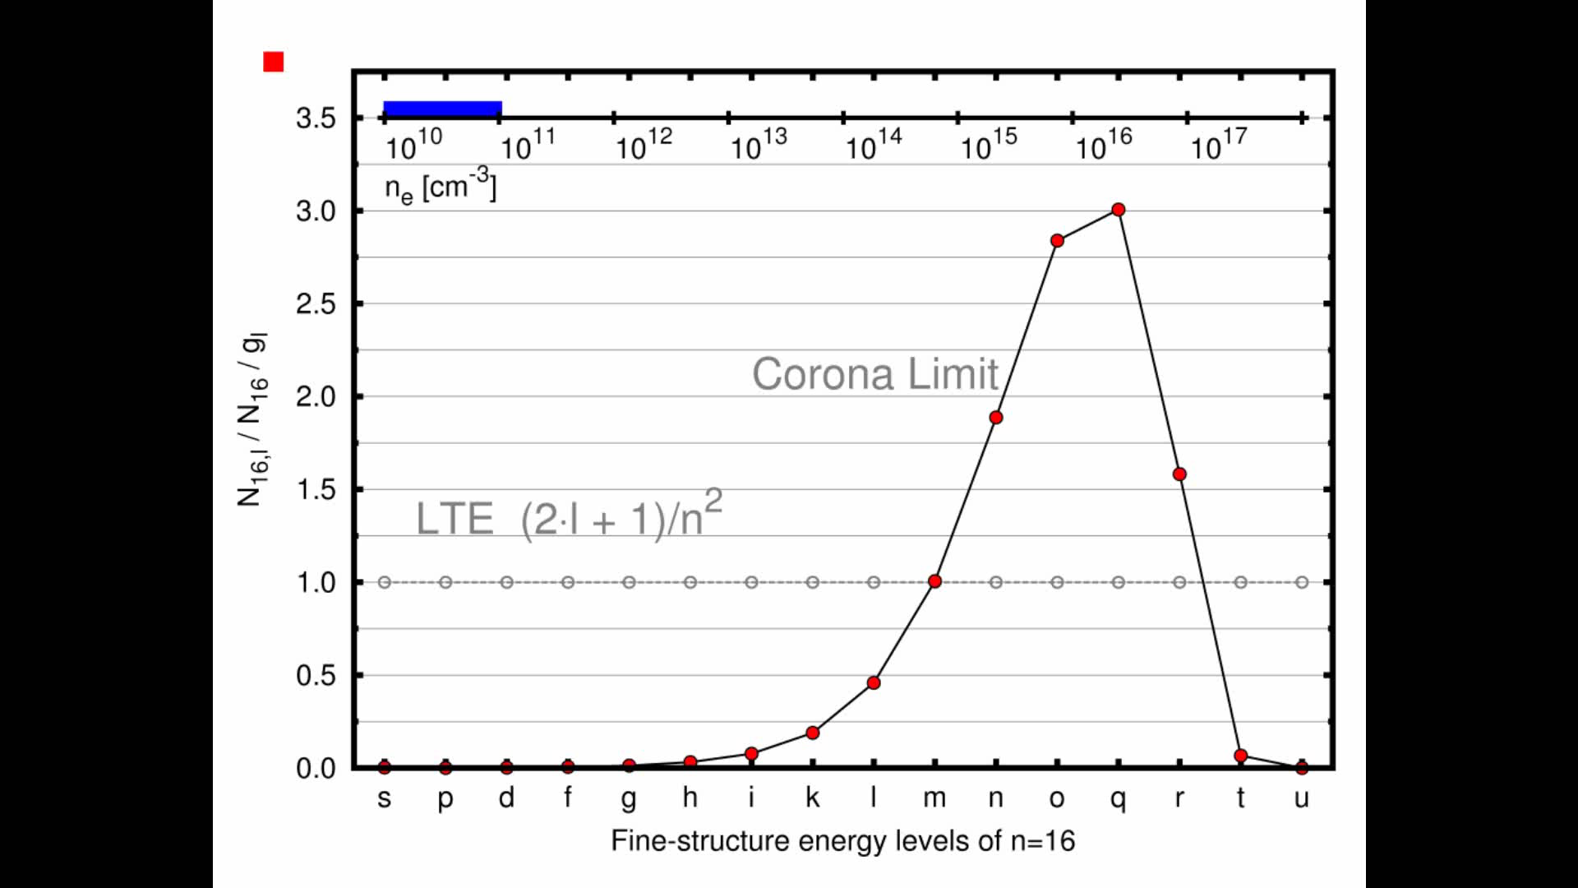
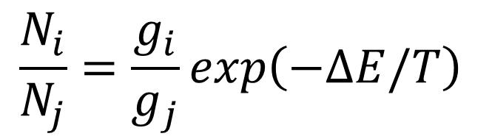
Principle of Local Thermodynamic Equlibrium (LTE)
for H-like ions (g_{l}~2l+1)
n, j₁
Collisional channel
Collisional channels within the fine structure dominate radiative decays from this level
Heavy particle collisions (H⁺, D⁺) are responsible for the redistribution within the same principal quantum number
n, j₂
Radiative channel
m, j₃
$$\frac{N_{i}}{N_{j}}=\frac{g_{i}}{g_{j}}exp\left(−ΔE/T\right)⁡$$

Slide 25
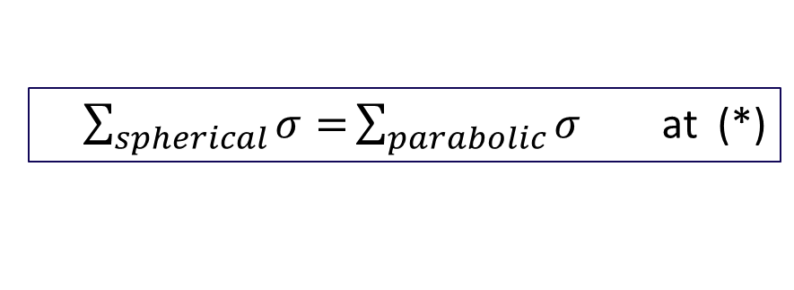
Statistical models are based on the atomic data in spherical representation
The beam eigenstates are close to the parabolic ones
ΔE _{Δn=0,F=0} << ΔE _{Δn=0,F≠0} << ΔE _{Δn>0} (*)
F=0
F≠0
ΔE_{Δn=0}
n₂l
ΔE_{Δn=0}
n₂km
ΔE _{Δn>0}
ΔE _{Δn>0}
n₁l
n₁km
$\sum_{spherical}{σ=}\sum_{parabolic}{σ}$ at (*)
The statistical results are still valid if and only if the populations of the real states in the plasma are proportional to the statistical weights

Slide 26
Contents
Principles of active plasma spectroscopy in fusion
Role of the excited states of hydrogen atoms in plasma diagnostics
The needs for the non-LTE models in the atom-plasma interaction
Collisional atomic data in different representations
Non-LTE collisional-radiative model NOMAD in parabolic states
Comparison with experimental data for Stark effect
Summary and Outlook

