Slide 1
Atomic Data for
Light Species Population Modeling
Teck-Ghee Lee, Stuart Loch, Connor Ballance,
John Ludlow, Mitch Pindzola
Auburn University
This work was supported by a grant from the US Department of Energy.
The computational work was performed on the NERSC and ORNL Supercomputers

Slide 2
Overview
In recent years we have used various theoretical methods to compute large amount of atomic collision data sets for H, He, Li, Be, B and C.
Briefly outline the theoretical methods used to generate the atomic data.
Present the current status of these light species data in ADAS.
  Excitation data
  Ionization data
  Recombination data
  Generalized Collisional-Radiative data

Slide 3
Theoretical methods
Perturbation theory
    Distorted-wave (mainly for ionization process)
Non-perturbative methods
    R-matrix close-coupling (RM, RMPS)
    Time-dependent close-coupling (TDCC)
    Convergent close coupling (CCC)
    Exterior complex scaling (ECS)
Collisional-radiative codes from ADAS
Cross sections/ rate coef.
{T_{e}}
GCR coefficients
{N_{e}, T_{e}}
Plasma transport codes

Slide 4



Generalized collisional-radiative
(GCR) coefficients
Effective ionization rates
Effective recombination rates
Total Line Power Loss
Ionization rates
CR matrix
elements
A^{(q+1)+}
υ
A^{q+}
j
i
ρ
σ
RR and DR
rates
excitation
rates
spontaneous
emission rates
j->k transition energy

Slide 5
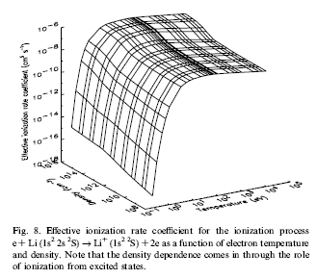
Effective ionization rate coefficient vs density and electron temperature
Li
Density dependence comes in through the role of ionization from excited states.
Loch et al., ADNDT, 92 813 (2006)

Slide 6
Elements, Processes and Methods
Elements/Proc | Excitation (n<=5) | Ionization (n<=2) | RR | DR
H | RMPS | TDCC, RMPS, CCC | DW | DW
He | RMPS | TDCC, RMPS, CCC | DW | DW
He+ | RMPS | TDCC, RMPS, CCC | DW | DW
Li isonuclear sequence | RMPS | TDCC, RMPS, CCC, ECIP | DW | DW
Be isonuclear sequence | RMPS | TDCC, RMPS, CCC, ECIP, DW | DW | DW
B isonuclear sequence | RMPS | TDCC, RMPS, CCC, ECIP, DW | DW | DW
In good shape,
agrees
with CCC & TDCC
In good shape
In good shape, compare well with expt.

Slide 7
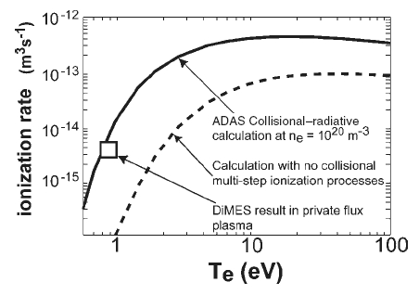
Measurements of Li ionization rates at DIII-D
Plasma transport studies on the DIII-D tokamak measured the density dependent ionization rate to be more than an order of magnitude larger than the ground Li.
For moderate densities plasma (10¹⁰ –
10¹⁵ cm⁻³), ionization from excited states (ES) may be significant.
ground + excited states
ground state
Allain et al., Nucl. Fusion, 44 655 (2004)

Slide 8
GCR data
  H & He : Loch et al., Plasma Phys. Control. Fusion, 51 105006 (2009)
  Li: Loch et al., ADNDT, 92 813 (2006)
  Be: Loch et al., ADNDT, 94 257 (2008)
  B: we have all the fundamental data, just needs GCR processing.
  C: needs C+ and C excitation and some ionization cross section data.

Slide 9
Boron isonuclear sequence data source
Dielectronic Recombination
  B⁴⁺ : Badnell et al., Astron. Astrophys. 447 389 (2006)
  B³⁺ : Bautista et al., Astron. Astrophys. 466 755 (2007)
  B²⁺ : Colgan et al., Astron. Astrophys. 417 1183 (2004)
  B⁺ : Colgan et al., Astron. Astrophys. 412 597 (2003)
Excitation
  B⁴⁺ : RMPS – Ballance et al., J. Phys. B 36 3707 (2003)
  B³⁺ : RMPS – Ballance (unpublished) – available at ADAS
  B²⁺ : RMPS – Griffin et al., J. Phys. B 33 1013 (2000)
  B⁺ : RMPS – Badnell et al., J. Phys. B 36 1337 (2003)
  B: RMPS – Ballance et al., J. Phys. B 40 1131 (2007)
Ionization
    B⁴⁺ : RMPS+DW – Griffin et al., J. Phys. B 38 L199 (2005)
  B³⁺ : CCC + Expt – Renwick et al., J. Phys. B 42 175203 (2009)
  B²⁺ : RMPS – Badnell & Griffin., J. Phys. B 33 2955 (2000)
  B⁺ : TDCC, RMPS, DW + Expt – Berrengut et al., Phys. Rev. A 78 012704 (2008)
  B: TDCC, RMPS, DW + BEB – Berrengut et al., Phys. Rev. A 76 042704 (2007)
  ES ionization for B, B⁺ and B²⁺ – Lee et al., Phys. Rev. A 82 042721 (2010)
GCR data production

Slide 10
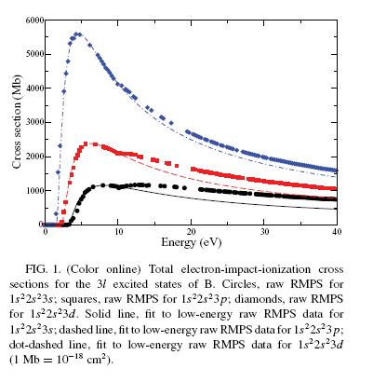
Excited states ionization of neutral Boron
Configurations in CC: 1s²2s²2p, 1s²2s²nl, 1s²2s2p², 1s²2s2pnl, 1s²2p³ and 1s²2p²nl
Excitation-autoionization from 1s²2s2p²,1s²2s2p3l, 1s²2s2p4l and 1s²2s2p5l.
Excitation-autoionization contributions become less pronounced as n increases.
Same analysis was done for B⁺ and B²⁺.
3d
3p
3s

Slide 11
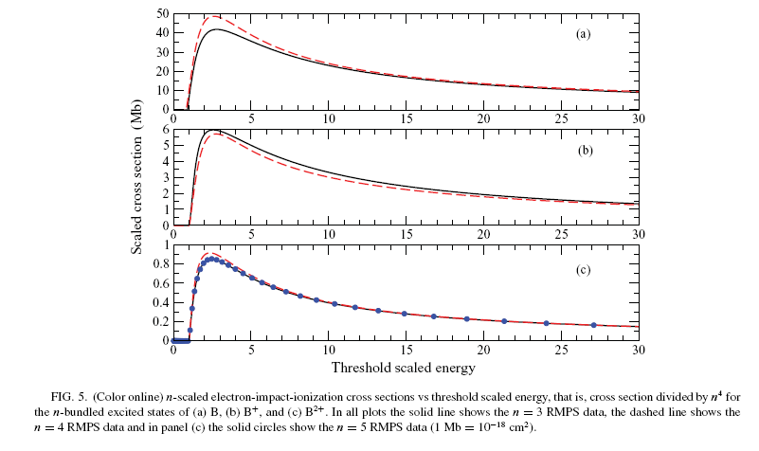
Bundled-n of ionization data for B, B⁺ and B²⁺
1/n⁴ scaled cross section (Mb)
n=4
B
n=3
Semi-empirical method (ECIP)
can be fitted to the RMPS results
and used to scale to even higher n shells, i.e., n = 6 and 7.
But the situation is more complex when there is a significant EA in the excited-state ionization cross sections.
B⁺
B²⁺
n=5
Lee et al., Phys. Rev. A 82 042721 (2010)

Slide 12
Carbon isonuclear sequence data source
Dielectronic Recombination
  C⁵⁺ : Badnell et al., Astron. Astrophys. 447 389 (2006)
  C⁴⁺ : Bautista et al., Astron. Astrophys. 466 755 (2007)
  C³⁺ : Colgan et al., Astron. Astrophys. 417 1183 (2004)
  C²⁺ : Colgan et al., Astron. Astrophys. 412 597 (2003)
  C⁺ : Altun et al., Astron. Astrophys. 420 775 (2004)
Excitation
  C⁵⁺ : RMPS – Ballance et al., J. Phys. B 36 3707 (2003)
  C⁴⁺ : RMPS – Loch & Ballance, (unpublished) – available at ADAS
  C³⁺ : RMPS, TDCC + DW – Griffin et al., J. Phys. B 33, 1013 (2000)
  C²⁺ : RMPS – Mitnik et al., J. Phys. B 36 717 (2003)
  C⁺ : Work in progress.
  C: Work in progress.
Ionization
  C³⁺ :RMPS – Badnell & Griffin., J. Phys. B 33 2955 (2000)
  C²⁺ : TDCC, CCC, RMPS, DW + Expt – Loch et al., Phys. Rev. A 71 012716 (2005)
  C⁺ : TDCC, RMPS, DW + Expt – Ludlow et al., Phys. Rev. A 78 1 (2008)
  C: TDCC, DW + Expt – Pindzola et al., Phys. Rev. A 62 042705 (2000).
  Ionization from excited states of C³⁺ – Pindzola et al., Phys. Rev. A 83 062705 (2011)
  Ionization from excited states of C²⁺, C⁺ and C: Work in progress.
GCR data production.

Slide 13
Present status of GCR data
  H & He : Loch et al., Plasma Phys. Control. Fusion, 51 105006 (2009)
  Li: Loch et al., ADNDT, 92 813 (2006)
  Be: Loch et al., ADNDT, 94 257 (2008)
  B: has all the fundamental data, just needs GCR processing.
  C: needs C+ and C excitation and some ionization cross section data.
  Then onto N, O, F and Ne.

