Slide 1

Charge-Exchange Spectroscopy at the University of Wisconsin-Madison
Mark Nornberg
Santhosh Kumar, Daniel Den Hartog
Alexis Briesemeister
2012 ADAS Workshop • CEA Cadarache, France • 24 Sept. 2012

Slide 2
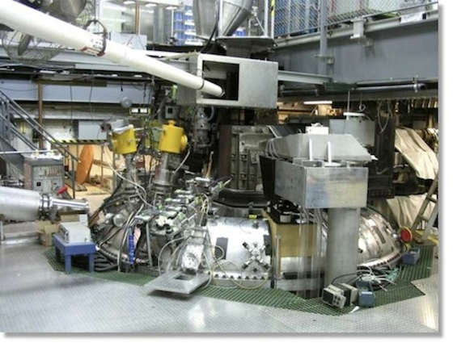
Overview of CX measurements on 2 devices at Madison
Helically Symmetric Experiment (HSX)
Stellarator
Effect of quasi-symmetry on
neoclassical transport
Madison Symmetric Torus (MST)
Reversed Field Pinch
RFP as potential reactor design
General toroidal confinement physics
Astrophysical processes

Slide 3
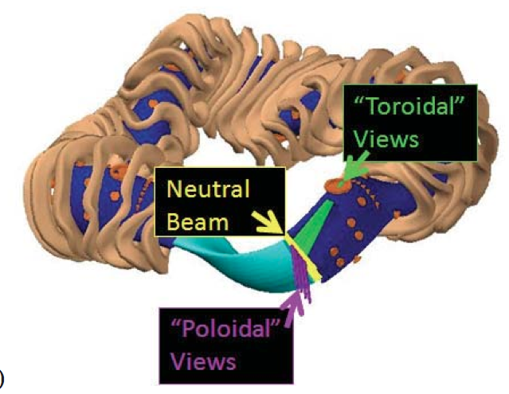
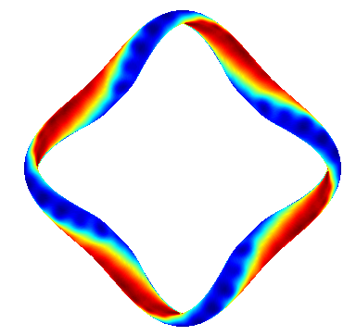
HSX is a Stellarator Optimized For Quasi-Helical Symmetry
<R> | 1.2 m
<a> | 0.12 m
ι | 1.05 →1.12
B₀ | 1.0 T
ECRH 28 GHz | 100 kWx2
n_{e} ≤ 6 × 10¹² cm⁻³
T_{e} ~ 0.5 - 2.5 keV >> T_{i} ~ 30-60 eV
30keV H beam stimulates C⁺⁵ emission
Notes:
HSX is an optimized quasi-helically symmetric stellarator. Its magnetic field strength is constant along a helical direction. This is shown in this picture of a flux surface. Different colors represent different values of magnetic field strength. You can see that bands of constant magnetic field strength wrap helically around the machine.
Quasi-symmetry has been shown to reduce neoclassical transport. HSX has also been shown to have reduced flow damping along its helical direction of symmetry.
Only electron cyclotron resonance heating is available on HSX, so the ions are typically much colder than the electrons.

Slide 4
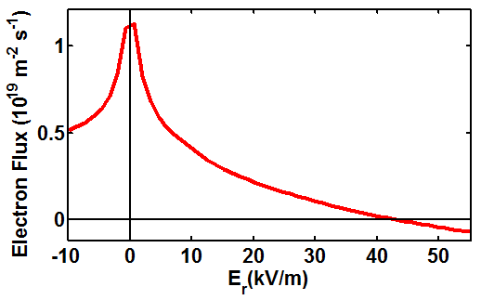
Goal is to measure radial electric field and its impact on transport
Neoclassical transport suppressed by sheared E×B flow
Measuring flows and ion pressure gradient allows E_{r} to be determined from force balance:
These measurements test models used to predict E_{r} and plasma flows

Slide 5
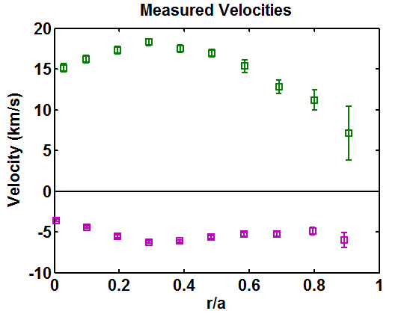
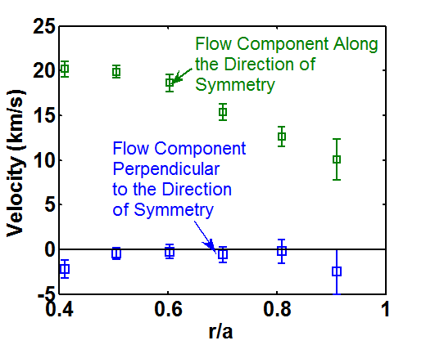
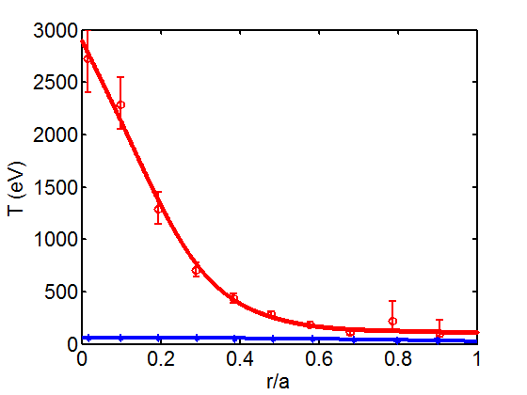
ADAS modeling is essential to interpret C⁺⁶ emission in HSX
Velocity Along and Across the Symmetry Direction
Electron and Ion Temperatures
Velocity Measured By Each View
“Toroidal” Views
T_{e}
T₊₆~50eV
“Poloidal” Views
Ion flow determined from Doppler shift of 529nm n=8-7 transition (2 views for magnitude and direction)
Large intrinsic flow along helical direction of symmetry due to reduced parallel viscosity

Slide 6
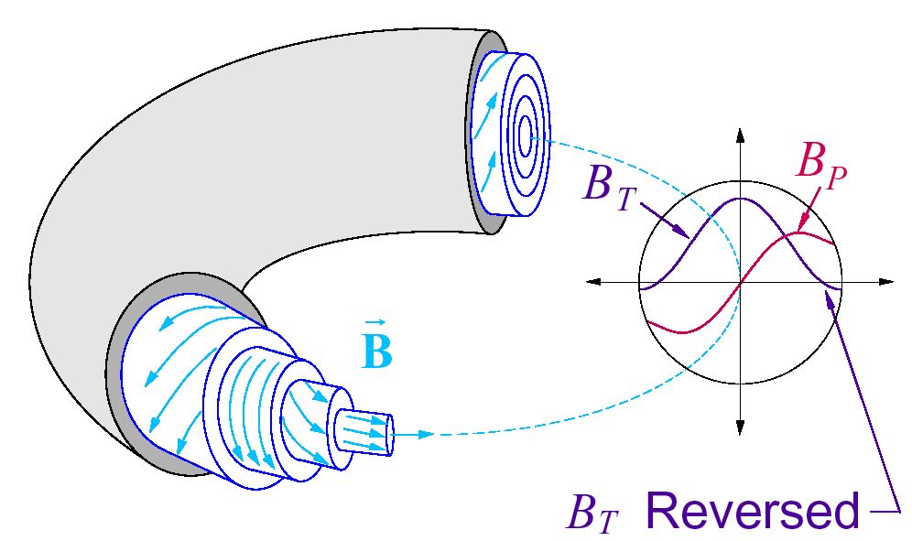
The Madison Symmetric Torus Experiment provides a platform for addressing ion confinement, heating, and acceleration
Reversed Field Pinch
R = 1.5 m a = 0.52 m
Pulse length: 60-120 msec
(20 msec flattop)
I_{p} = 200 – 650 kA
n_{e} = 0.5 – 1.5 × 10¹⁹ m⁻³ (puffing)
6 × 10¹⁹ m⁻³ (with pellet injection)
Ohmically heated
Access to a range of plasmas
  T_{e} ~ Ip in standard RFPs
  T_{e} up to 2 keV in enhanced confinement
  T_{i} up to 1 keV

Slide 7
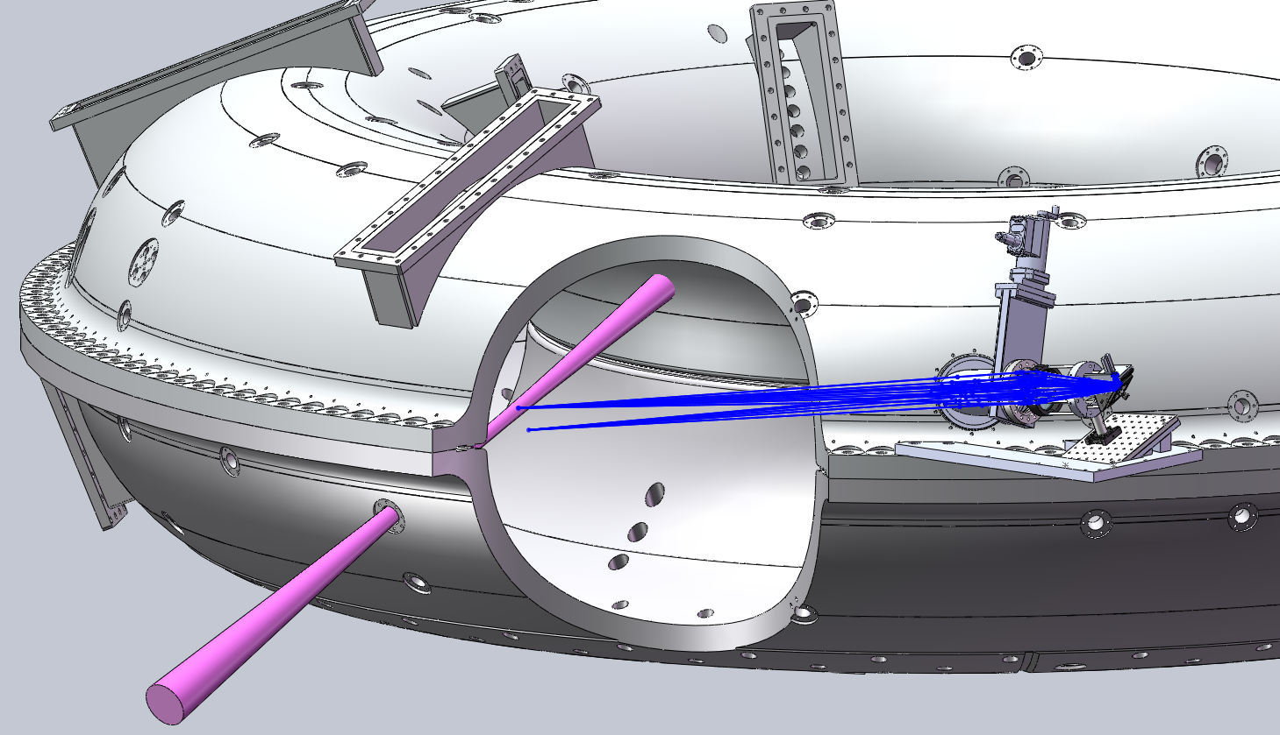
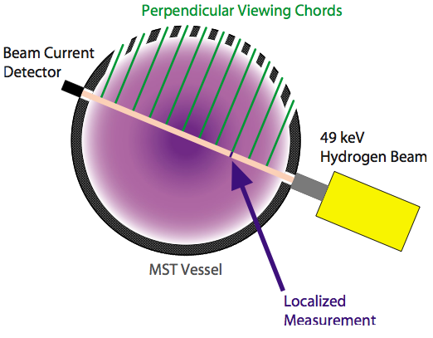
Charge-exchange recombination spectroscopy (CHERS) measures local carbon impurity T_{perp}, T_{par}, and n_{C}.

Slide 8
Ion heating from magnetic reconnection

Slide 9
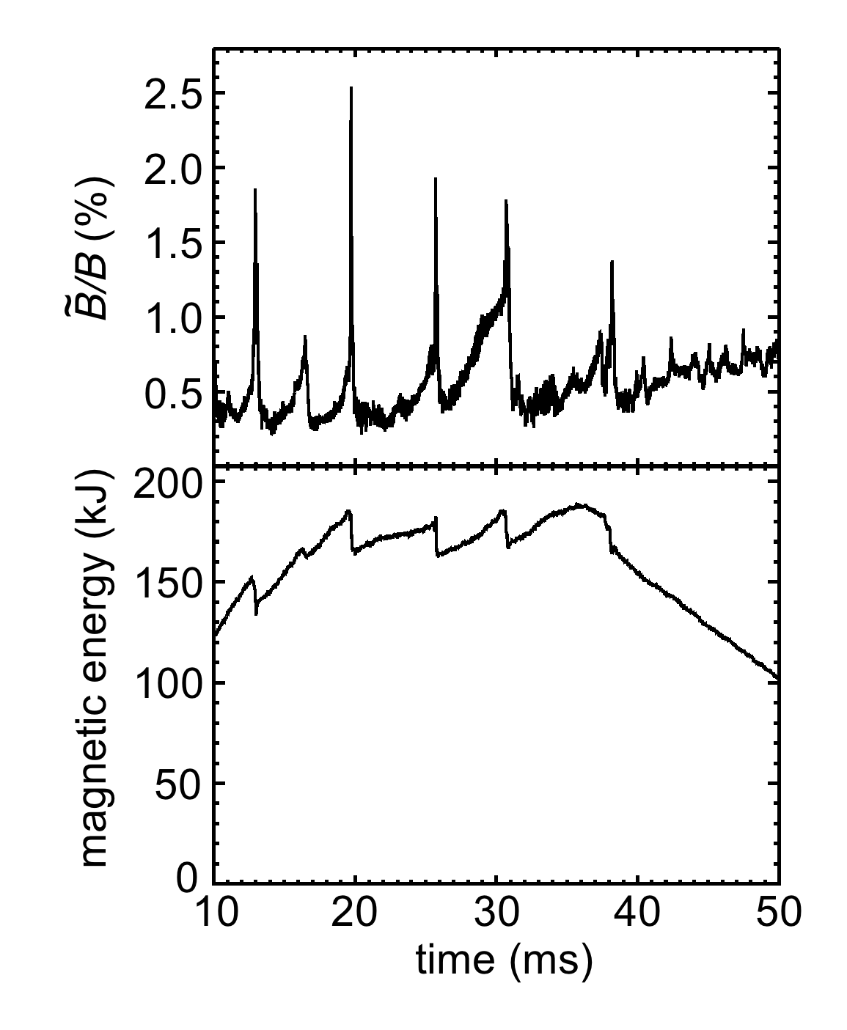
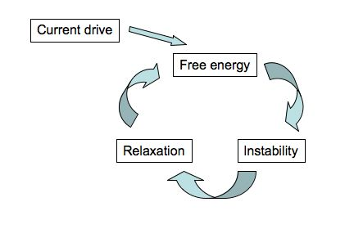
Standard RFPs in MST are punctuated by impulsive quasi-periodic bursts of reconnection events (sawteeth)
Plasma parameters change dramatically during fast reconnection events (“sawtooth crashes”)
  fluctuations increase, stored magnetic energy drops, ions are heated, ….

Slide 10
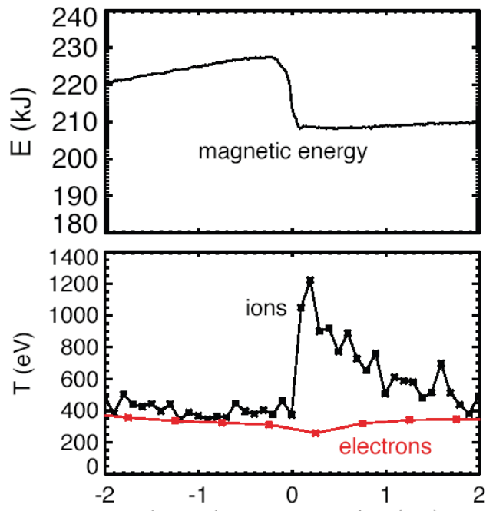
Dramatic ion heating occurs during the reconnection event
Magnetic energy in the equilibrium magnetic field drops suddenly
Large fraction of released
energy transferred to ions
Δt ~100 µs
Time (ms)
(relative to reconnection event)

Slide 11
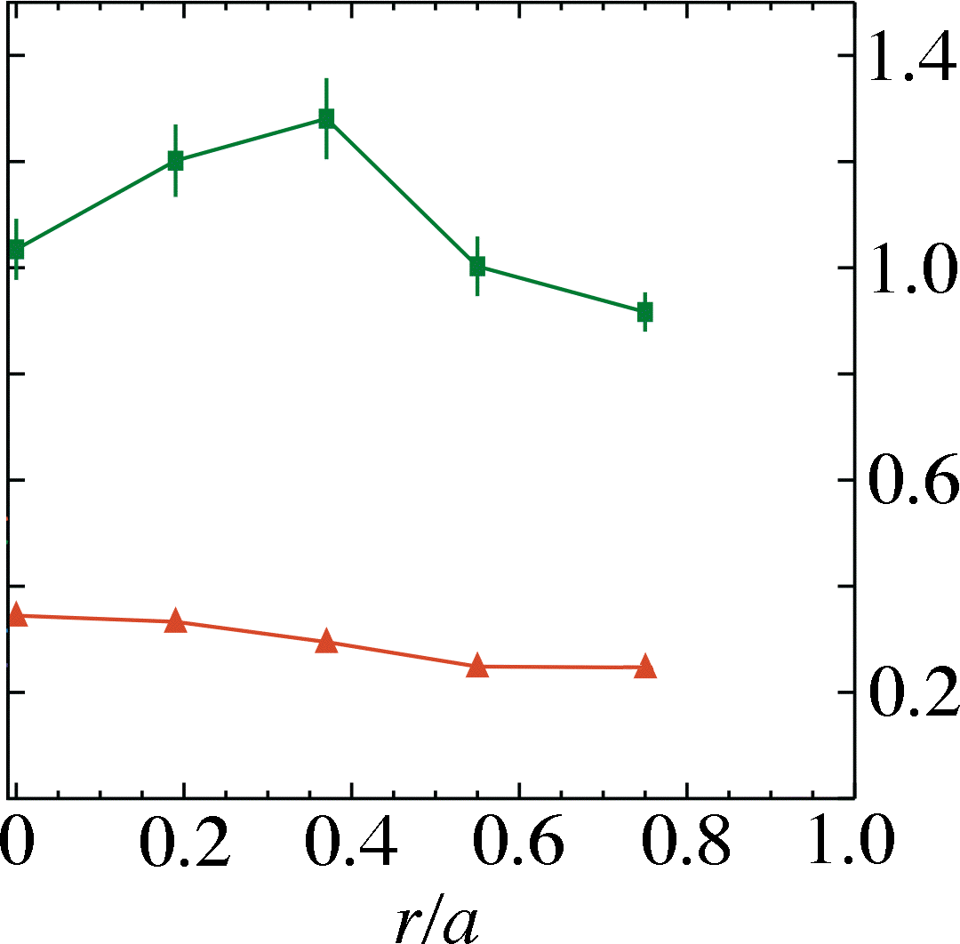
Ion heating is distributed throughout the plasma
T_{i} versus radius
after (+0.15 ms)
T_{i} (keV)
before (-0.3 ms)
T_{i} normally drops following a reconnection event

Slide 12
Much is known about thermal ion heating in MST.
Equilibrium magnetic field is the ultimate energy source.
The heating rate is very large (3-10 MeV/s).
The majority ion heating efficiency ~ m^{1/2}.
Fully-developed magnetic turbulence is required (i.e. m=0 is a necessary condition).
Impurities tend to be hotter than the majority ions.
The heating is anisotropic with T_{perp} > T_{par}
However, a comprehensive theoretical understanding of the thermal heating mechanism remains elusive.

Slide 13
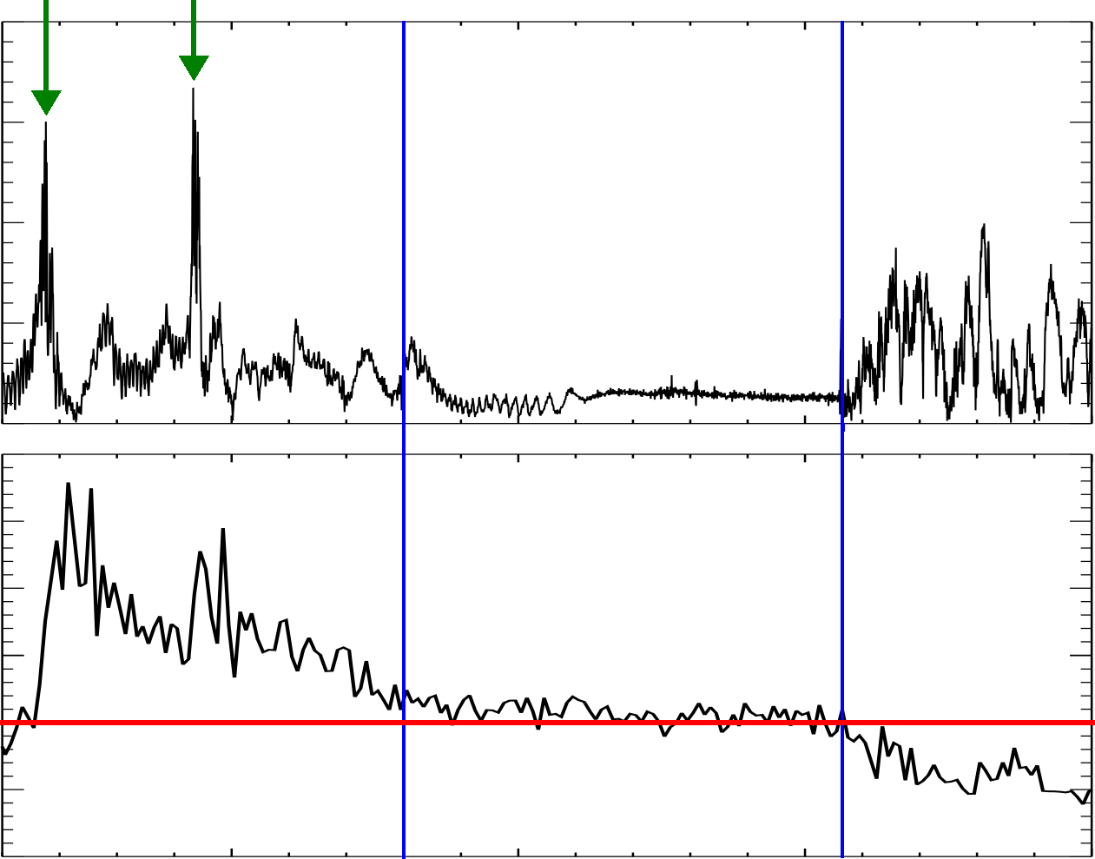
Reconnection-heating is exploited to achieve Ti ~ 1 keV in enhanced confinement discharges
Ion energy is retained by initiating improved confinement following a sawtooth event
reconnection
events
20
15
←
improved
confinement
→
~
B (gauss)
10
5
0
3.0
2.0
T_{i} (keV)
1.0
0
10
15
20
25
time (ms)

Slide 14
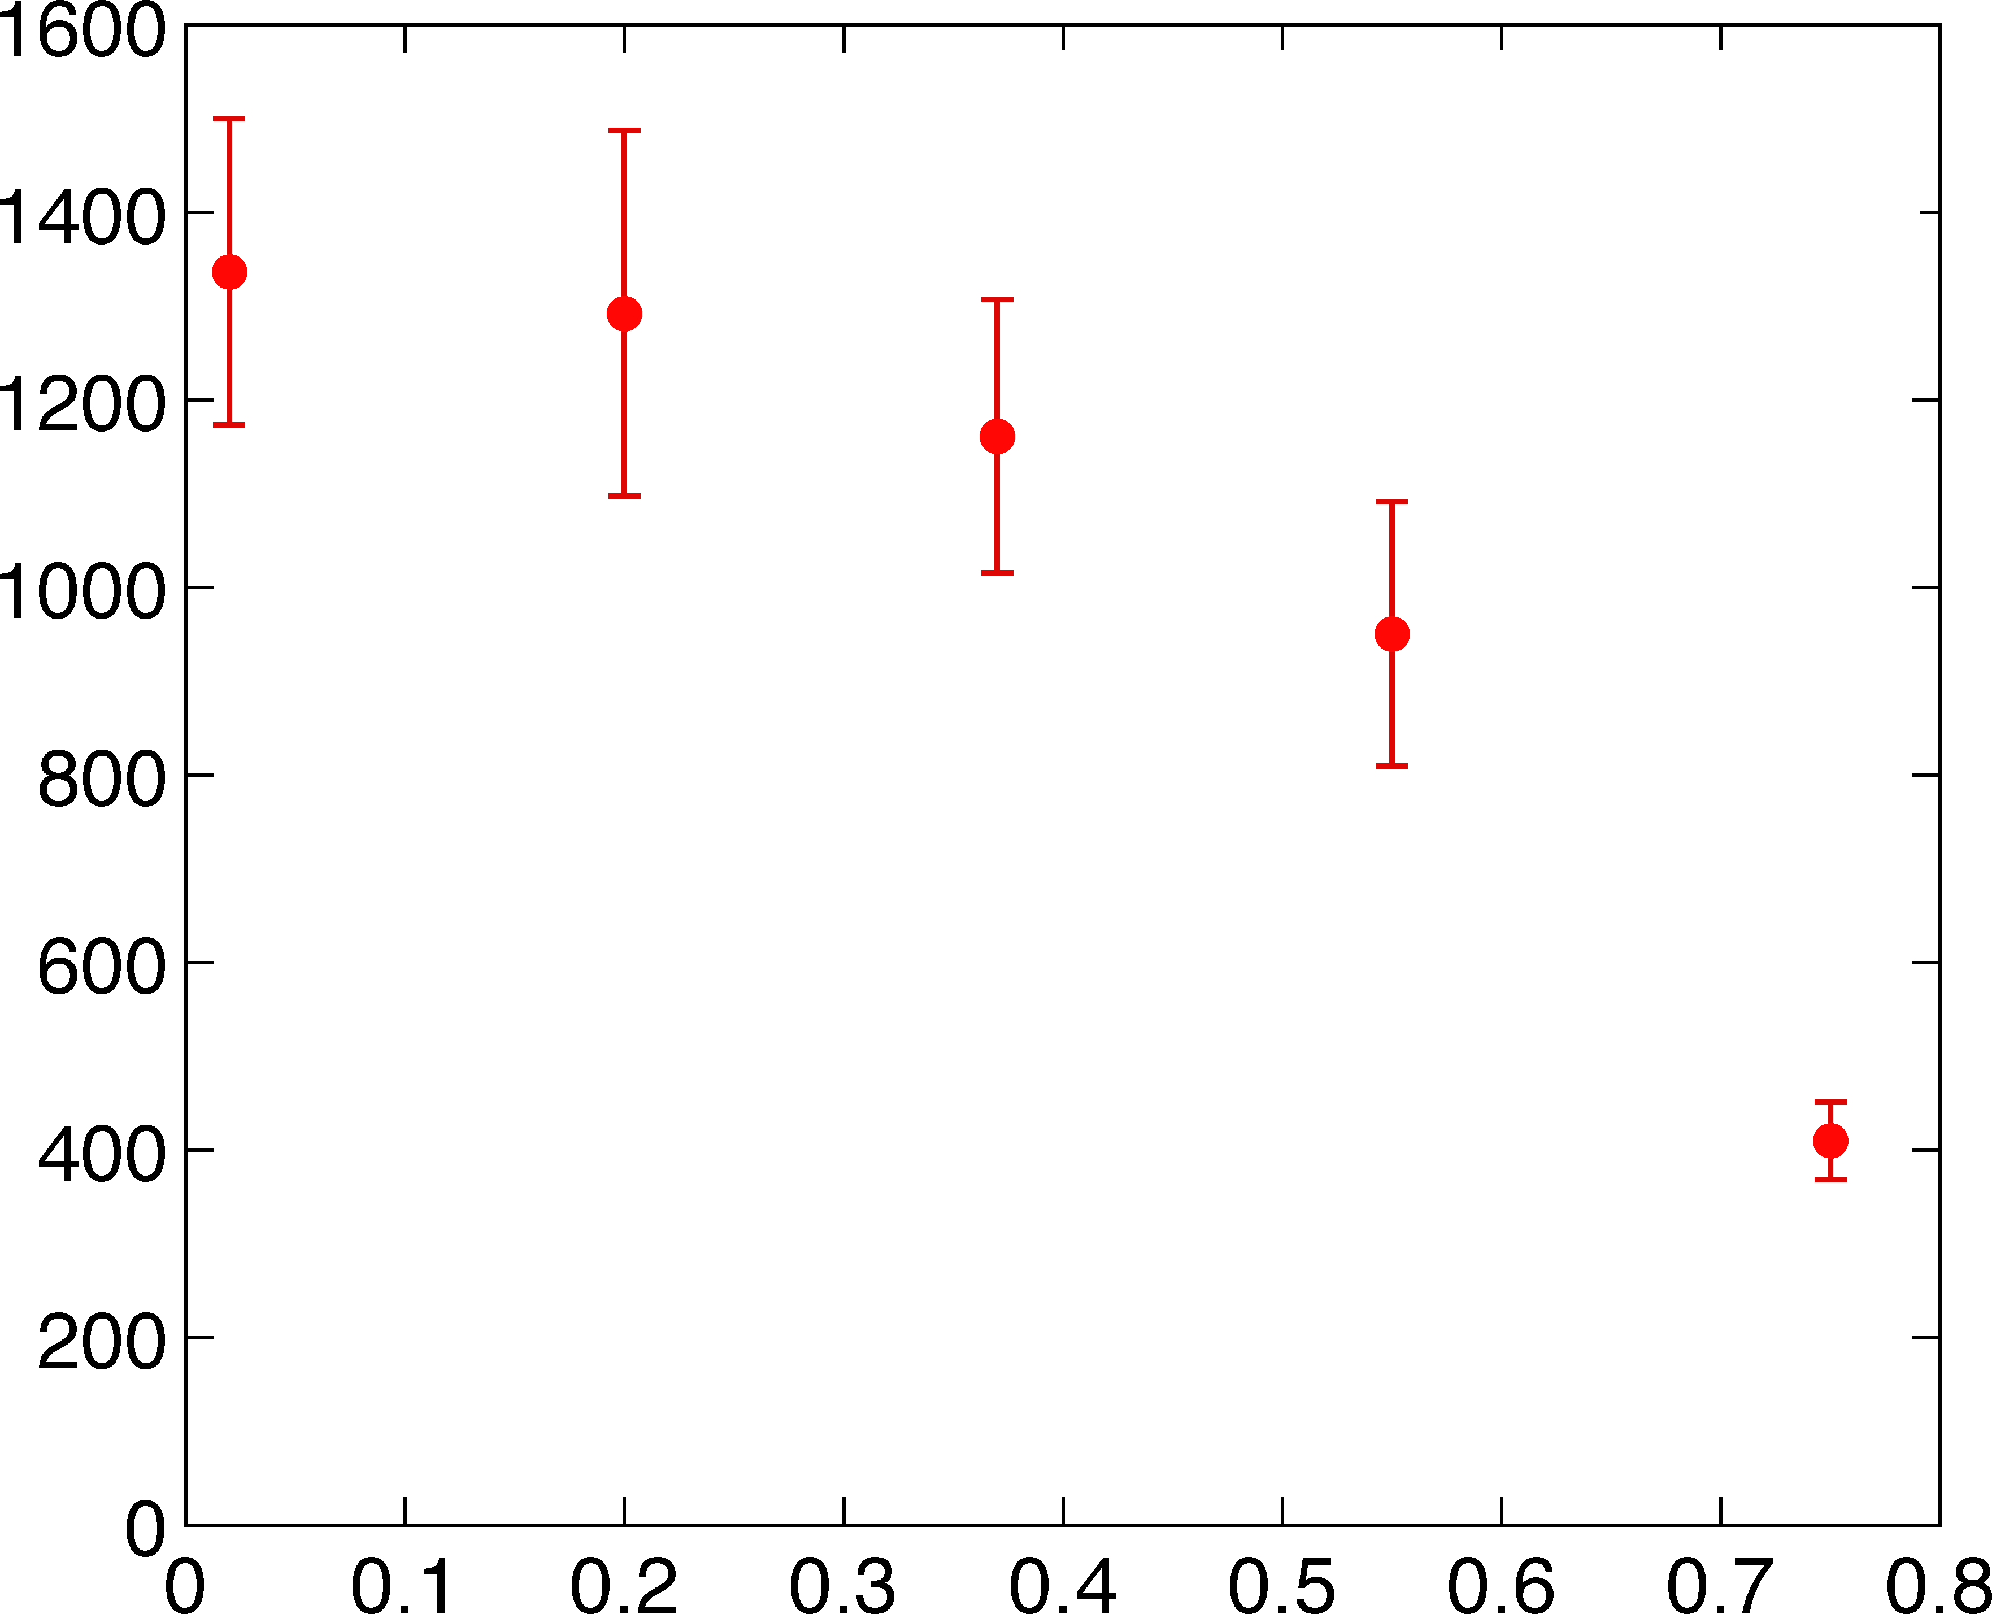
T_{i} is sustained at a high level throughout the plasma during the PPCD improved confinement period.
T_{i} (eV)
⟨τ_{E,i}⟩ ≈ 10 ms
r/a
Both impurity and majority T_{i} are ≥ 1 keV during improved confinement
  Impurity C⁺⁶ measured with CHERS (shown above)
  Majority D measured with Rutherford scattering

Slide 15
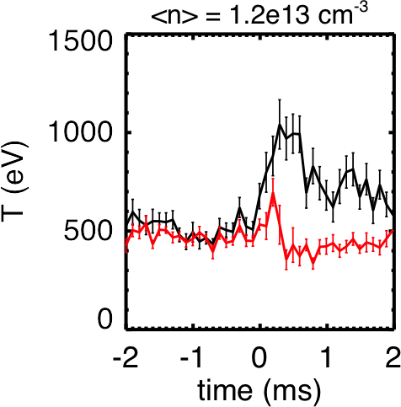
Impurity ion temperature anisotropy is observed during reconnection heating.
T_{perp}
T_{par}
R. Magee et al.
T_{perp} > T_{par} during heating implies perpendicular heating mechanism.
ΔT_{par} decreases with density, ΔT_{perp} does not.
  Anisotropy increases with density, behavior that can be modeled by assuming Z_{eff} decreases with density.

Slide 16
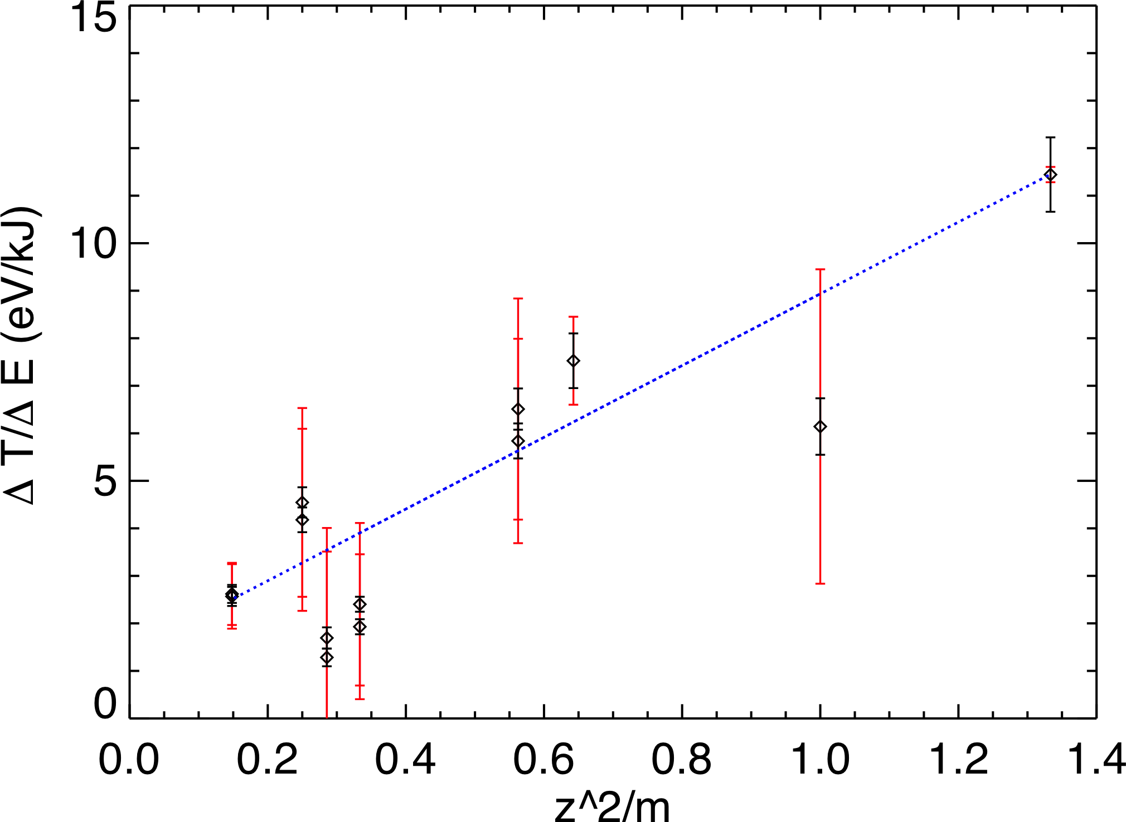
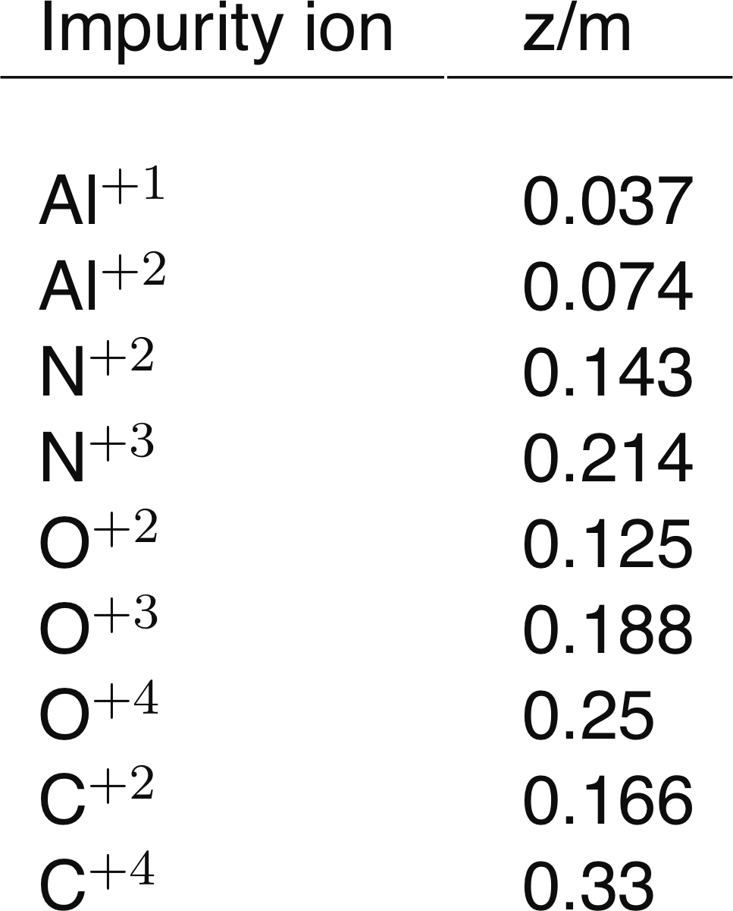
Recent passive emission measurements of edge impurities indicate heating is dependent on charge and mass.
Ion cyclotron heating model suggests
Measure ΔT_{i} during a sawtooth for various impurity species
➔ Trend, but proportionality to Z²/m (or Z/m) not definitive.

Slide 17
Power from tearing modes nonlinearly cascades to small scales
Frequency Power Spectrum
10^{–4}
tearing
P( f )
(T²/Hz)
10^{–8}
10^{–12}
ion cyclotron
1
10
100
1000
Frequency (kHz)

Slide 18
Aluminum Impurity Emission Measurements
and modeling

Slide 19
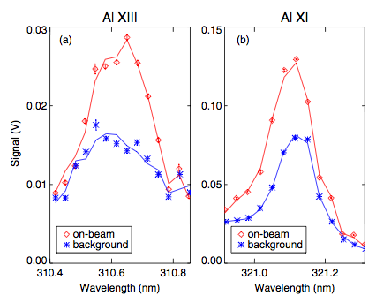
Aluminum emission was measured to help constrain Z_{eff}
Discrepancies in Zeff measurements from x-ray emissivity
Original hypothesis was that Al contribution could explain discrepancy
Kumar, Plasma Phys. Control. Fusion (2012)

Slide 20
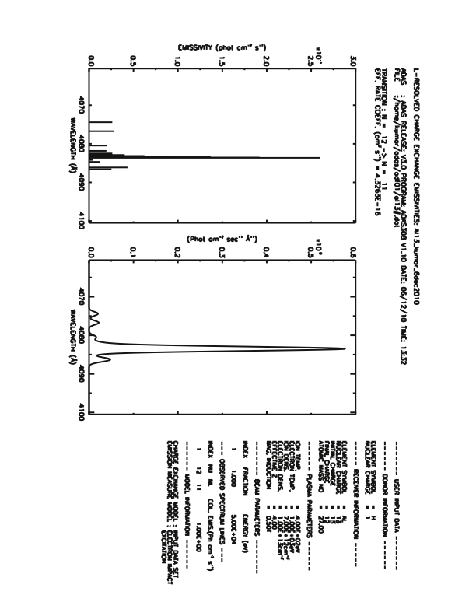
Emission line model for beam on/off views generated with ADAS
ADF01 state selective charge exchange cross-sections for H0 beam stimulating Al emission generated using ADAS universal dataset
  Use ADAS 315 to generate an ADF01 file from arbitrary ion (Z0=13)
  Use ADAS 306 to create J-resolved fine-structure components and emissivities

Slide 21
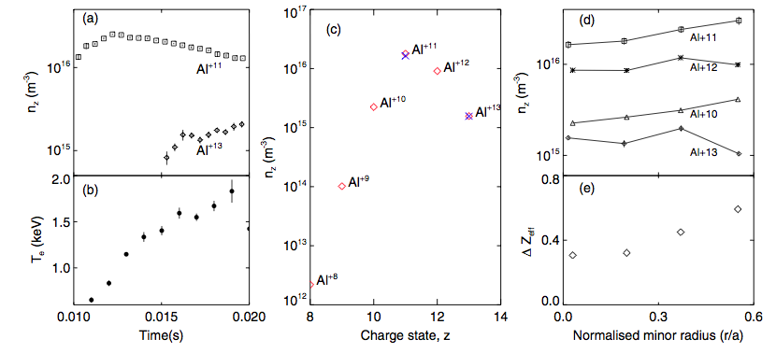
Measurements of Al XIII & XI used to model abundances for Z_{eff}
ADAS 405 used to obtain fractional abundances fit to Al⁺¹³ density
Transport model under development
Zeff contribution too small to account for discrepancy with soft X-ray measurements
Hollow profile (seen in C, O, B profiles as well)

Slide 22
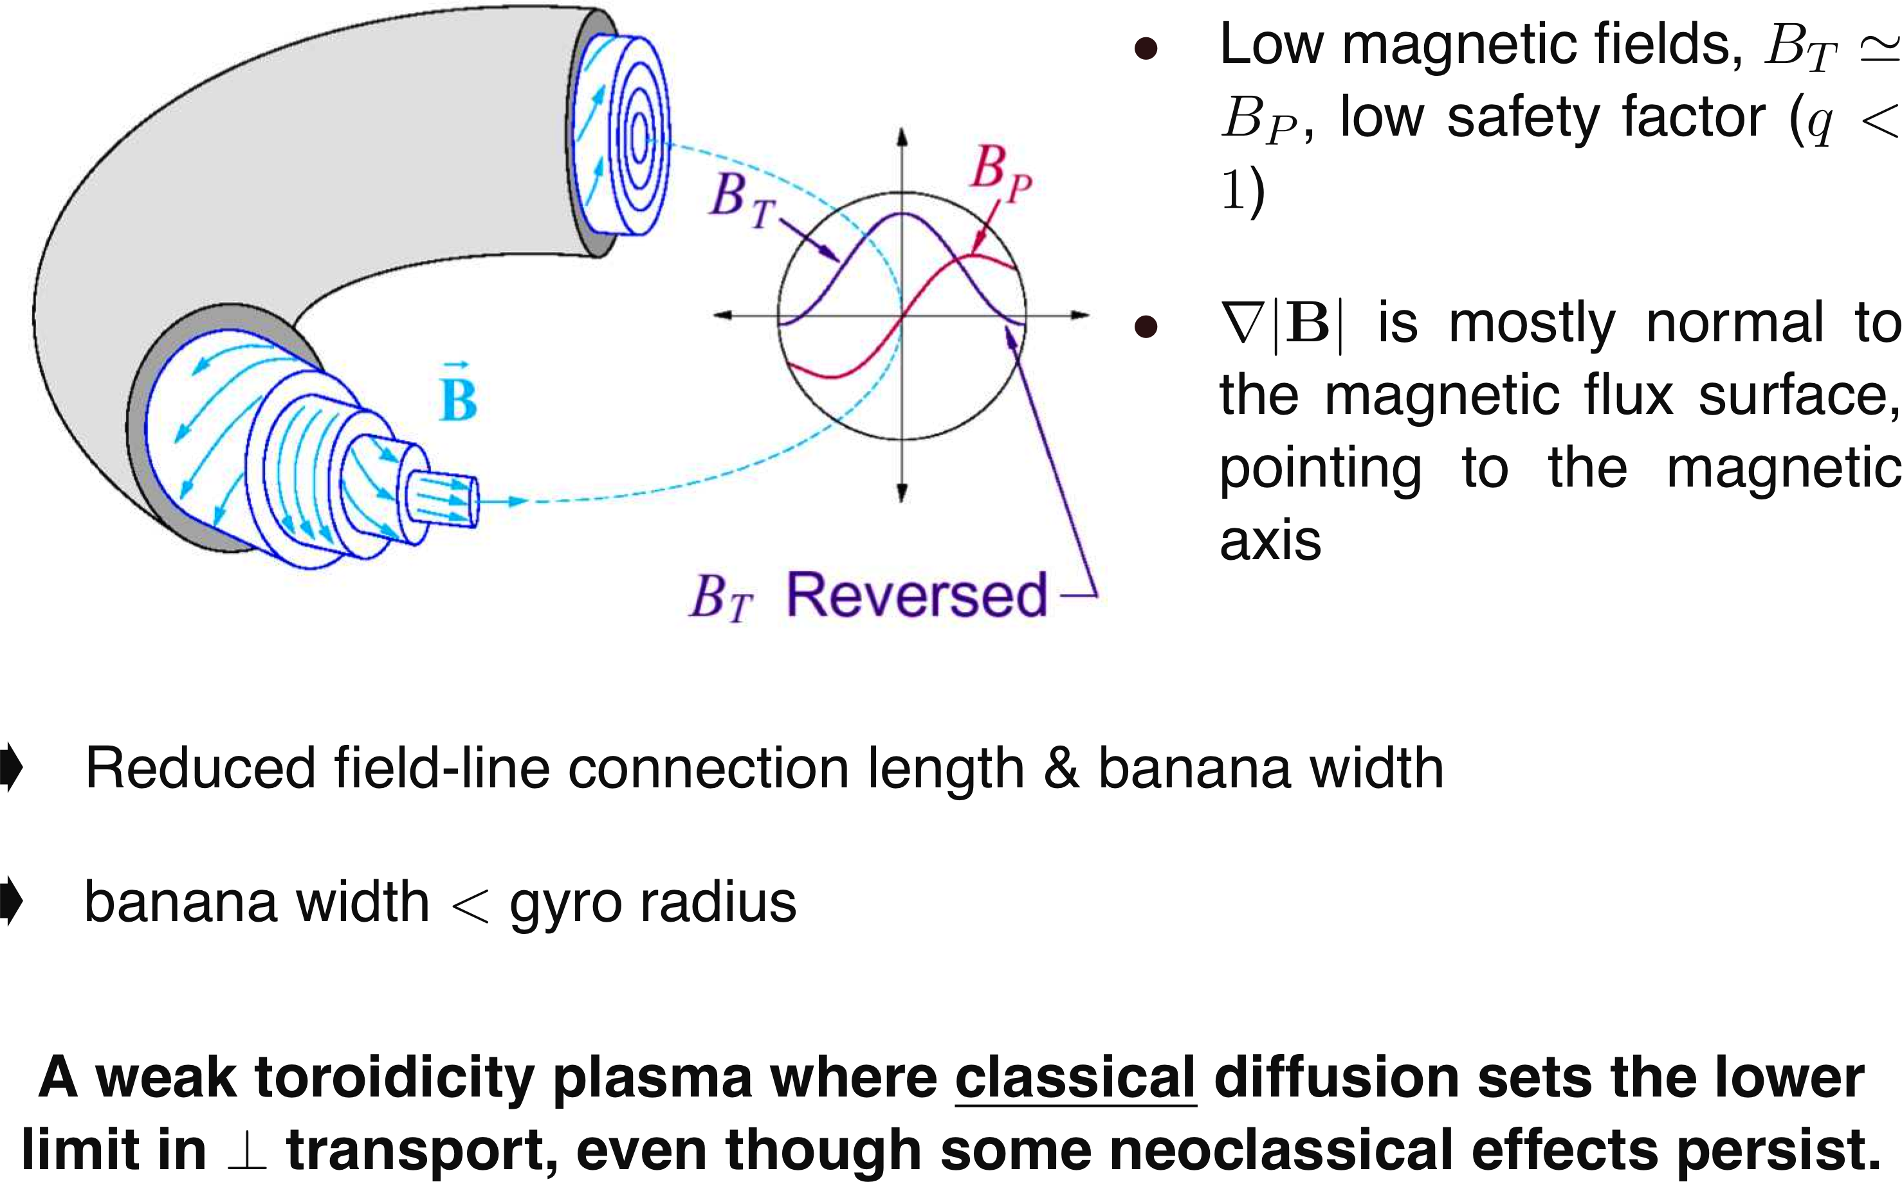
Neoclassical corrections for particle diffusion are small in the RFP.

Slide 23
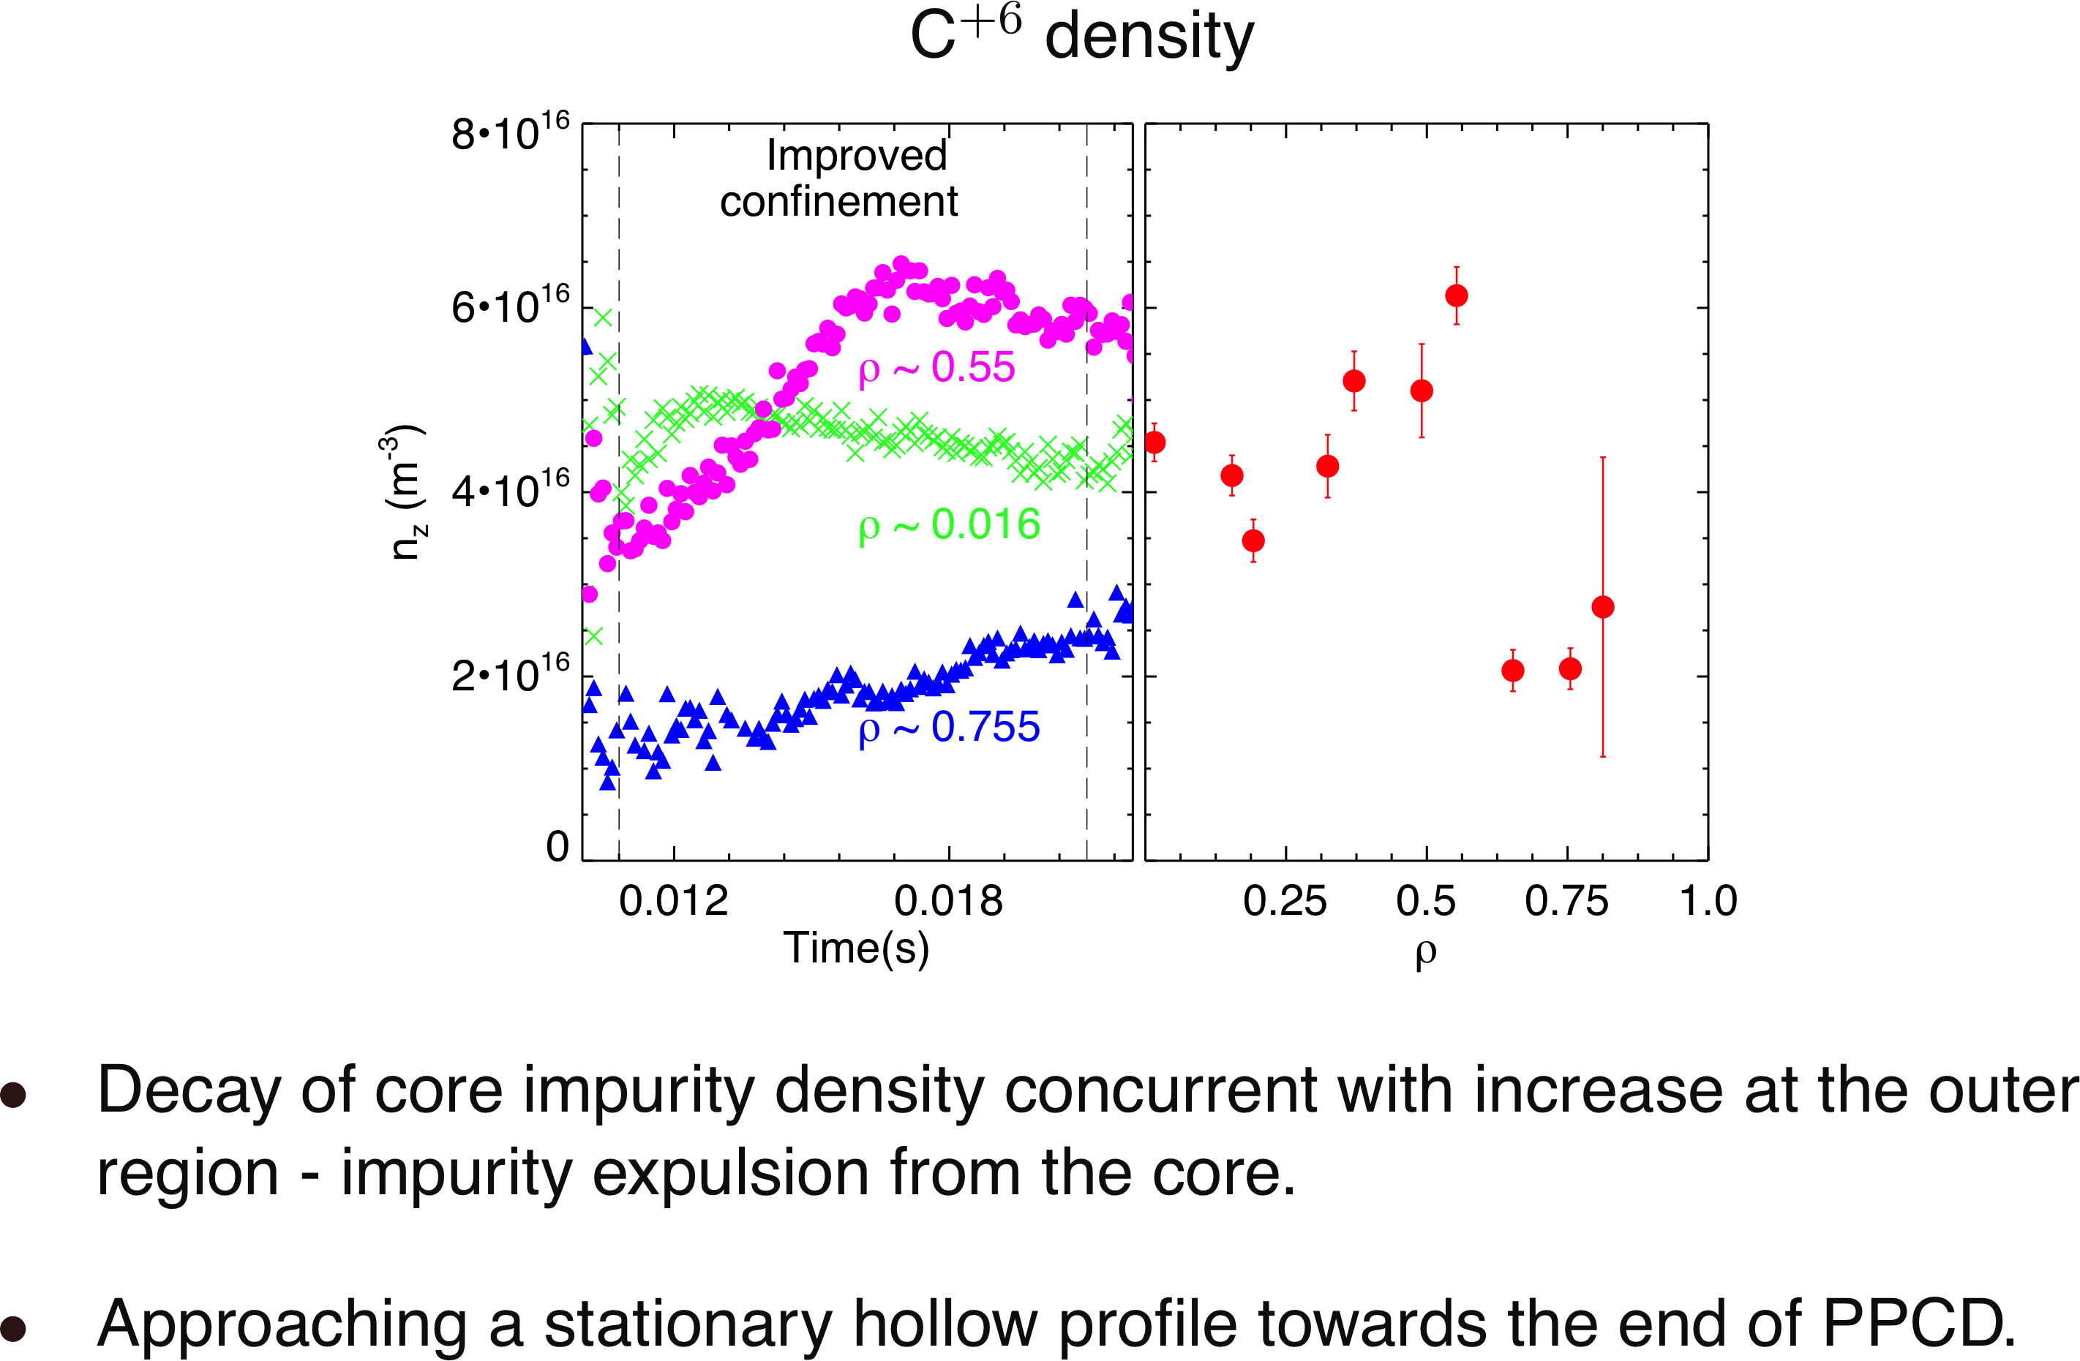
The radial profile of impurity density evolves to a nearly stationary hollow shape during the PPCD period.
S. Kumar et al.

Slide 24
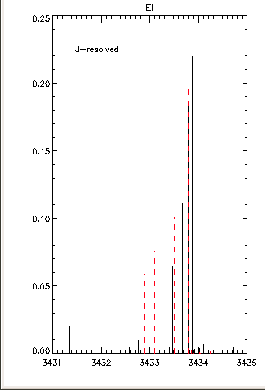
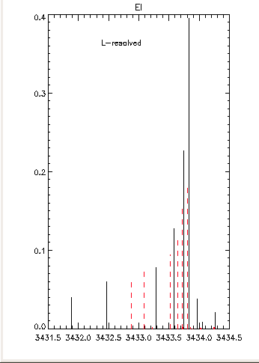
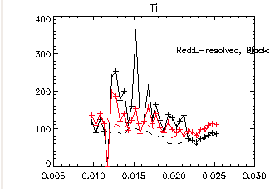
We need to address the model uncertainty associated with using either L-resolved or J-resolved fine-structure components
Black: J-resolved
Red: L-resolved

Slide 25
ADAS continues to be a critical tool for CX spectroscopy at UW
Charge-exchange spectroscopy
  Impurity temperature as proxy for main ion temperature
  Impurity concentration and dynamics (Z_{eff})
  Ion confinement, heating, and flow as it relates to heating and acceleration processes due to magnetic reconnection and intrinsic rotation
Beam Emission Spectroscopy – Motional Stark Effect Measurement
  Low field environment (MST) -> Stark shift not well resolved
  Initial development for use on HSX

