Slide 1



Tungsten Source Spectroscopy for the ITER-Like Wall on JET
S. Brezinsek
G.V Rooij, J.W. Coenen
A.G. Meigs, M. Stamp, R. Dux and JET-EFDA Contributors
ADAS Workshop, Cadarache, 24.9.-25.9.2012

Slide 2
Outline
ITER-Like Wall at JET: Installation, Key Results and Issues related to W components
W Source Quantification
  Spectroscopic Transitions
  Dependence on Plasma Conditions
  Prompt Redeposition
Summary

Slide 3
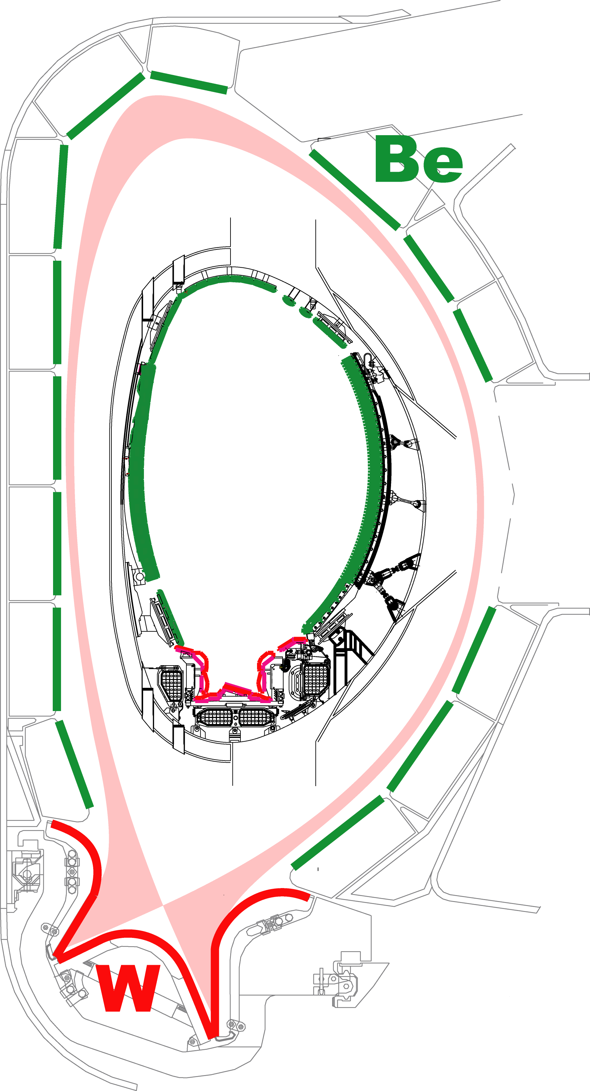
Metallic Walls: ITER-Like Wall at JET
ITER
ITER-material mix used for the first in a tokamak
“Carbon-free” environment
  Reduced migration to remote areas
  Reduced tritium retention
  Loss of carbon as main radiator
JET
Change in operational space
  Need for better plasma control
  Need for heat load mitigation schemes
Main goals of the ILW experiment
Demonstrate low fuel retention, migration
and possible fuel recovery
Demonstrate plasma compatibility
with metallic walls
Input to the decision about the first ITER divertor
V. Philipps
FED 2011
G. Matthews
Phys. Scripta 2011
Notes:
NBI upgrade in parallel

Slide 4
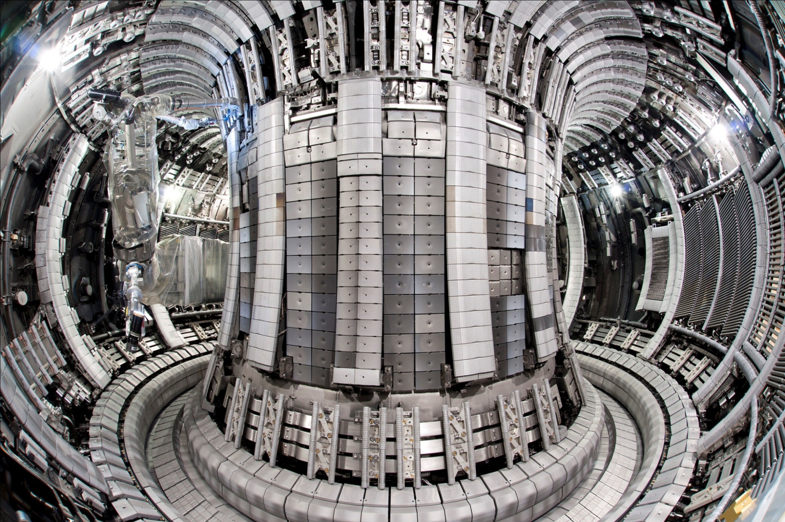
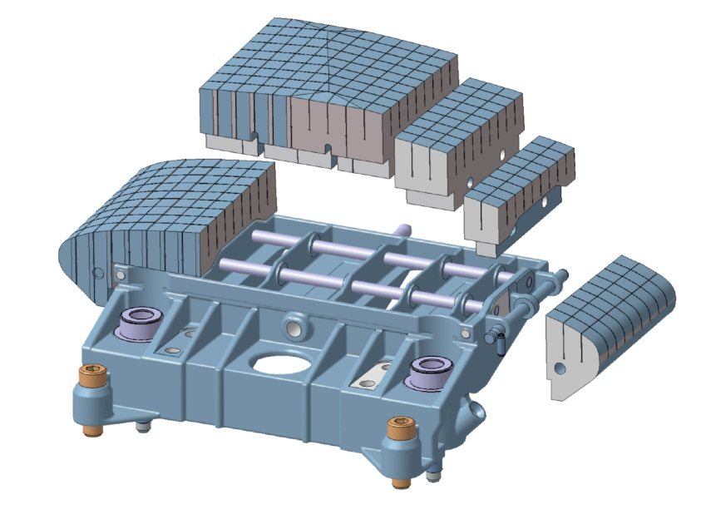
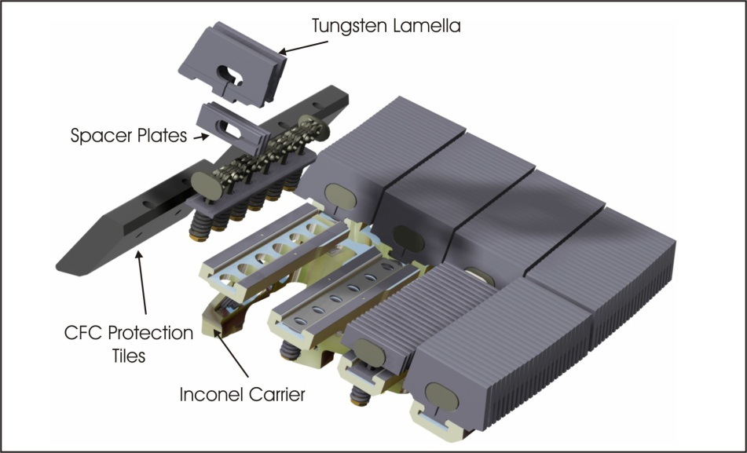
ILW completed: 8th May 2011
Be limiter
bulk
W divertor
Total: 2t of Be installed
Beryllium
Total: 2t of W installed
Tungsten
ITER-wall material combination, but only inertial cooled plasma-facing components
New energy and power load limitations imposed with respect to JET-C
Notes:
Figure W-coated CFC

Slide 5
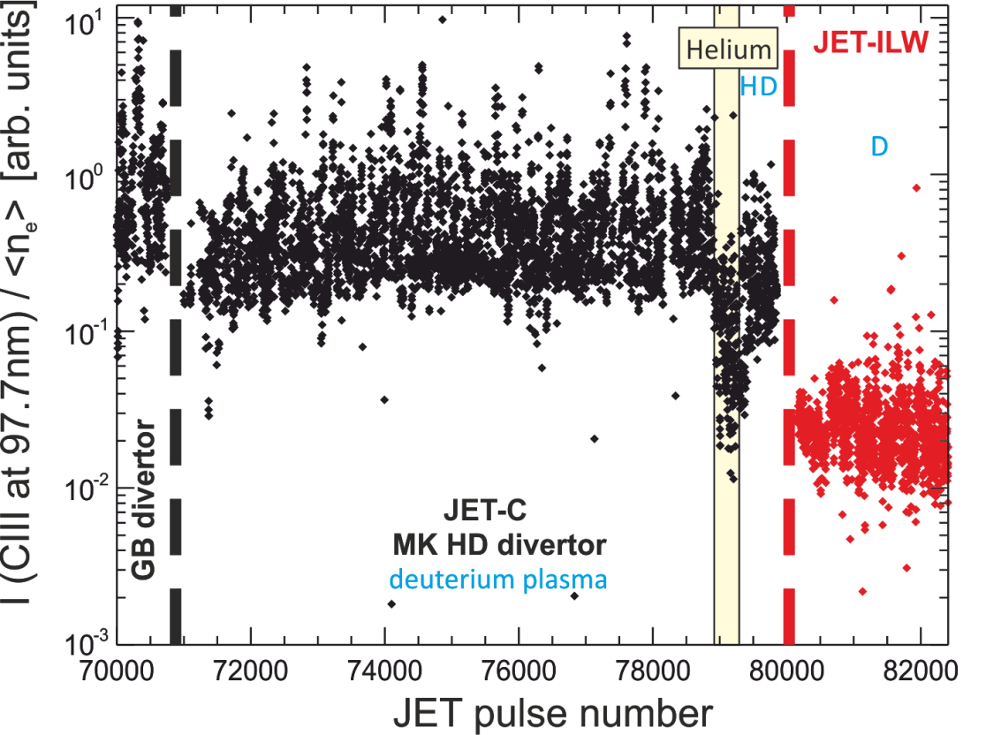
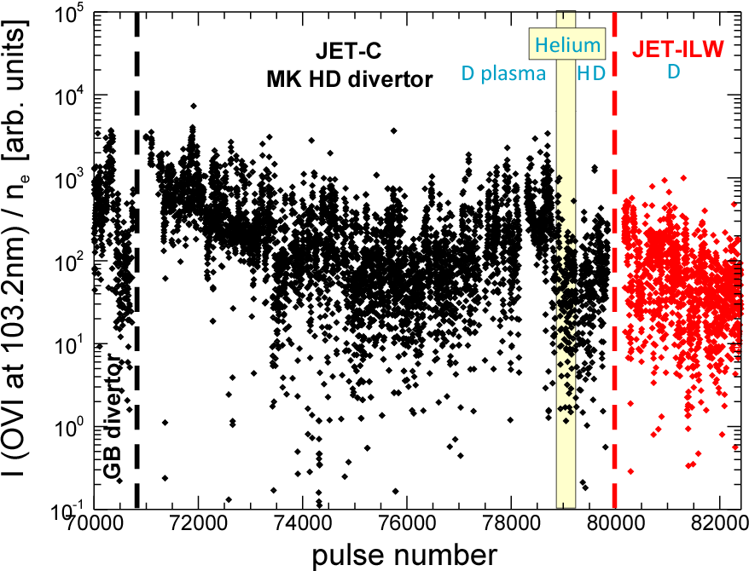
Residual Carbon and Oxygen
Main chamber CIII and outer divertor CII edge fluxes:
Residual C dropped with ILW installation by one order of magnitude
Dedicated JET-C/JET-ILW comparison pulses show a drop of about a factor 20
Oxygen gettered by Be, but still present at low levels in the plasma
x20
S. Brezinsek
PSI2012
Comparable C reduction also observed in core and edge concentrations by CXRS
Averaged Z_{eff} dropped from 1.9 (JET-C) to 1.2 (JET-ILW)

Slide 6
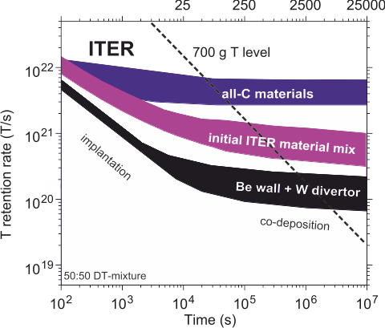
Key Result: Long Term Fuel Retention
JET gas balance measurements
ITER D-T discharges (400s)
x10
T retention rate [T/s]
JET
S. Brezinsek
IAEA 2012
time [s]
Reduction of fuel retention rate with JET-ILW just in line with ITER-predictions!
Lower fuel content in Be co-deposits in comparison with C co-deposits
Note post mortem analysis shows typically a factor ~4 lower retention in comparison with gas balances => tile extraction end of year => post mortem analysis

Slide 7
Key Result: Stable H-mode Operation
Pulse 82240 I_{P}=2.0MA, B_{T}=2.1T, Z_{eff}=1.2
P_{NBI}, P_{ICRH}
P_{RAD}, [MW]
Type I ELMy H-modes achieved in low
and high triangular plasma with NBI
Operational window is smaller and requires
  Gas fuelling (to reduce W source)
  Minimum ELM frequency (to flush W)
  Central heating (to avoid peaking)
otherwise W-accumulation can occur
Stable ELMy H-mode at D injection rates Γ≥ 0.5x10²²/s with H₉₈~1 (I_{p}=2.5 MA, B_{t}=2.5 T)
  ELM flushing successful at f>10Hz
  W concentration below C_{W}~5x10⁻⁵
n_{C} [10¹⁹ m⁻³]
H_{98y2}
β_{N}
H_{a} [a.u.]
13
14
15
16
17
18
time [s]
E. Joffrin
IAEA2012
Notes:
One profile from HRTS to show regime

Slide 8
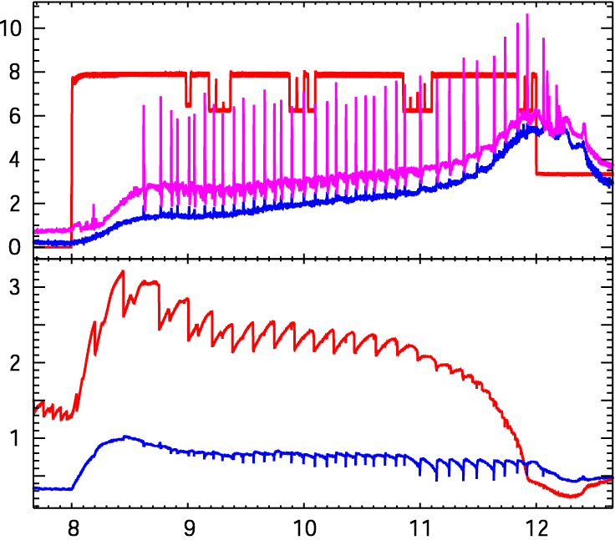
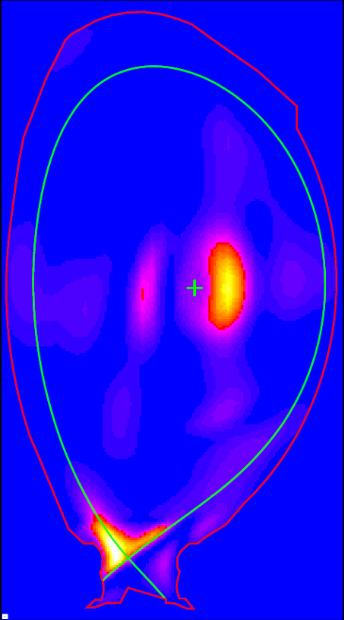
Issue: W Transport and Accumulation
ELM frequence too low
W peaking
Sawteeth die out
W accumulation
Temperature collapse
peaking
accumulation
JET-ILW
81913
P_{NBI}
Power (MW)
P_{rad tot}
P_{rad bulk}
T_{e} (0)
T_{e} (keV)
T_{e} (ρ~0.85)
Time(s)
S Brezinsek
EPS 2012

Slide 9
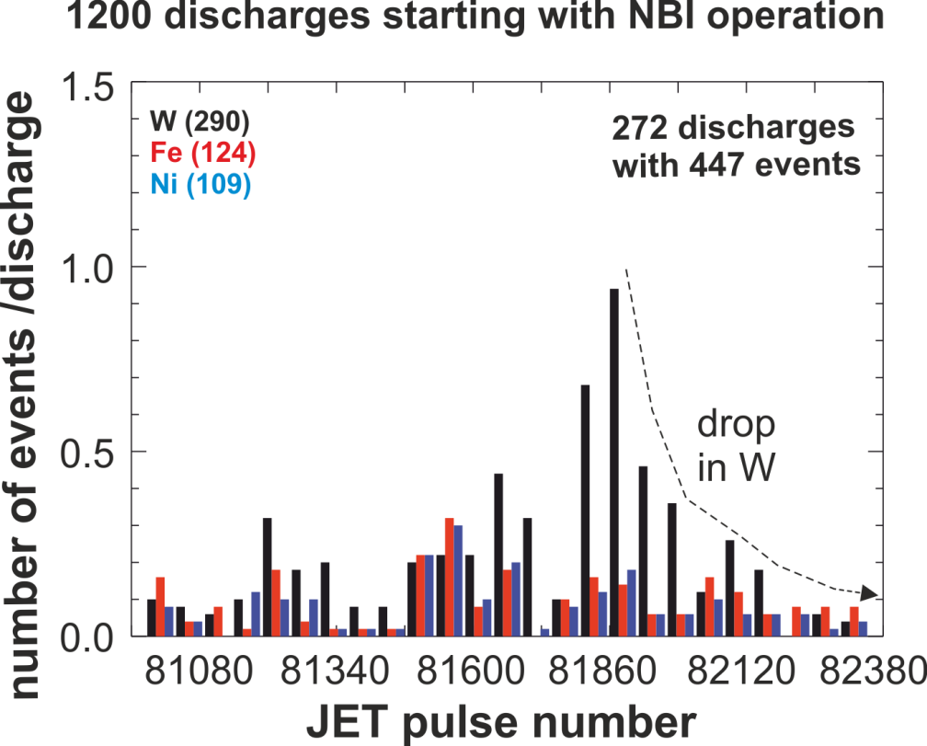
Issue: W Cluster Release
W cluster (~0.1mm) released from divertor => Usually not harmful, but cool plasma down
Number of events reduced with operational time => Thermal fatigue of components not cause
W cluster
JET-ILW #81765
power [MW]
VUV
T_{e} (0)
temperature [keV]
T_{e} (ρ~0.6)
18
20
22
time [s]
G. Matthews
PSI2012

Slide 10
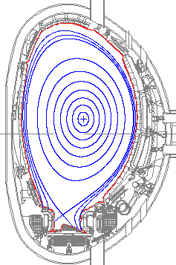
W Sources in JET
Strong W source (outer divertor) critical issue:
  Radiative cooling and W accumulation
  Limit lifetime of W plate by erosion
Best plasma performance in JET-CFC obtained in
  Plasmas with low density in the divertor
  Plasmas showed large ELM energy drop
Not possible with W divertor
  Low density means high T_{e} and energy of impinging ions => strong W sputtering
  Large ELMs carry high energy ions
  => melting and sputtering of W possible
Needs best compromise:
  Low W sputtering
  High W divertor retention
  Small ELMs to flush confined W
W?

Slide 11
W Source Distribution
Modelling of WI and WII lines photon efficiencies: Γ_{W}=S/XB φ_{W}
TEXTOR & PSI-2
Calibration by WF₆ injection
Modelling of WF₆ injection
W source spectroscopy
ERO modelling
W source distribution
Impinging impurity mixture (Be, O, C)
Ionisation stage of impurities
W sputtering
=> In divertor
mainly
by impurities!
Impinging ion and deuterium flux
Local cooling (low T_{e})
Surface effects (nitrides?)

Slide 12
W Source Spectroscopy
Divertor plasma
Full ionising plasma conditions
W sputtering flux from neutral
W line observation
WΙΙ
S′
W^{+ *}
n_{e}, T_{e} increase
W⁺
S for ioniSation rate coeffecient
X for eXciatation rate coeffecient
B for Branching ratio
S
WΙ
B
W*
W
Accordingly for the flux of single
ionsed W
Z_{imp}
X
Y
Comparison of Γ_{W0} and Γ_{W+}
=> prompt redeposition factor
G.v.Rooij PSI 2012
W target plate

Slide 13
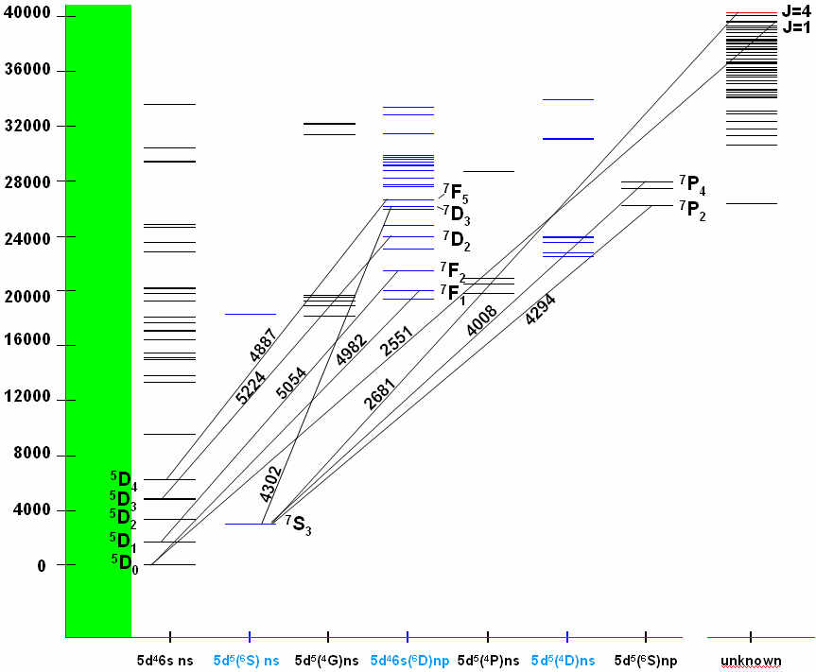
Grotian Diagramm for Neutral W
wave numbers / cm⁻¹
NIST tables version 3
1eV→8066 cm⁻¹
»
population mechanisms:
e-collisions from ground state
cascades from upper levels
line
ratios
f(T
e
)
0.5eV
line
ratios
f(T
W
)
Which transition should or can be observed? S/XB values?

Slide 14
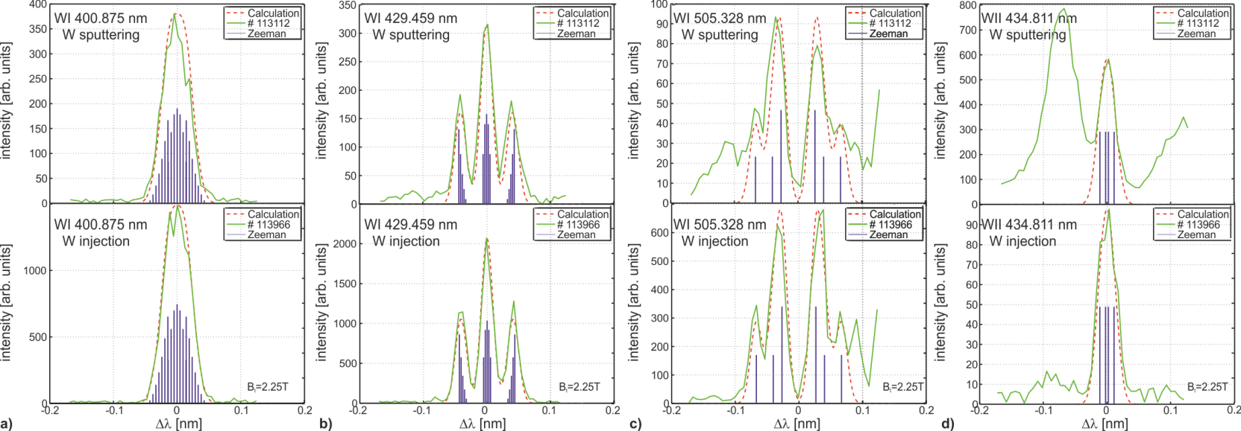
Example Lines from TEXTOR
No difference in line shape of different WI and WII lines
Line ratios of WI lines with same lower level comparable
WII lines measured and quantified in WF₆ injections
S. Brezinsek Phy. Scripta 2011
Main favourites for JET: WI at 400.875nm and UV lines
Alternative lines to weak or blended by impurites from Be, C, Ar, N etc.

Slide 15
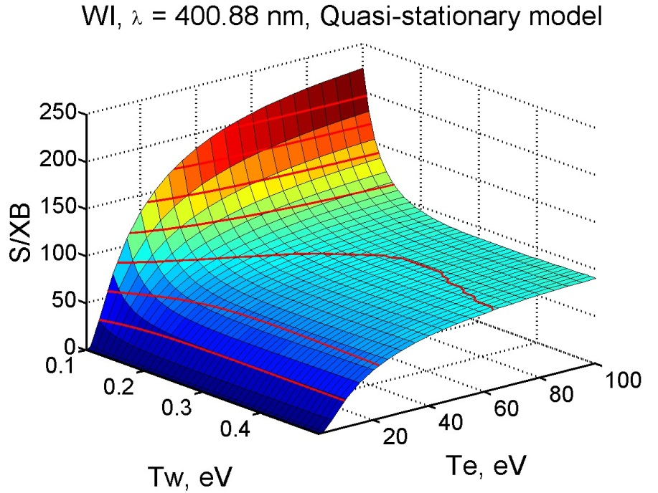
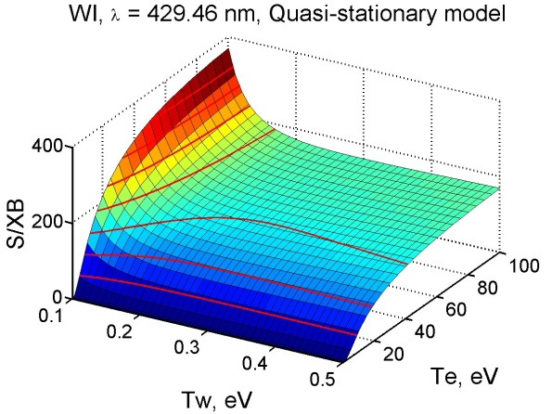
S/XB for WI lines
WI @ 400.9nm
WI @ 429.5nm
D. Kondratjev GKU

Slide 16
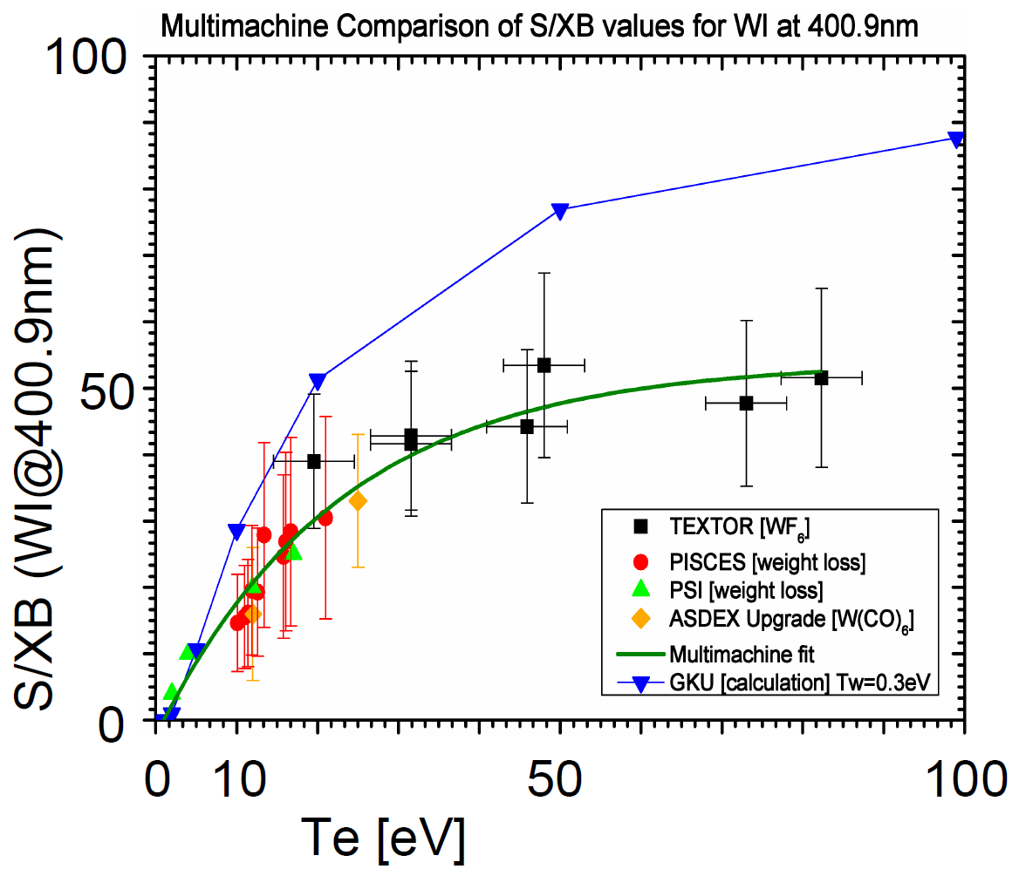
Photon Efficiencies
WI at 400.9nm best documented line
Multimachine fit of S/XB values applied for quantification of W fluxes
Contrast to AUG which uses constant 20 (but works in the range od 5-15 eV)
JET outer divertor hotter and has larger ELM energy drops (higher T_{e})
Different methods:
Weight loss
Spectroscopy
WF₆ injection
W(CO)₆ injection
S. Brezinsek ITPA 2012

Slide 17
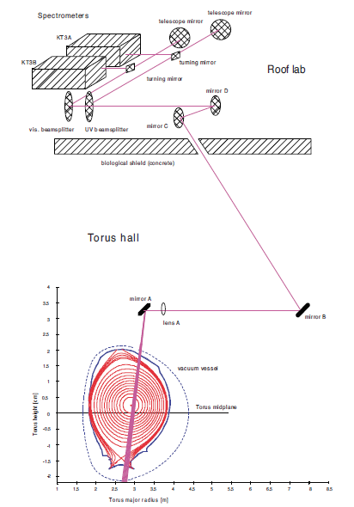
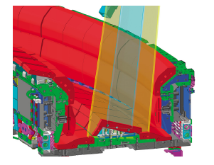
Direct Imaging Spectrometer in JET
Line-of-sight
A. Meigs PSI 2012
UV –NIR system: three spectrometers
250nm -1100nm
up 30 nm coverage per system
300 / 600 /1200 l/mm gratings
Spatial coverage of 360 mm
Spatial resolution: 1.8cm
Time resolution: 40ms

Slide 18
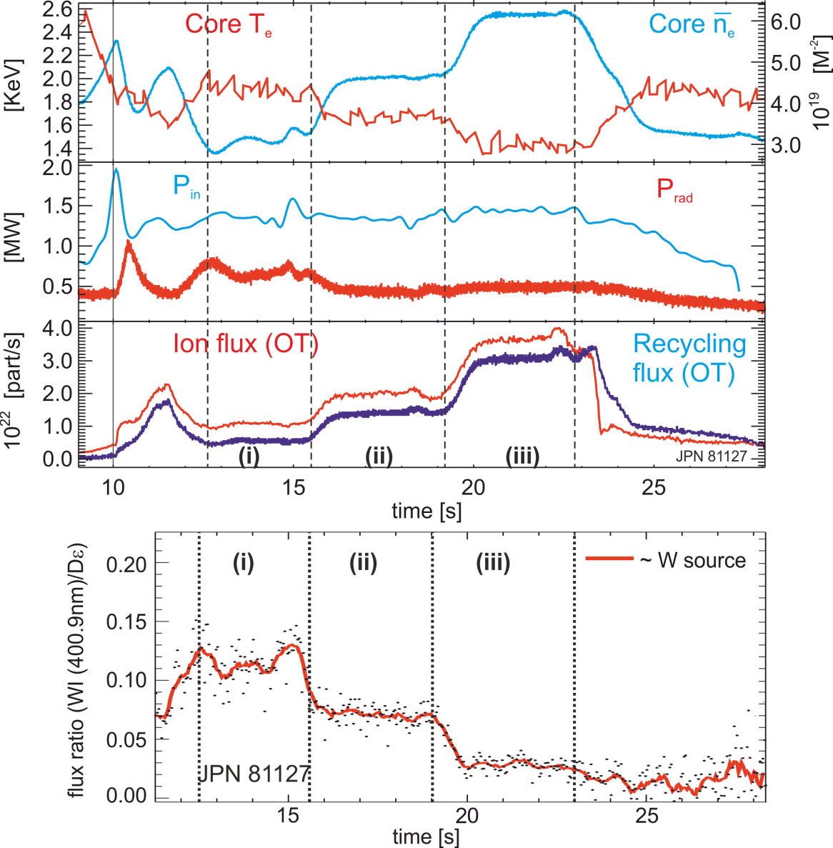
W Sputtering – L-mode
Low recycling regime (steady-state):
W sputtering decreases with density increase and temperature decrease
Impact of flux increase to the target
compensated by drop in temperature
Sputtering caused by impurity ions
(here: Be ions)
T_{e}=45eV
T_{e}=35eV
T_{e}=25eV
W source in the outer divertor
S. Brezinsek EPS2012

Slide 19
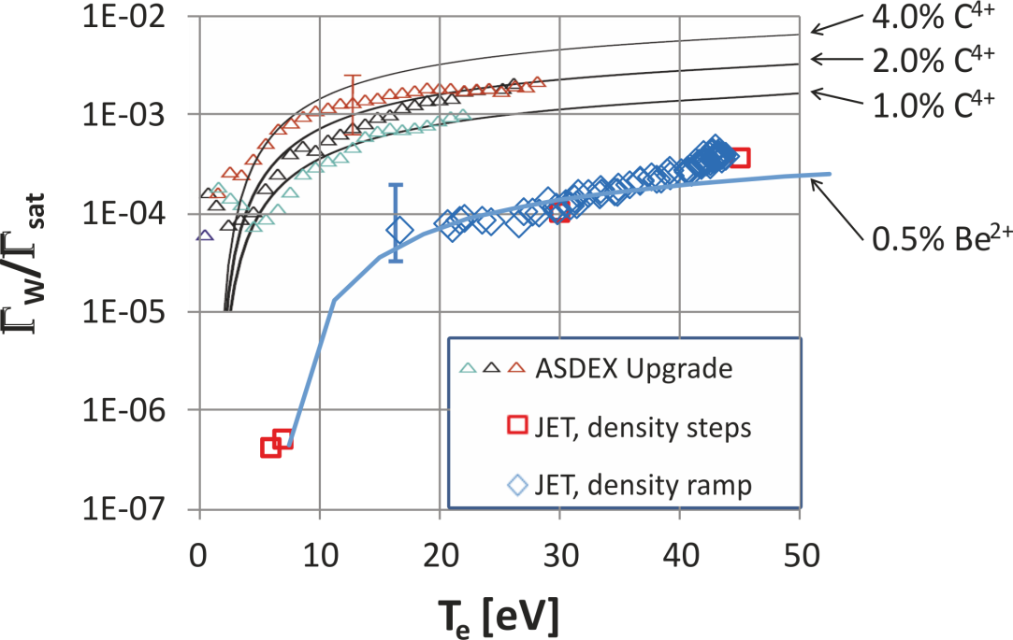
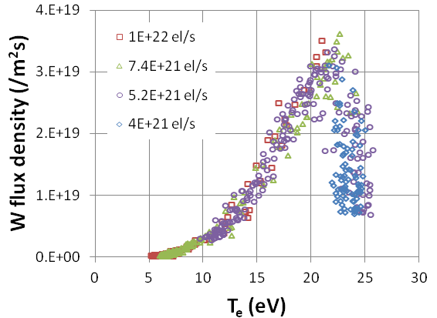
W Sputtering Yields
Inter-ELM and steady-state regimes with low T_{e} and low W sputtering achieved
Competition between higher impurity flux and local cooling in seeded discharges
Increasing N
AUG-W
JET-ILW
J.W. Coenen
PSI2012
L. Aho-Mantilla
PSI2012
Divertor plasma cooling by deuterium fuelling or by deuterium+nitrogen seeding leads to reduction of W source => below phys. sputtering threshold

Slide 20
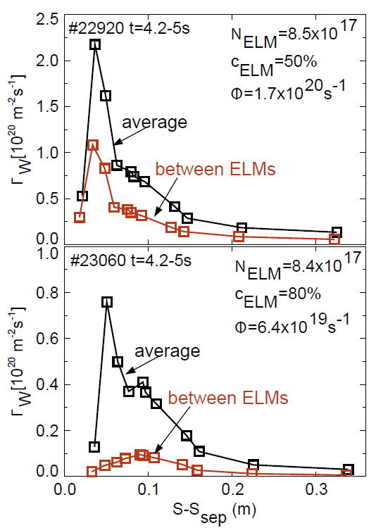
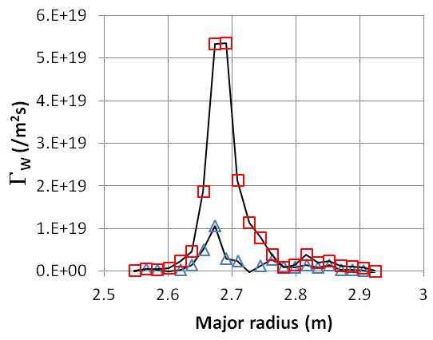
W Sputtering – H-mode
JET: 13 MW NBI, n_{e} =7.5·10¹⁹ m⁻³, 10 Hz ELMs
average
between ELMs
G.v. Rooij PSI2012
        Factor 8 between inter- and intra-ELM sputtering
Similar ratio for JET T_{e}=20 eV and AUG Te=6 eV
Erosion during ELMs dominate at high densities
ASDEX: Dux et al., J Nucl Mat 390–391 (2009) 858

Slide 21
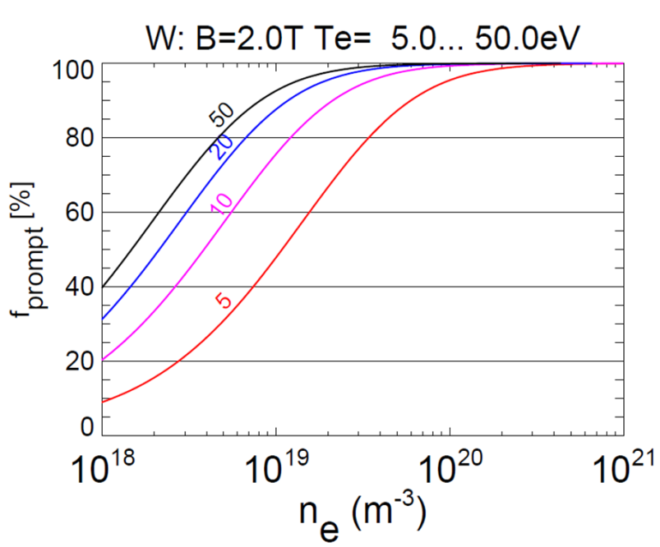
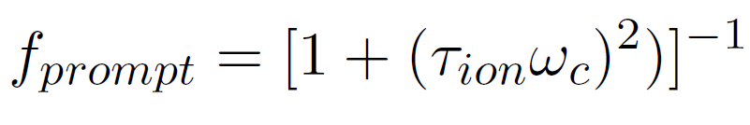
Prompt Redeposition
Divertor plasma
W⁺
⊗ B
WII
e.g. 364 nm
r_{L}
S′
B ′
λ_{ion}
n_{e}, T_{e} increase
W⁰
W^{+ *}
W⁺
X′
WI
e.g. 400.9 nm
S
B
W*
W
Z_{imp}
X
Y
JET
W target
G. v. Rooij PSI2012

Slide 22
Example: Divertor UV – Spectra in JET

Slide 23

Ratio of WII / WI
1.4×10¹⁹ m⁻³, 50 eV:
4×10¹⁸ m⁻³, 50 eV:
G. v. Rooij PSI2012
Factor 2 change indicates >50% redeposition
Textor same result at same T_{e} and n_{e}
S. Brezinsek et al., Phys. Scr. T145 (2011) 014016.

Slide 24
Summary
ILW installed in JET and in operation
  Low fuel retention measured
  Good plasma performance in H-mode obtained, but operational window narrow
  W peaking and accumulation can occur => avoidance by optimisation
W sputtering measured by optical spectroscopy
  WI at 400.9nm used – other lines measured
  W sputtering as function of impurity composition, impinging flux and temperatures characterised in L-mode
  W sputtering by ELMs dominate
  Prompt redeposition of W measured by WI and WII line ratio analysis

Slide 25
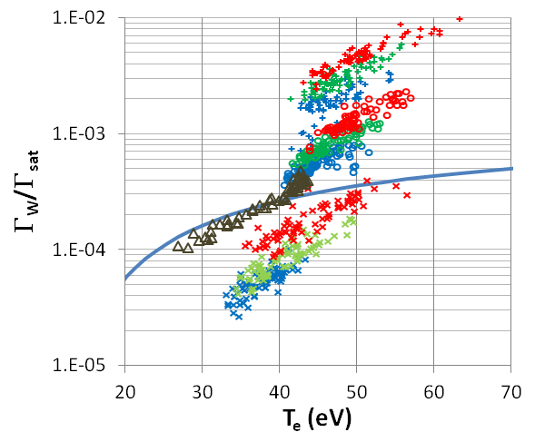
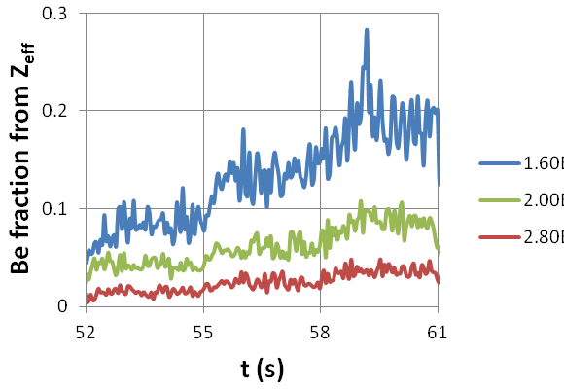
Change in Impurity Composition
3 MW ICRH
2 MW ICRH
1 MW ICRH
n_{e} = 1.6·10¹⁹ m⁻³
3 MW ICRH
2 MW ICRH
1 MW ICRH
Effect of steps in power in line with Be impurity variation
Sputtering yield ~quadruples in each density step
n_{e} = 2.0·10¹⁹ m⁻³
0.5% Be²⁺
3 MW ICRH
2 MW ICRH
1 MW ICRH
n_{e} = 2.8·10¹⁹ m⁻³
Be fraction doubles in each step
1 MW 2 MW 3 MW
1 MW NBI ramp
n_{e} =
1.6·10¹⁹ m⁻³
2.0·10¹⁹ m⁻³
2.8·10¹⁹ m⁻³

Slide 26
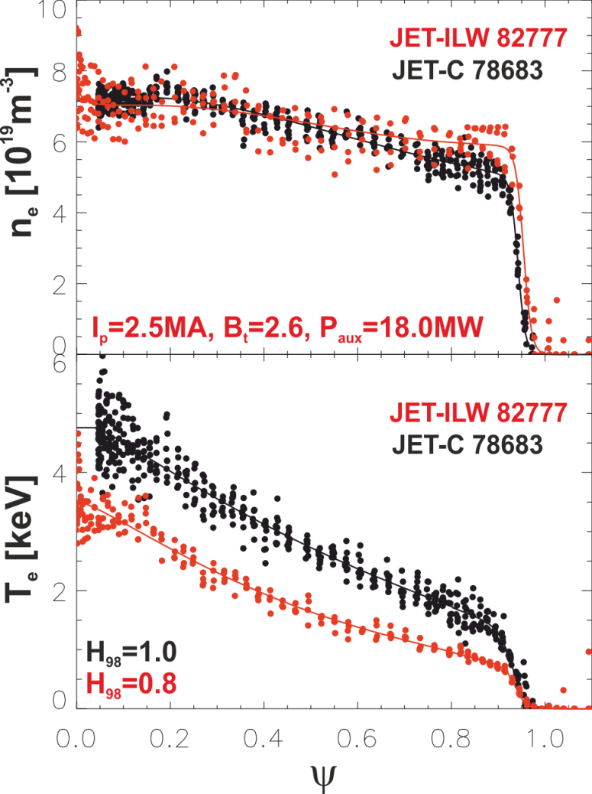
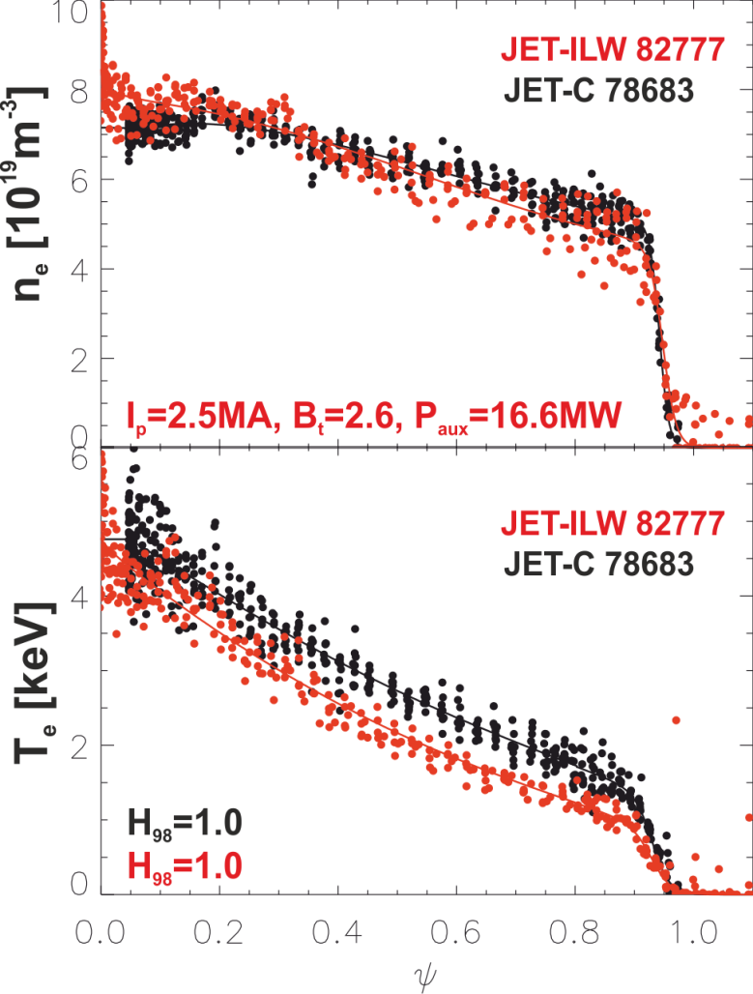
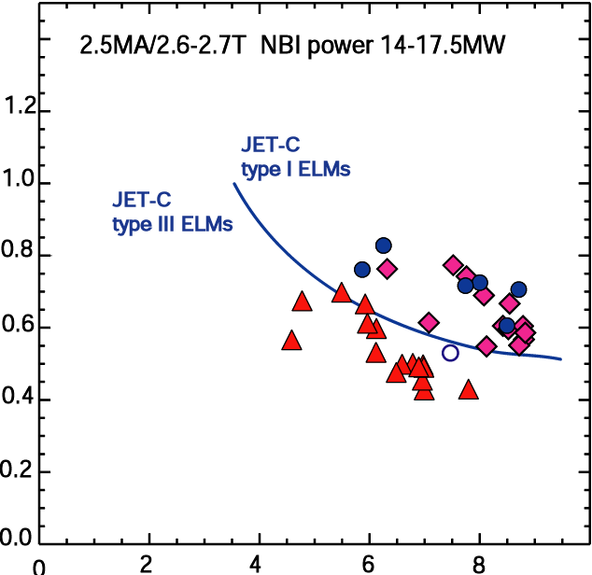
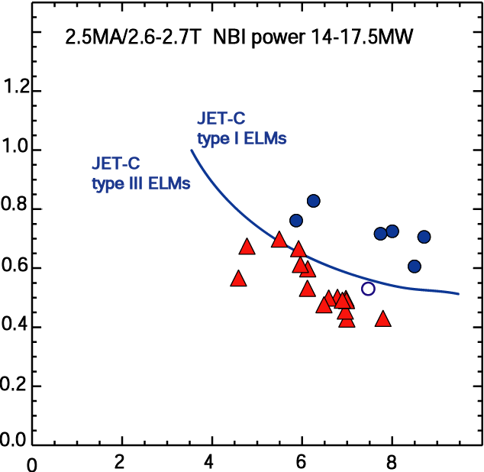
H-mode Pedestal and Impurity Seeding
H-mode pedestal is colder with JET-ILW in comparison to JET-C
JET-C D₂ fuelling
T_{e, ped} [keV]
JET-C D₂ fuelling
JET-ILW D₂ fuelling type I ELMs
JET-ILW D₂ fuelling type I ELMs
JET-ILW D₂ + N₂ seeding
L. Frasinetti P4.072
n_{e,ped} [10¹⁹m⁻³]
C. Giroud IAEA2012
JET-ILW boundary for type I ELM below type III boundary for JET-C
Nitrogen seeding restores pedestal and temperature regime

Slide 27
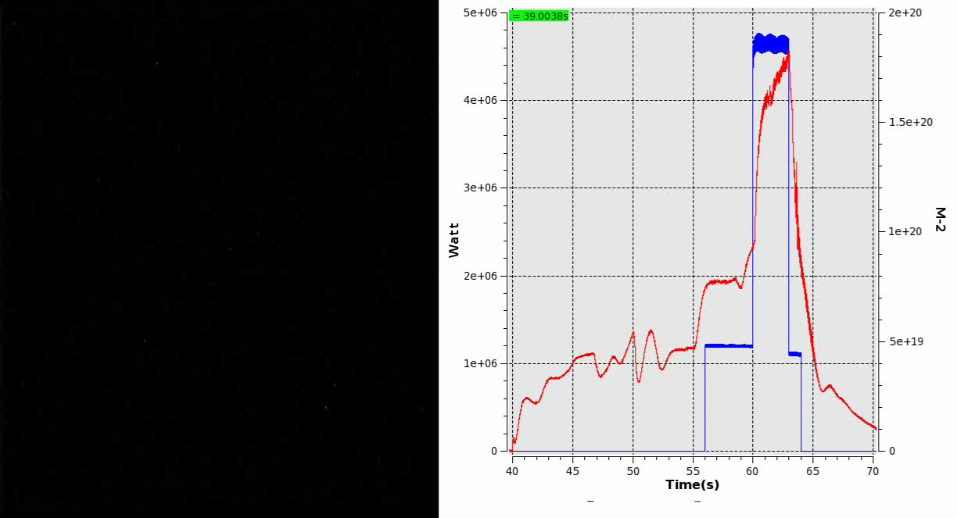
Example: Monitoring Discharge
H-mode
L-mode
ohmic
density
limiter
aux. power
S. Brezinsek
EPS 2012
Identity plasmas repeated regularly to document wall conditions
Monitor status of impurities (Be, C, O, Ar, N, W) with operational time

Slide 28
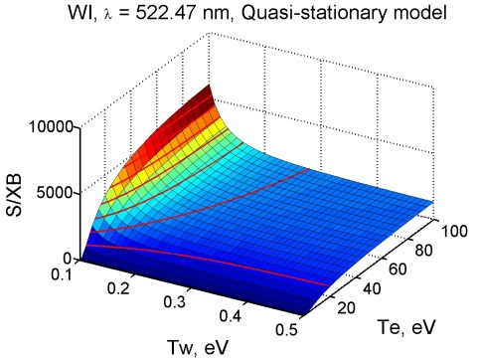
S/XB for WI and WII lines
WI @ 522.5nm
WII @ 434.8nm
Comparison with experimental data from JET
in preparartion
New W data (in ADAS) should be compared
D. Kondratjev GKU

Slide 29

Be Impurities in the Divertor
Measure and simulate initial start-up situation with Be/W material mix
First wall Be erosion by impinging ions => transport in the scrape-off layer
=> deposition in the W divertor => material mixing
Be deposition in both legs, but initial Be contamination from limiter plasmas
Be flux in the divertor after first 1000 plasma seconds
SOL flow
Be net erosion
Ion flux
B×∇B
Separatrix
Vessel walls
deposition
deposition
/ erosion
PFR
BeII 527nm
W divertor target plates
K. Krieger
PSI2012

