Slide 1
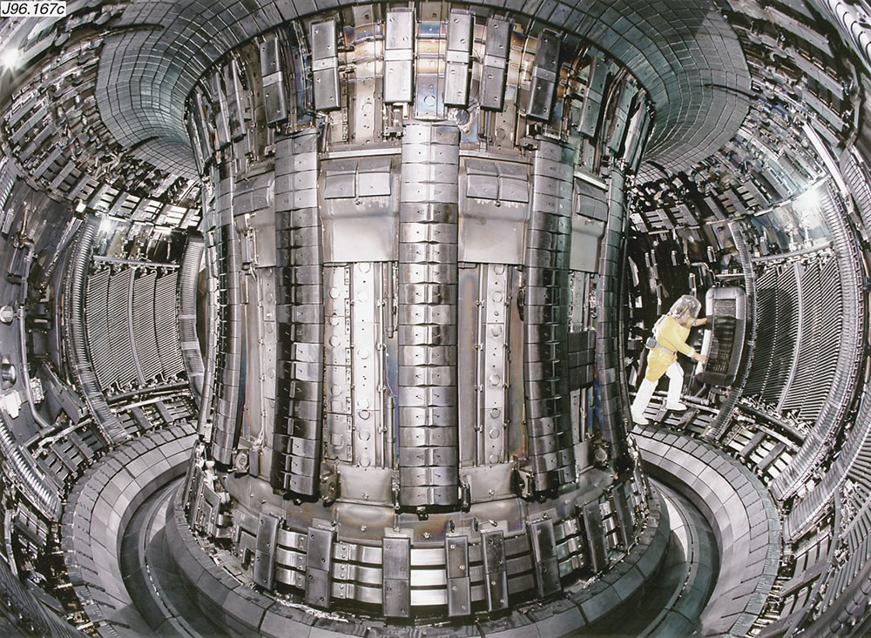
Measuring DR cross sections
Absolute recombination rate coefficients of tungsten ions from storage-ring experiments
Stefan Schippers
Institut für Atom- und Molekülphysik
www.uni-giessen.de/cms/iamp

Slide 2
Outline
Motivation
  Atomic data requirements
  Dielectronic recombination data for tungsten ions
  Charge balance of tungsten in a hot plasma
Dielectronic recombination measurements @ TSR
Results for W^{q+} ions (q=18-21)
Atomic structure of open 4f-shell systems
Comparision with available theoretical results
DR of Fe XVIII Fe17+

Slide 3
Ionization balance in a plasma
ionisation
A^{(q-1)+}
A^{q+}
A^{(q+1)+}
recombination
We need to know rate coeffcients
for
electron-impact ionization
and
electron-ion recombination.

Slide 4
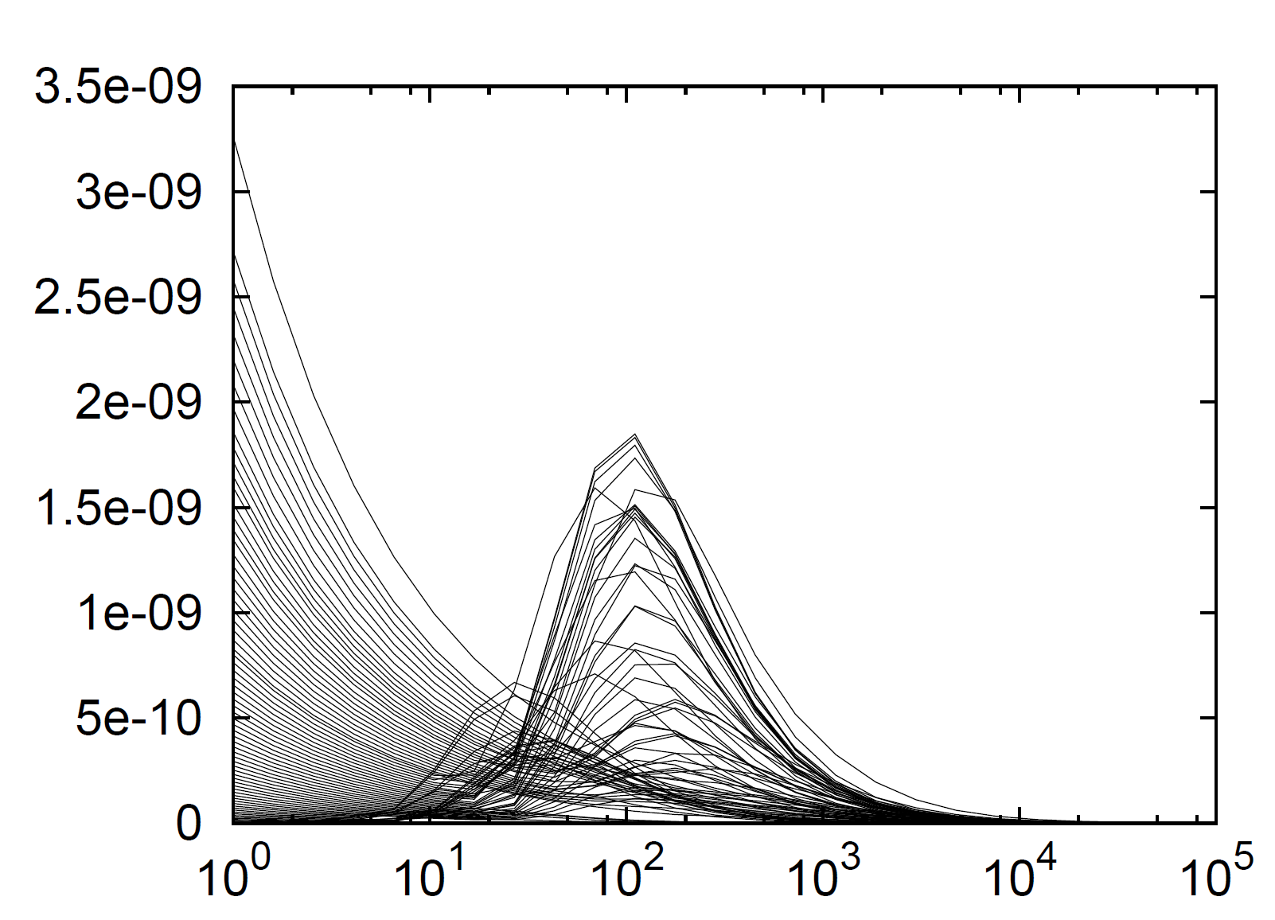
Tungsten DR rate coefficients
ADAS
Atomic Data and Analysis Structure
semi-empirical
(based on Burgess formula)
DR rate coefficient (cm³ s⁻¹)
Temperature (eV)
A. Whiteford, PhD Thesis, University of Strathclyde, UK (2004)
http://www.adas.ac.uk

Slide 5
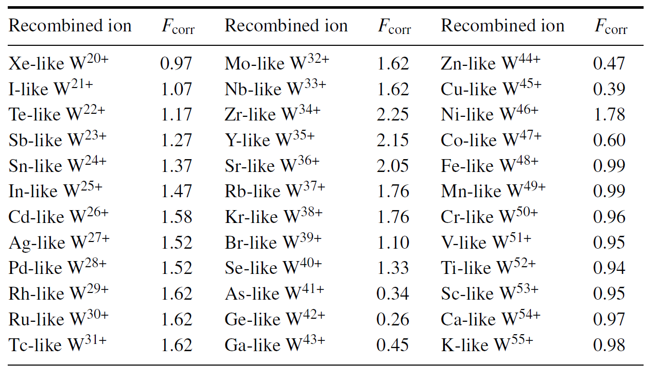
Tungsten DR fudge factors
to bring model calculations into agreement with observations
T. Pütterich et al., Plasma Phys. Control Fusion 50 (2008) 085016

Slide 6
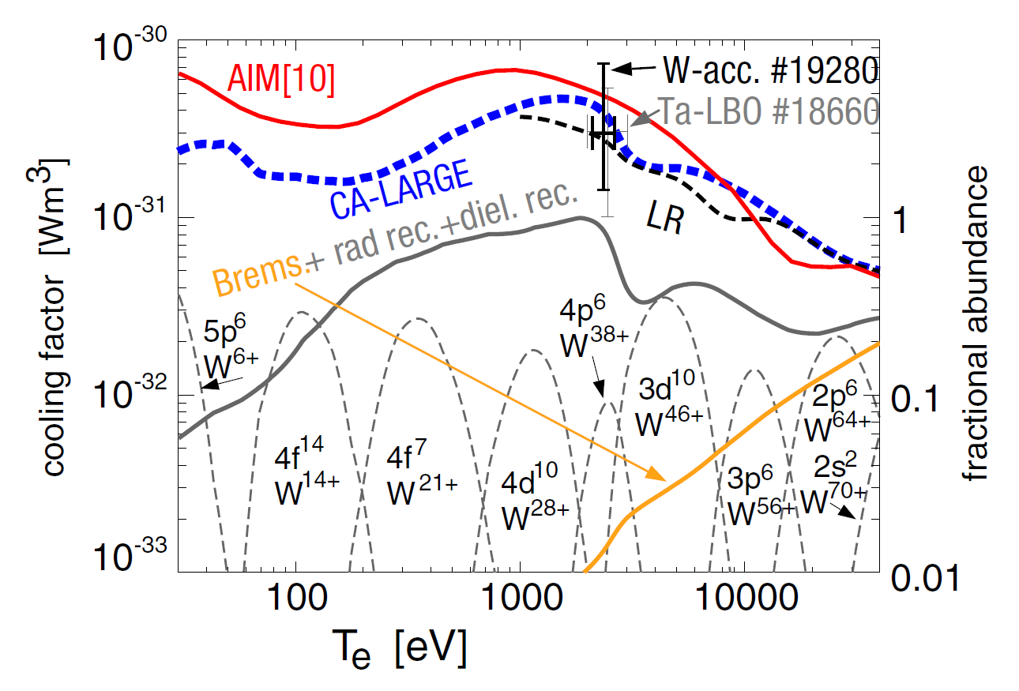
Tungsten ionization balance and cooling factor
T. Pütterich et al., Nuclear Fusion 50 (2010) 025012

Slide 7
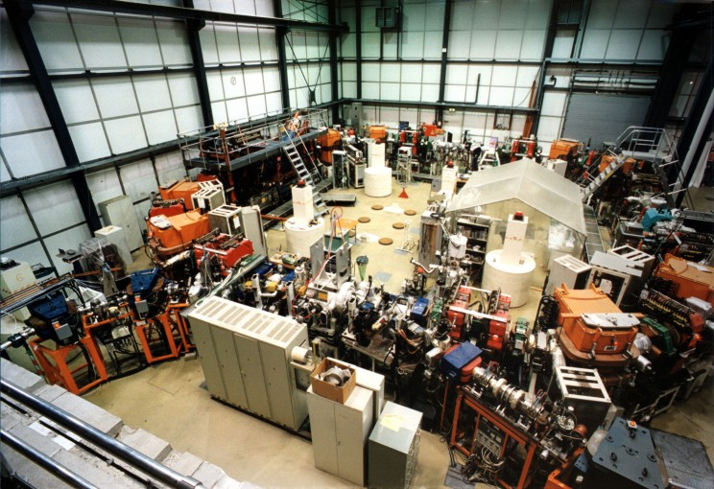
The heavy-ion storage ring TSR at the Heidelberg Max-Planck-Institute for Nuclear Physics

Slide 8
Heavy-ion storage rings
electron cooler
Storage of charged particles in well defined states
  mass
  charge
  velocity
Electron cooling reduces
  diameter of the ion beam
  velocity spread of the ion beam
  internal energy (molecules)
Control of external and internal degrees of freedom

Slide 9
Decay of excited states
Be-like ⁴⁷Ti¹⁸⁺
2s2p ³P₀
decay
Simply wait until
metastable ions
have relaxed to
their ground state.
S. Schippers et al.
PRL 98 (2007) 033001

Slide 10
Reactions e.g. charge changing electron collisions
Reaction products
  beams of high directionality
  high particle energies in lab frame
e⁻ beam
100% detection efficiency
collision experiments with dilute ensembles of particles
tunable relative energy: sub meV to sub MeV
electron-ion recombination
electron-impact ionization of ions
Absolute !!! cross sections and rate coefficients

Slide 11
Recombination of C³⁺
Dielectronic Recombination (DR) resonances
S. Schippers et al.,
ApJ 555 (2001) 1027
Stefan Schippers, 16th ADAS Workshop, Cadarache, France, September 24, 2012
11

Slide 12
What about more complex ions?
for example: W²⁰⁺(4d¹⁰4f⁸)
one-electron 4d or 4f excitations
COWAN code
results

Slide 13
Fine structure excitations
W²⁰⁺(4f⁸ ⁷F₆ → 4f⁸ ^{2S+1}L_{J})
COWAN code
results
293 excited levels
longest-lived are
³O₁₂ : 68 000 s
⁷F₀ : 8 s
⁵L₈ : ~ 2 s
S. Schippers et al.,
PRA 83 (2011) 012711

Slide 14
Density of doubly excited states
W¹⁹⁺(4f⁸ nl) states with n ≤ 72
S. Schippers et al.,
PRA 83 (2011) 012711

Slide 15
DR of Xe-like W²⁰⁺(4f⁸)
factor of 3000
difference
energy
range
of 4f⁸ fine-
structure
excitations
S. Schippers et al.,
PRA 83 (2011) 012711

Slide 16
W²⁰⁺ DR rate coefficient in a plasma
factor of 3000
difference
factor of 4
difference
S. Schippers et al.,
PRA 83 (2011) 012711

Slide 17
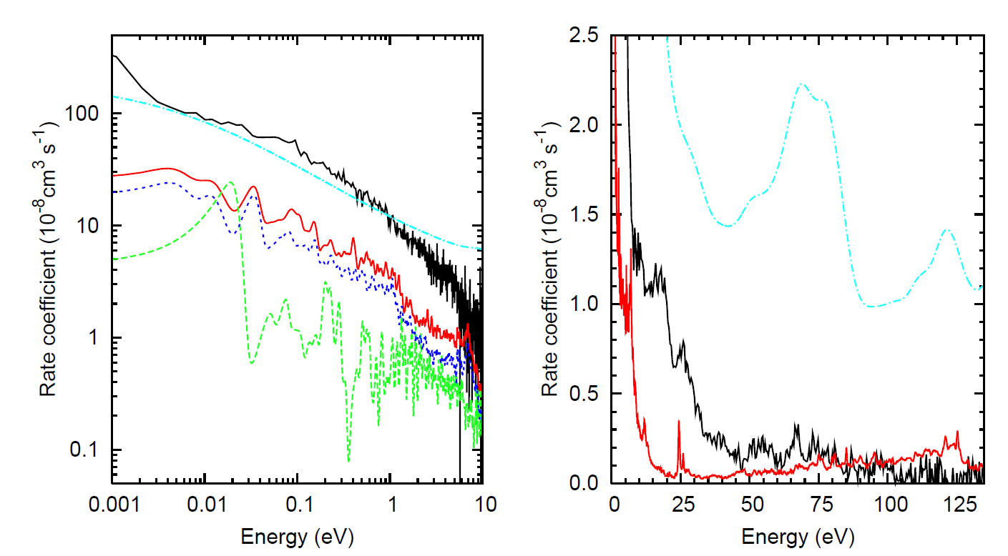
New theoretical W²⁰⁺ DR calculations
statistical approach (full mixing, see also Dzuba et al. PRA 86 (2012) 022714 )
4d→4f contribution (IC)
fine structure included (IC)
TSR
TSR
no fine structure
(LS-coupling)
N. R. Badnell, C. P. Ballance, D. C. Griffin, M. O’Mullane, PRA 85 (2012) 052716

Slide 18
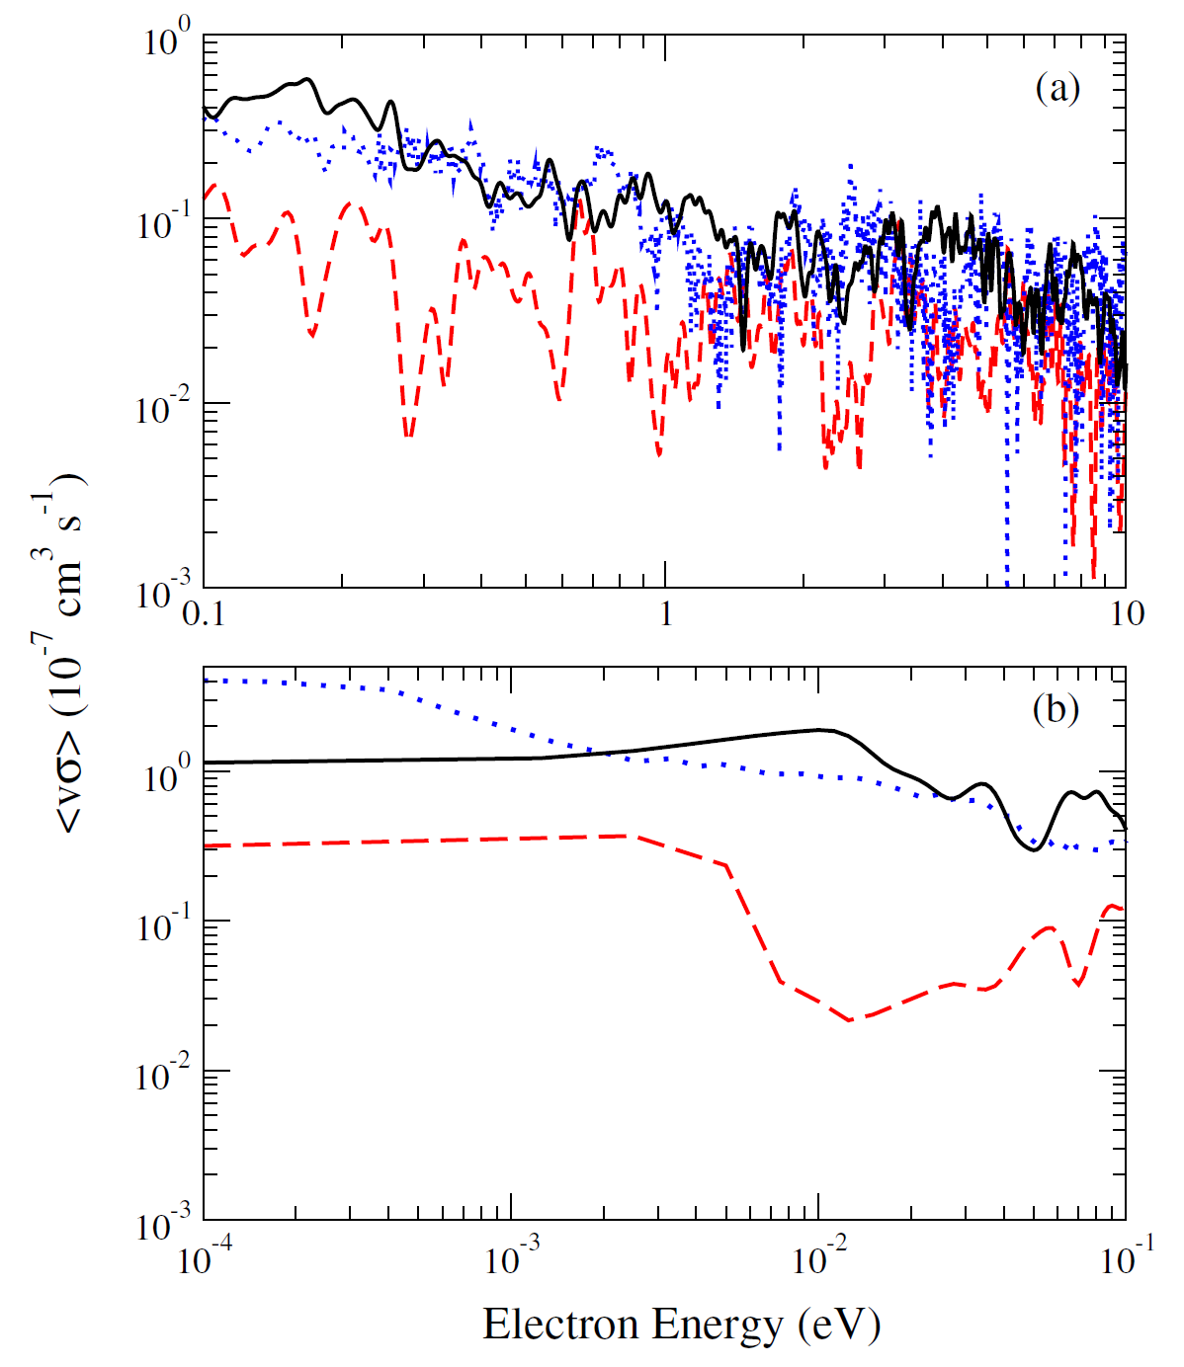
A simpler system: DR of Au²⁰⁺(4f¹³)
TSR
fine structure
included (IC)
TSR
no fine structure
(LS coupling)
C. Ballance et al., JPB 45 (2012) 045001; TSR: S. Schippers et al., Phys. Scr. T144 (2011) 014039

Slide 19
Recombination of W^{q+} (q=18-21)

Slide 20
W^{q+} (q=18-21) recombination in a plasma
K. Spruck et al.
(in preparation)

Slide 21
Conclusions
Tungsten is used as a plasma facing wall-material in tokamak reactors.
Quantitative plasma spectroscopy needs accurate plasma models.
This requires accurate atomic data for tungsten ions.
We measured dielectronic recombination of tungsten ions with open 4f shell.
DR rate coefficients are found to be significantly larger than those from ADAS.
Strong many-body effects make theoretical calculations difficult.
Even new large-scale calculations do not agree with experiment.
Novel theoretical approaches are being developed (statistical theory).

Slide 22



Collaborators & Funding
ADAS-EU
K. Spruck, D. Bernhardt, A. Müller
IAMP, Justus-Liebig-Universität Giessen
M. Lestinsky
GSI Helmholtzzentrum für Schwerionenforschung
M. Hahn, O. Novotný, D. W. Savin
Columbia Astrophysics Laboratory, Columbia University, New York
A. Becker, M. Grieser, C. Krantz, R. Repnow, and A. Wolf
MPI für Kernphysik, Heidelberg, Germany
Stefan Schippers, 16th ADAS Workshop, Cadarache, France, September 24, 2012
22

