Slide 1
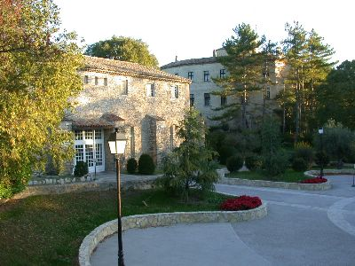

DR Calculations for M-Shell Ions
ADAS Workshop 2012
Tom Gorczyca
Oleg Zatsarinny
Jun Fu
Dragan Nikolic
Fatih Hasoglu
Shahin Abdel Naby

Slide 2



N. R. Badnell
M. G. O’Mullane
H. P. Summers
UK
M. S. Pindzola
S. D. Loch
J. Colgan (LANL)
D. M. Mitnik
T. W. Gorczyca
K. T. Korista
M. A. Bautista
O. Zatsarinny (DU)
D. Nikolić (NINT)
J. Fu
Shahin Abdel Naby
DR Project
Z. Altun
A. Yumak
Turkey

Slide 3
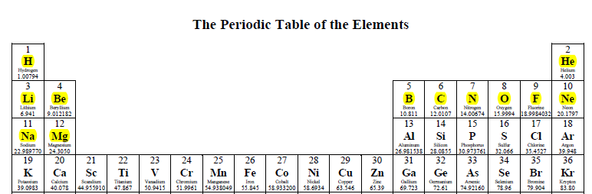

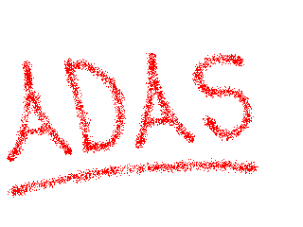
Status of the DR Project
Level-resolved DR rate coefficients for H-like through Mg-like
isoelectronic sequences have been computed.
The state-of-the-art AUTOSTRUCTURE package has been used.
For each sequence, calculations were performed up to Zn and we included
other heavy ions such as Kr, Mo, and Xe.
The Controlled Fusion Atomic Data Center
http://www-cfadc.phy.ornl.gov//data_and_codes
ADAS Atomic data and analysis structure
http://amdpp.phys.strath.ac.uk/tamoc/DATA/

Slide 4
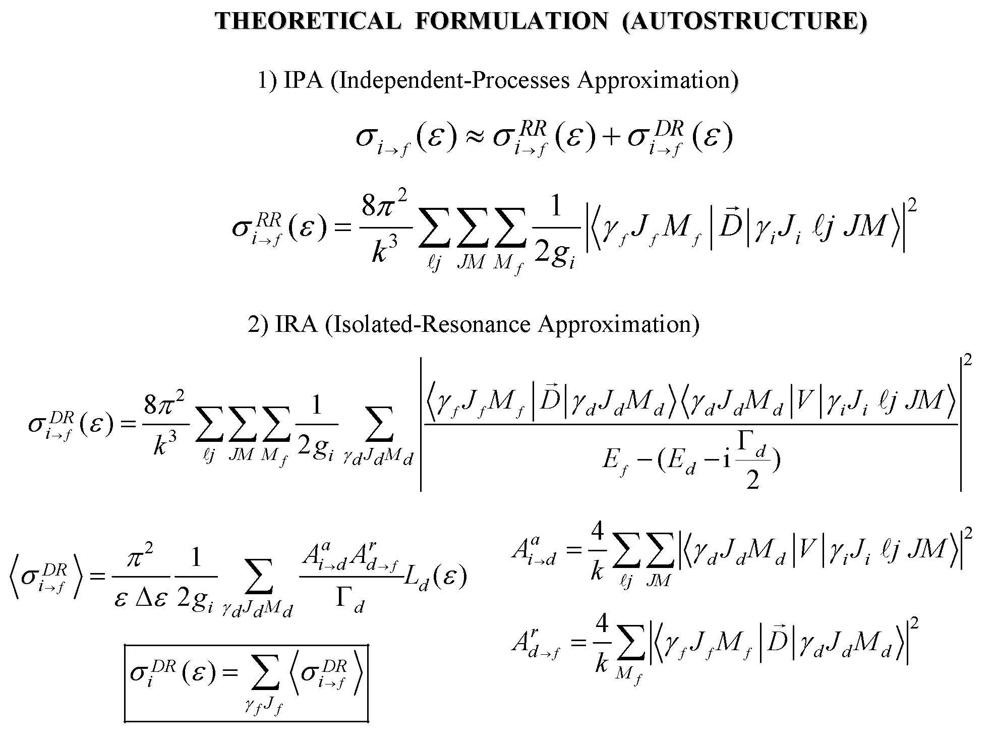

Slide 5
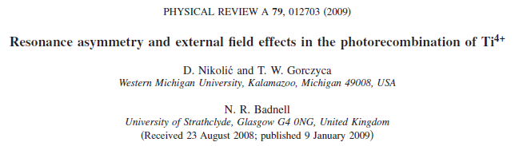
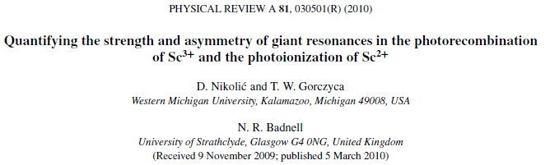
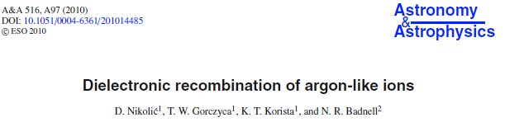
Ar-Like DR

Slide 6
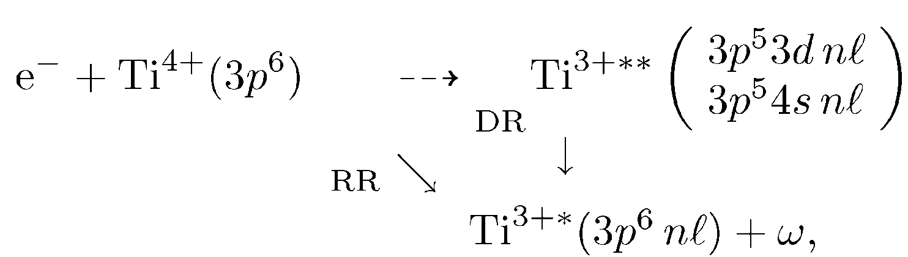
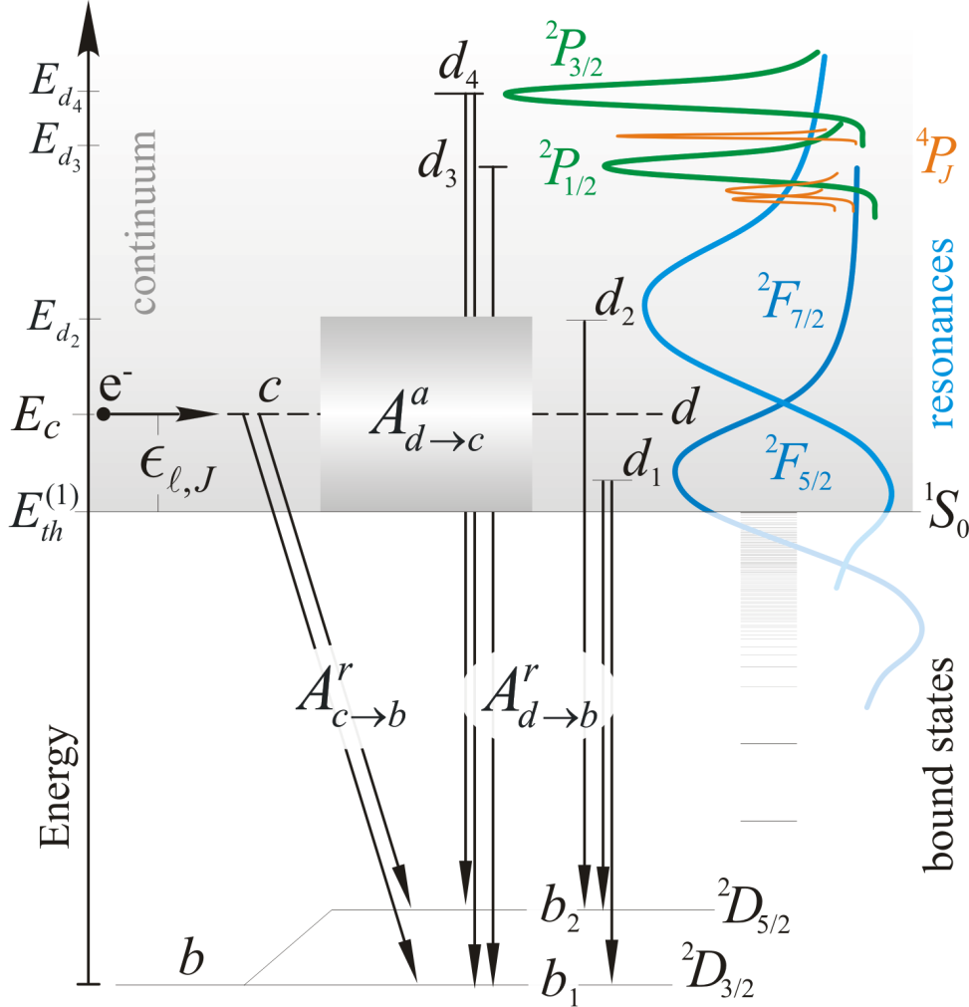
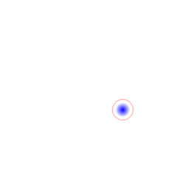
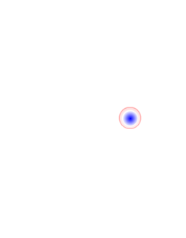
Description of Photorecombination
two near-threshold resonances

Slide 7
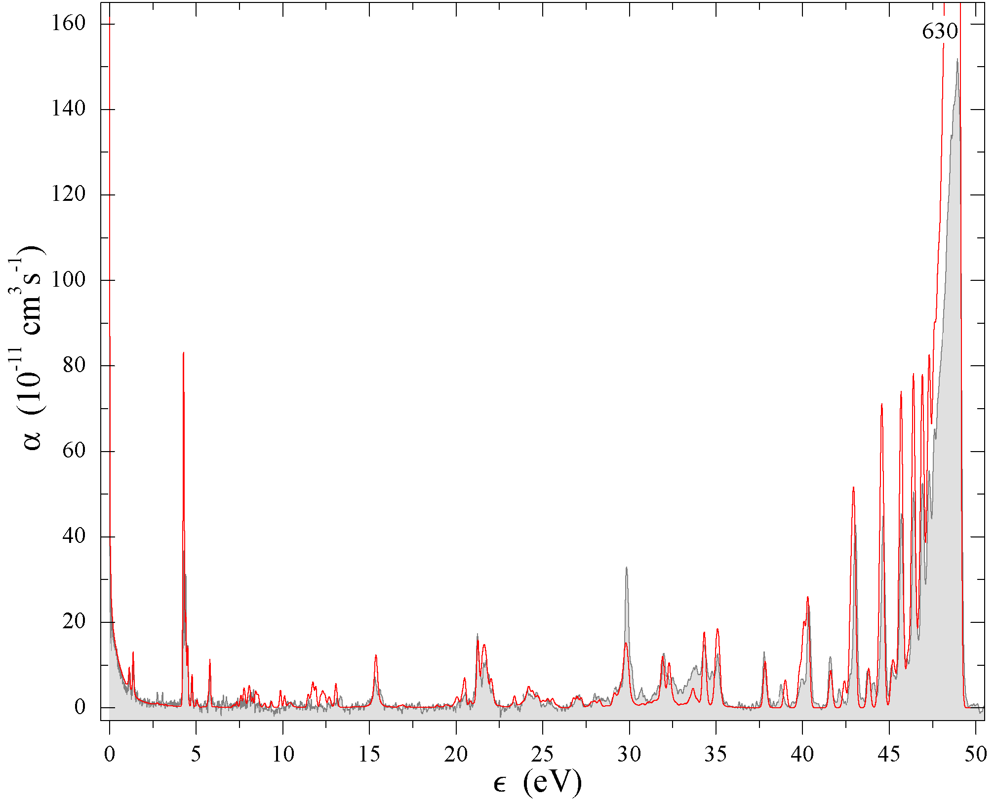
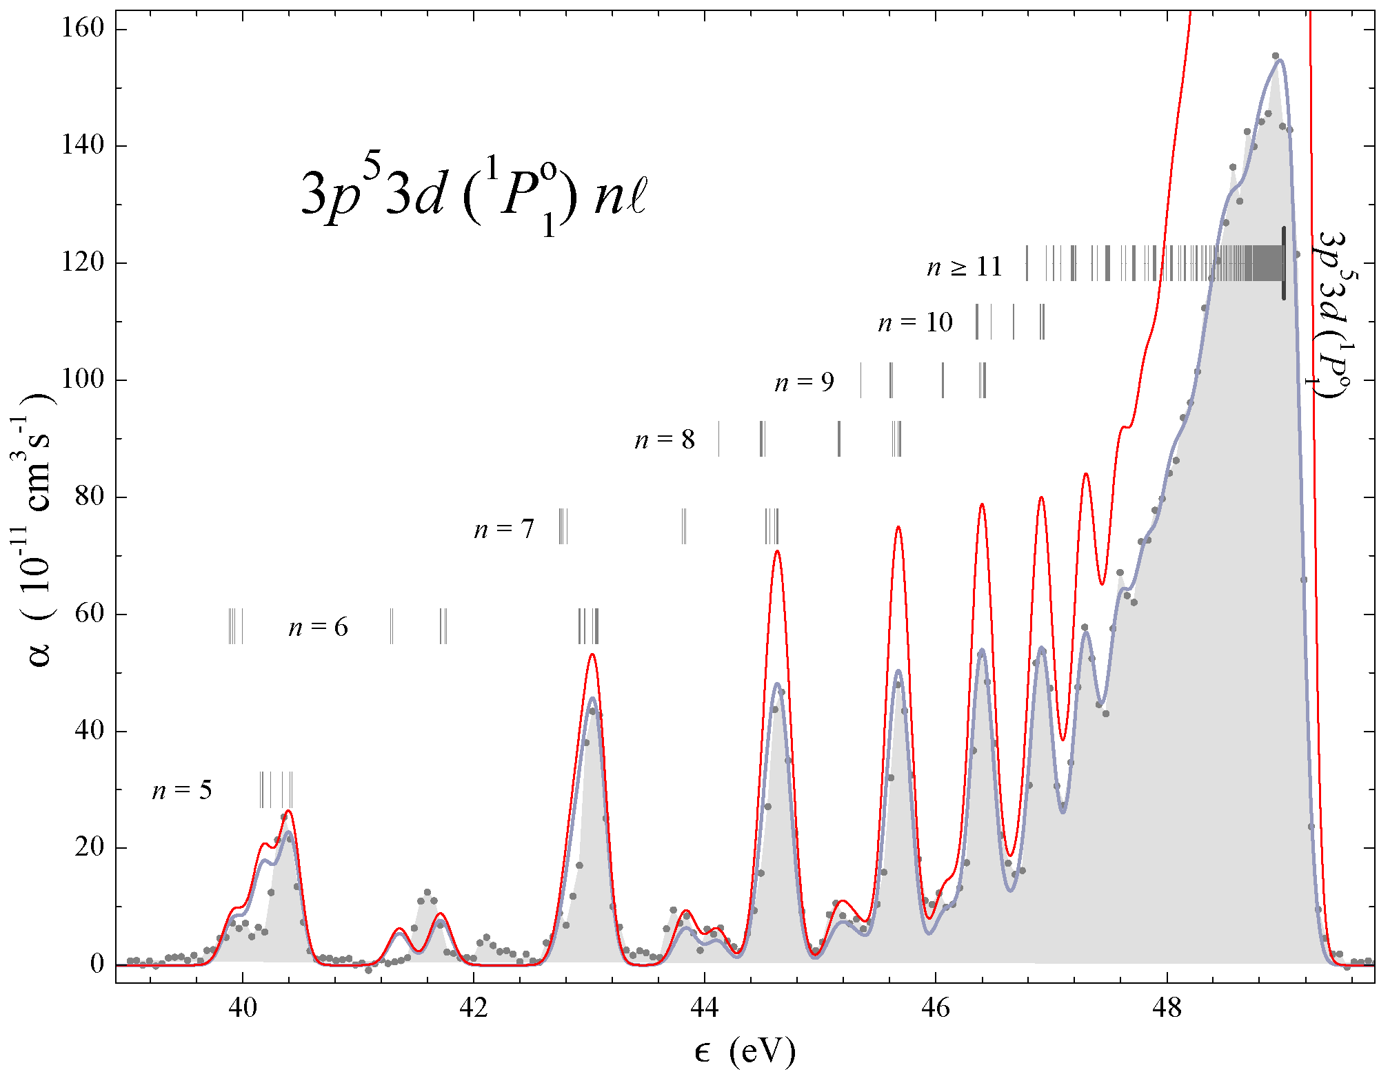
TSR Heidelberg
Experiment
Ti⁴⁺
J. Phys. B 31, 4873 (1998)

Slide 8
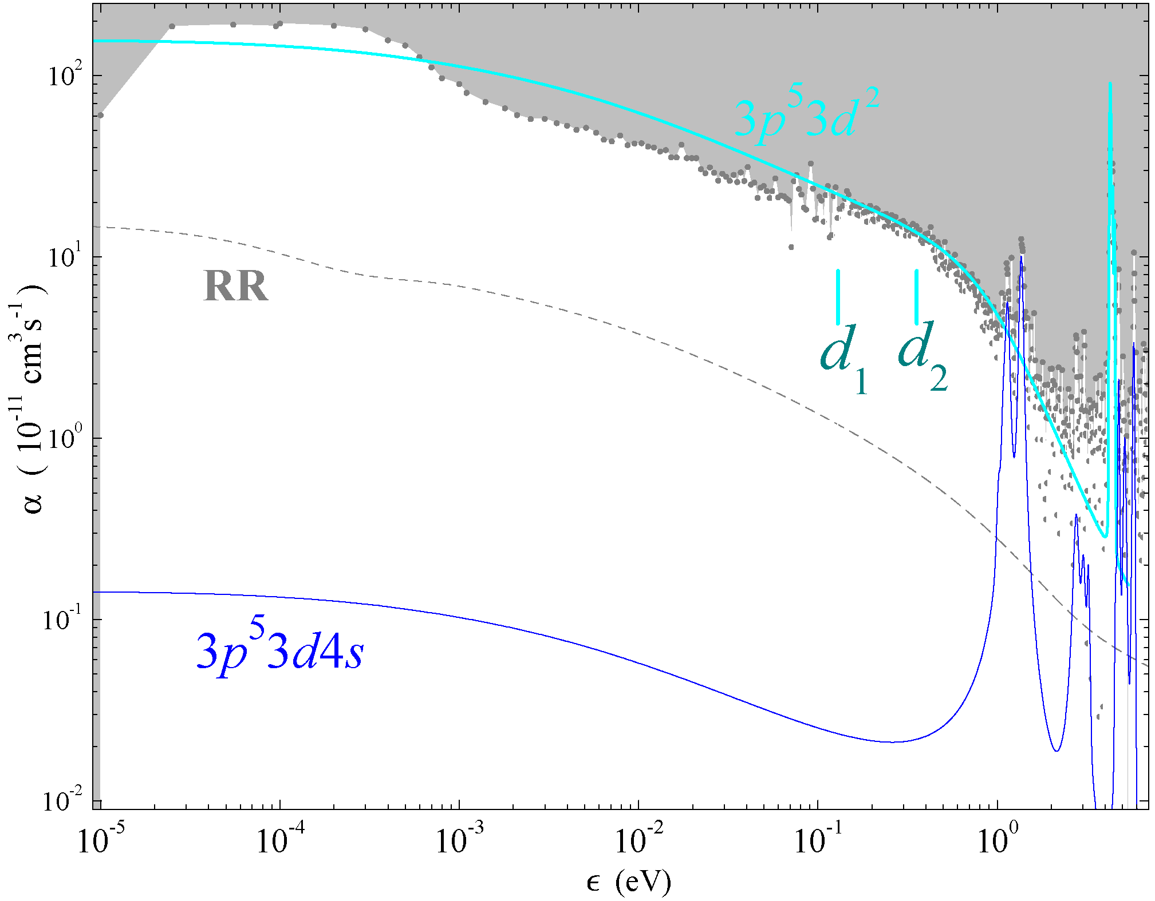
TSR Heidelberg
Experiment
Ti⁴⁺

Slide 9
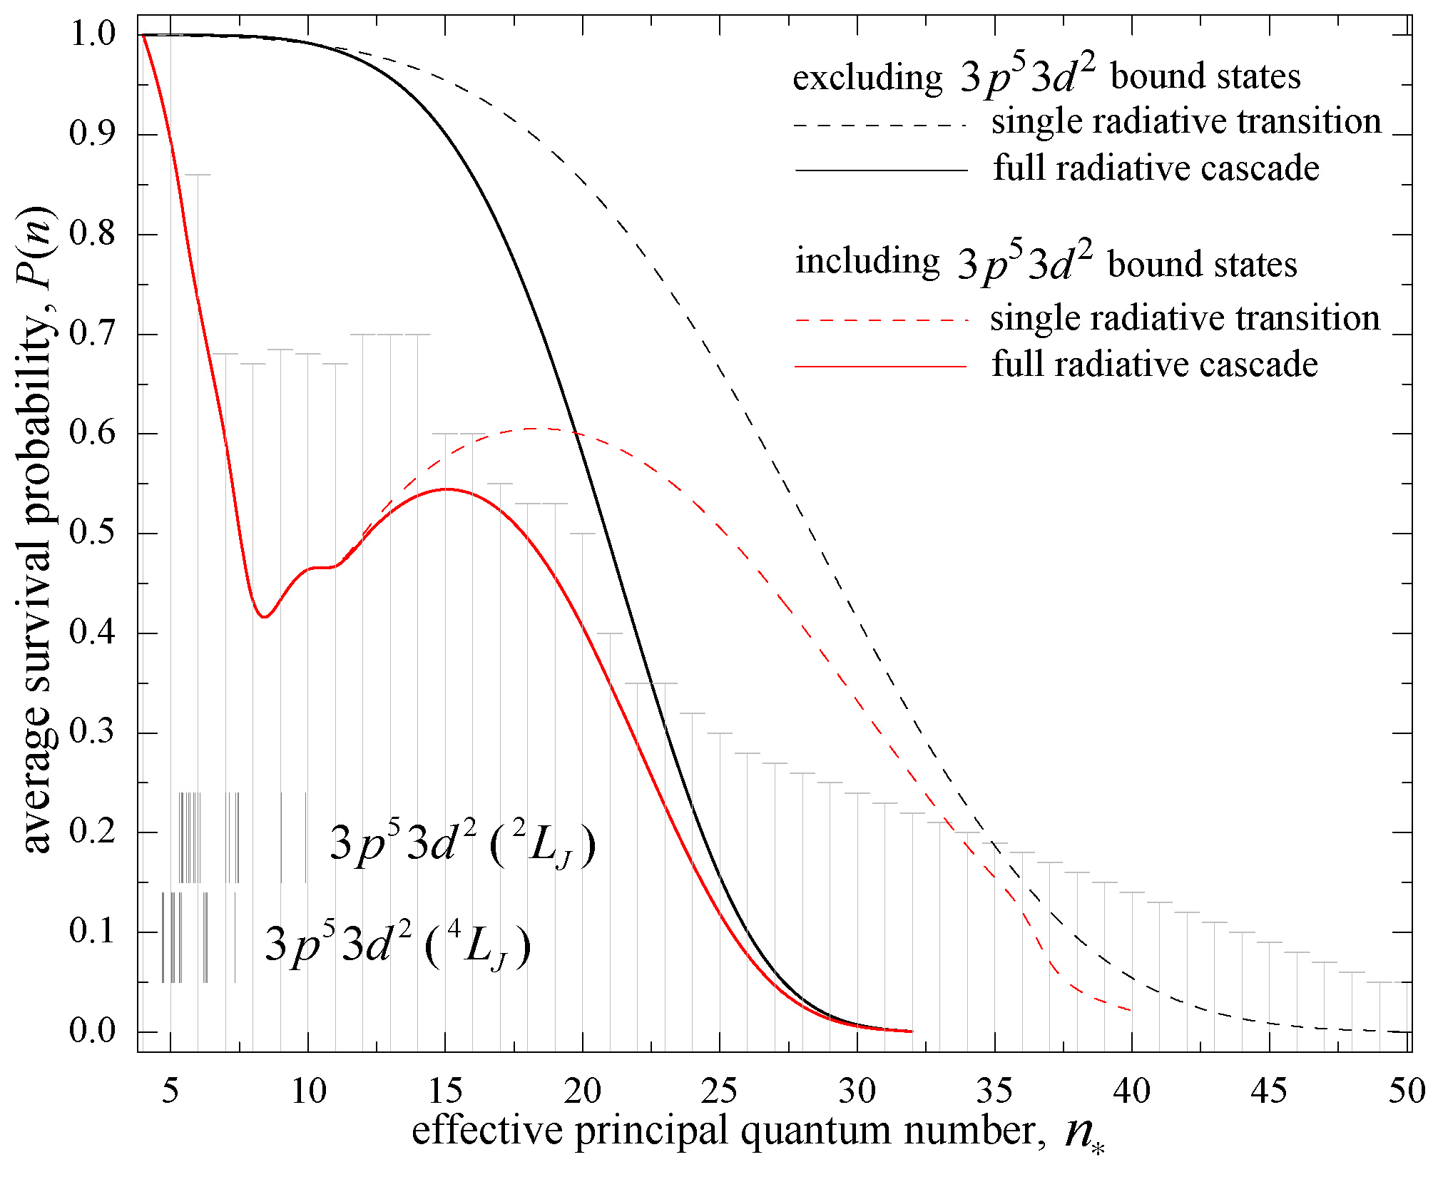
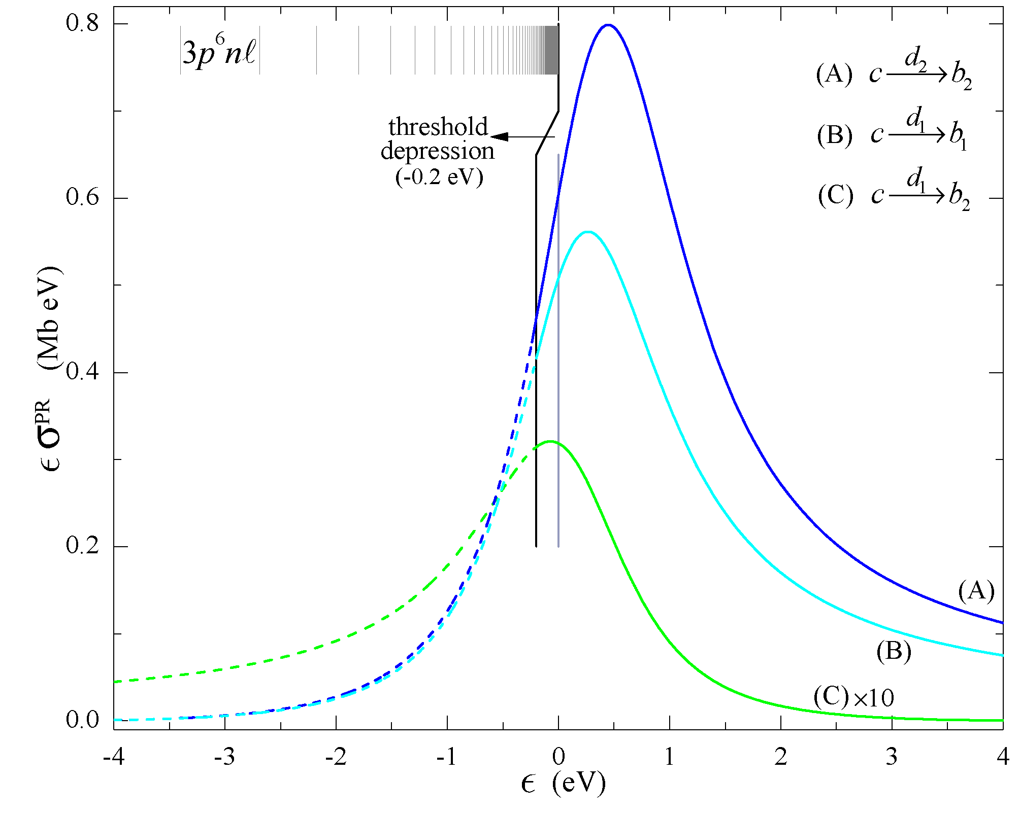
Forced Ionization
AUTOSTRUCTURE
Ti⁴⁺

Slide 10
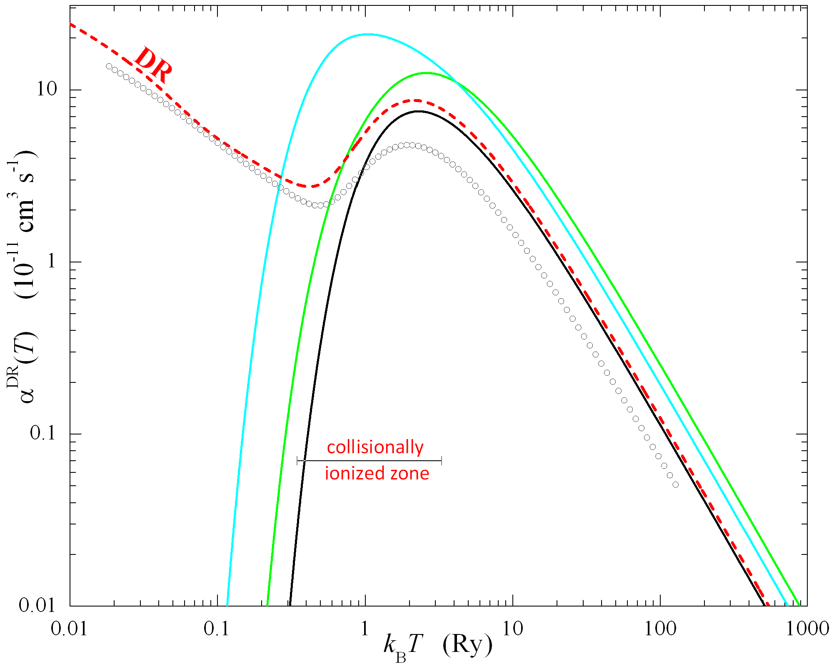
TSR Heidelberg
Experiment
Ti⁴⁺

Slide 11
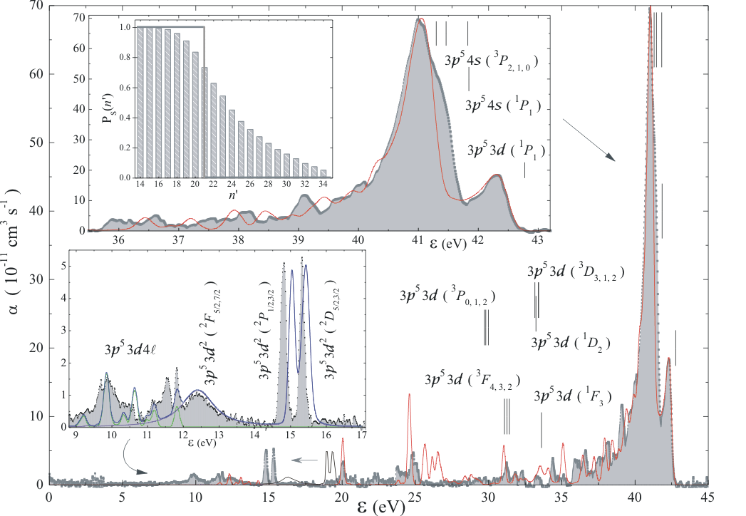
TSR Heidelberg
Experiment
Sc³⁺
PRA 65, 042723 (2002)

Slide 12
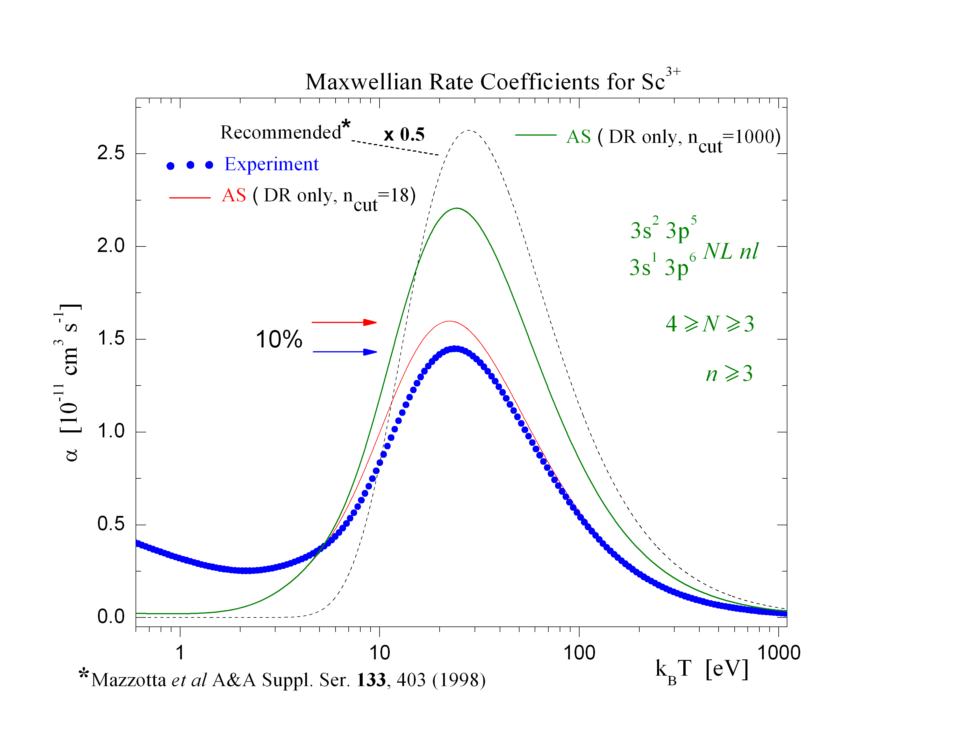
21)

Slide 13
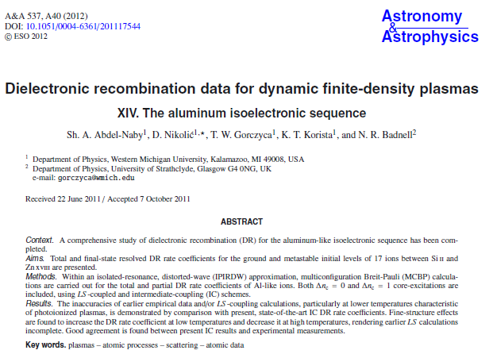

Slide 14
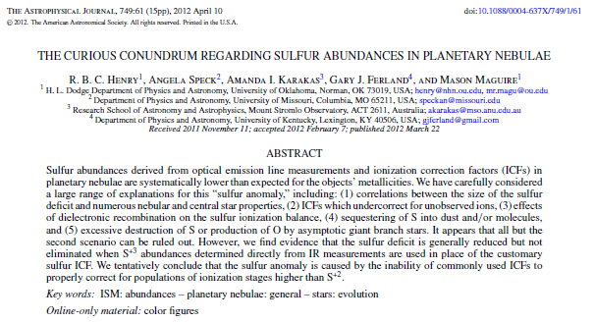
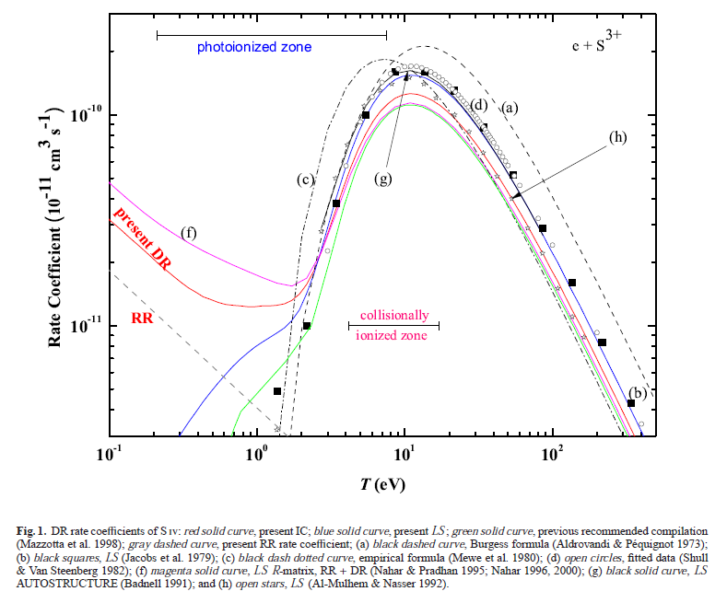

Slide 15
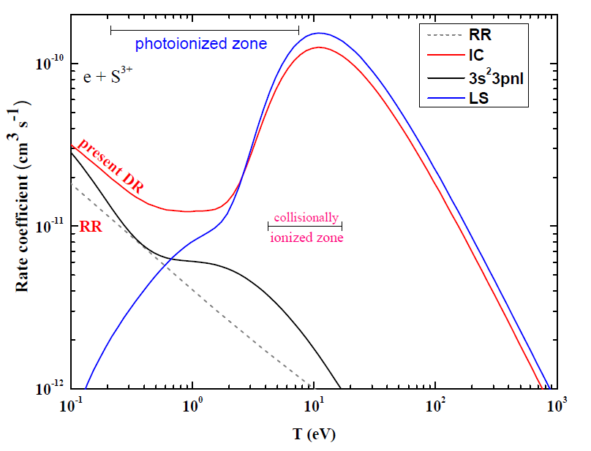
DR Rate Coefficient for S³⁺
At low T, the contributions from 3s²3pnl core relaxation is forbidden in
LS-coupling.
Why α^{DR} for IC-coupling is reduced?

Slide 16
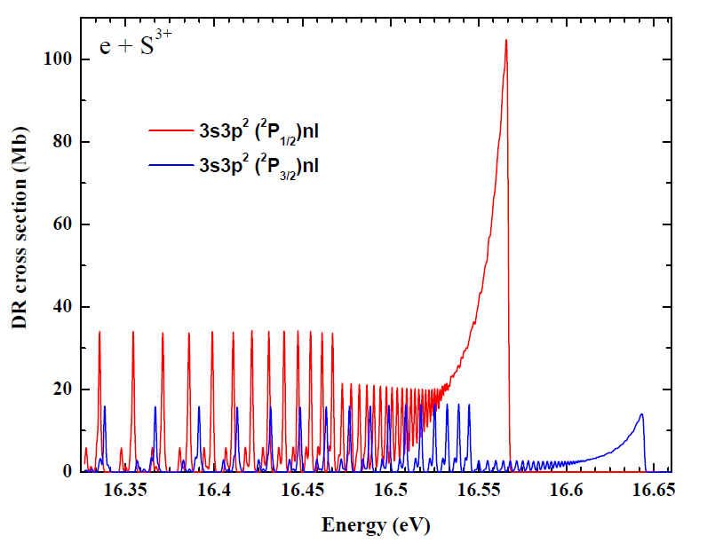

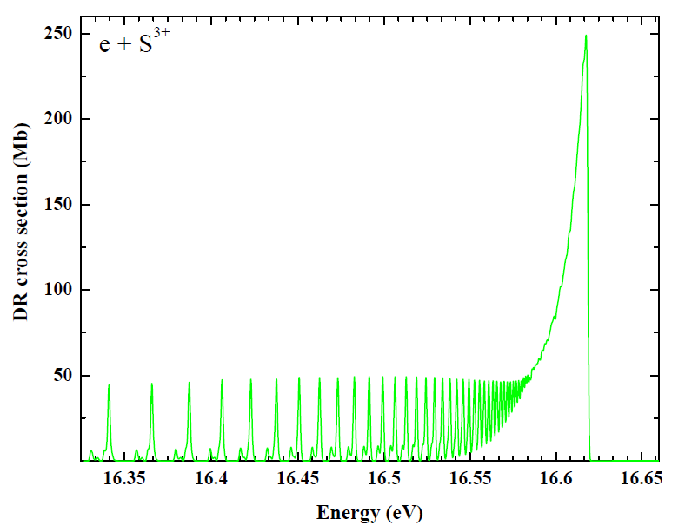
3s → 3p excitation
n=36
IC
The reduction in the σ^{DR} occurs at n=36 for both 3s3p²(²P_{1/2}, _{3/2})nℓ which is reflected in α^{DR}.
Such reduction doesn’t exist in LS coupling
3s3p² ²Pnℓ
LS
FWHM=1.2 meV

Slide 17

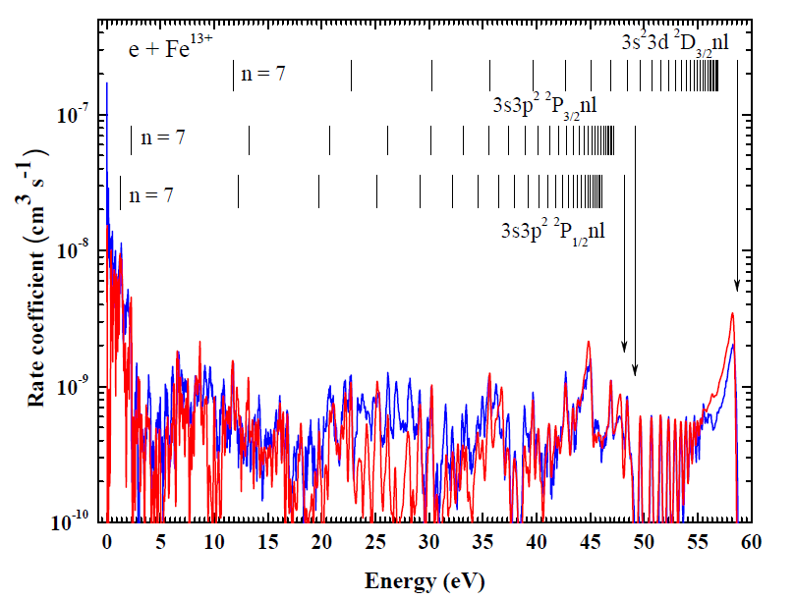
DR Rate Coefficient for Fe¹³⁺
kT║ = 0.09meV
____ Theory
____ TSR Experiment¹
¹ E. W. Schmidt et al, ApJ 641, L157-60 (2006).
ncut ≤ 95, ℓ ≤ 8
Notes:
3s23p 2P_{3/1}nl, 3s3p2 4P_{3/2}9f, 3s3p3d5g, 3p23dnl, 3s3d2nl

Slide 18
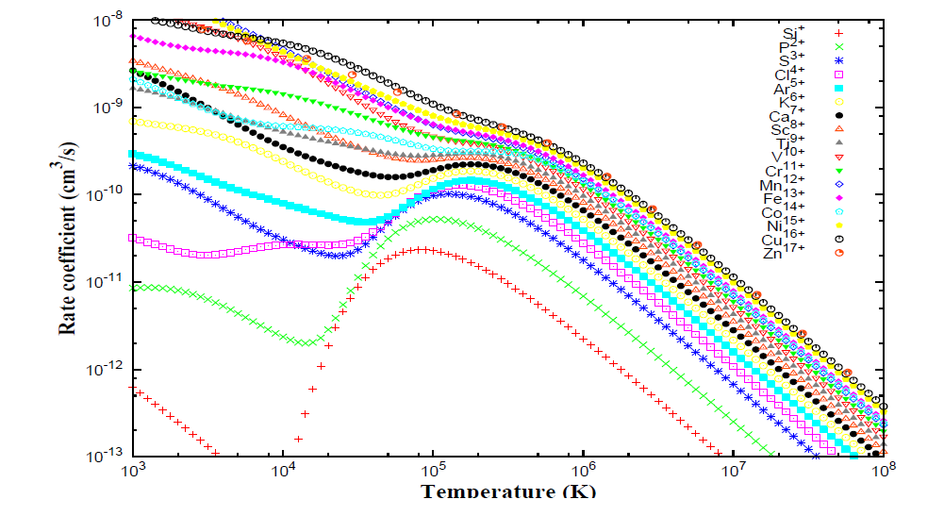
DR Rate Coefficient for Al-like Ions

Slide 19
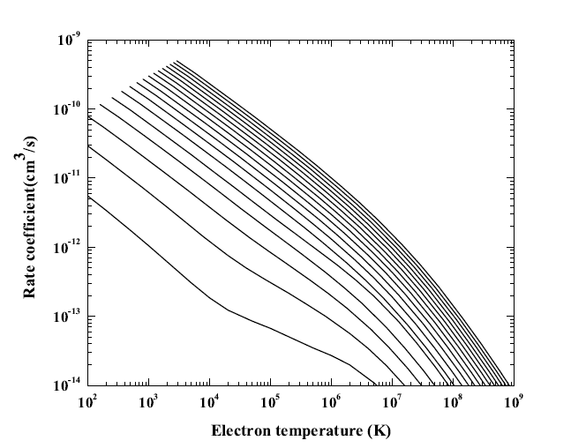
Zn¹⁷⁺
P²⁺
S³⁺
Si⁺
Total ground state RR rate coefficients for the Al-like isoelectronic sequence using AUTOSTRUCTURE package. Curves from Si to Zn are shown from left to right.

Slide 20
Thank You

