Slide 1


Atomic Structure (mainly tungsten) Studies at the Shanghai EBIT Laboratory
Roger Hutton, on behalf of the Shanghai EBIT laboratory.
Shanghai EBIT, Laboratory, Modern Physics Institute, Fudan University.
The Key Lab. of Applied Ion Beam Physics, Ministry of Education, China.
ADAS workshop, September 3rd 2013, Bad Honnef

Slide 2
Outline:
What is an Electron Beam Ion Trap (EBIT) and the EBITs in Shanghai
Tungsten Spectroscopy
Magnetic Sensitive Lines
Summary

Slide 3
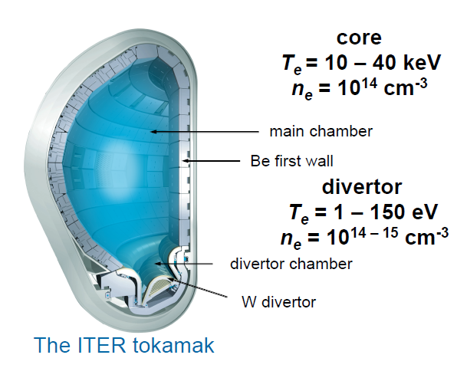
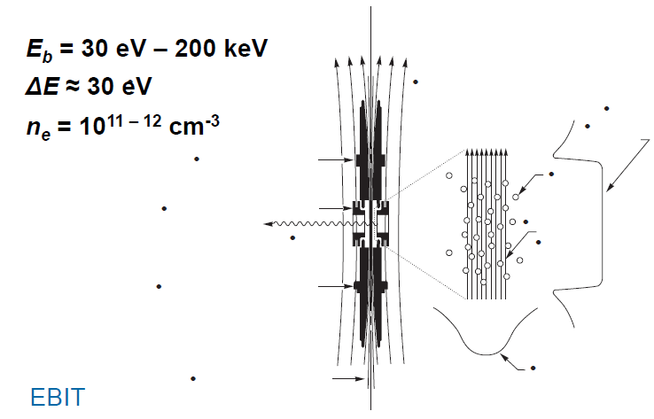
EBIT vs Magnetic Confinement Fusion Plasmas
EBIT and magnetic fusion plasmas have fairly similar densities similar spectral emission
Magnetic fusion plasmas often have several ion species – EBIT plasmas have one or a few
In fusion plasmas numerous atomic processes interact – EBITs can isolate these processes
Fusion plasmas have bulk motions and high temperatures – EBIT plasmas are cold and stationary
Courtesy Joel Clementsson, LLNL EBIT and now Greifswald

Slide 4



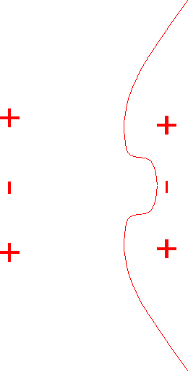








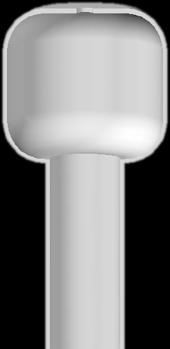
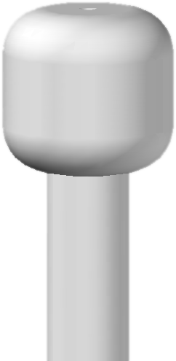





Electron Beam Ion Trap
Before EBIT, ions with charge states higher than 30 could be produced only by few high energy accelerators (100MUSD).
EBIT can easily produce these ions.
Basically it can produce any charge state of any element (MUSD).
EBIT is an excellent machine both as a light source and ion source of HCI.

Slide 5
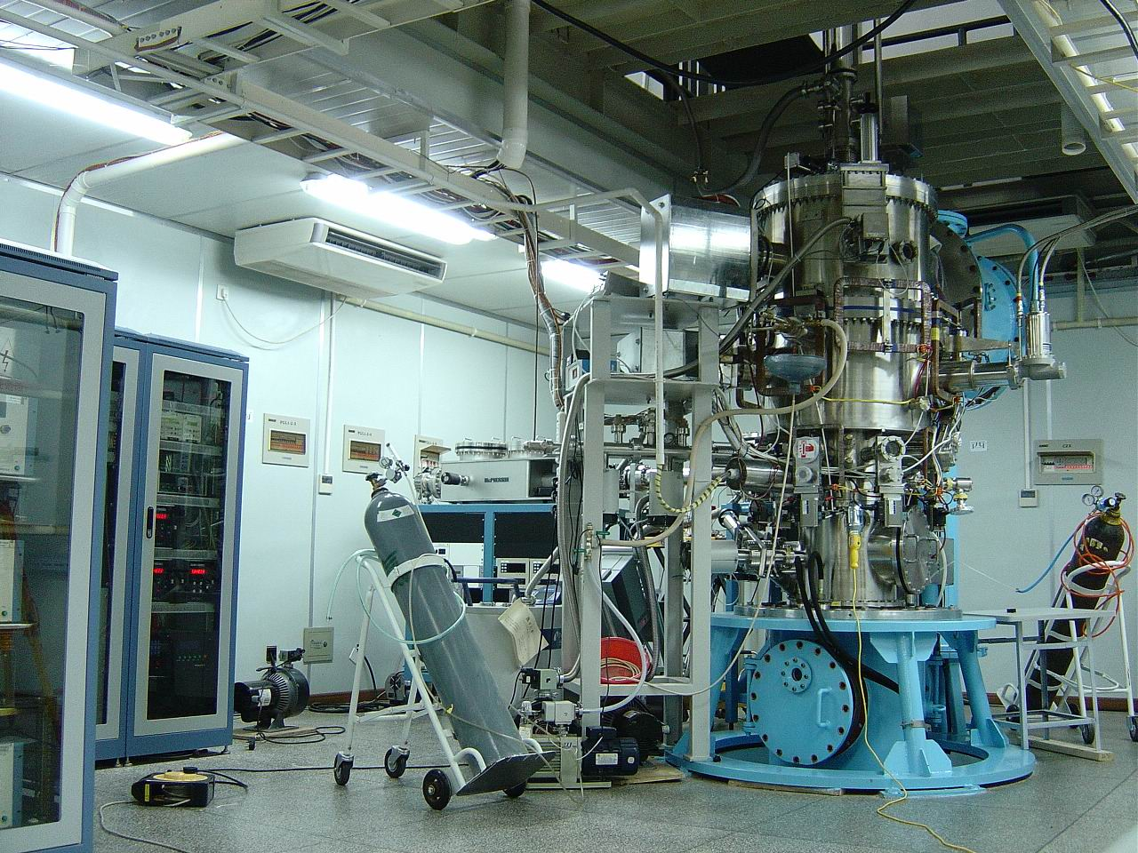
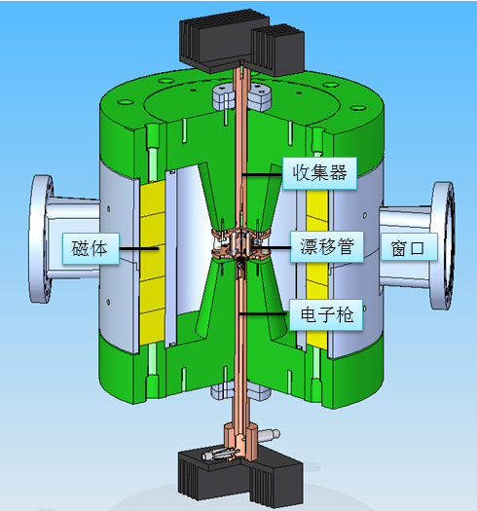
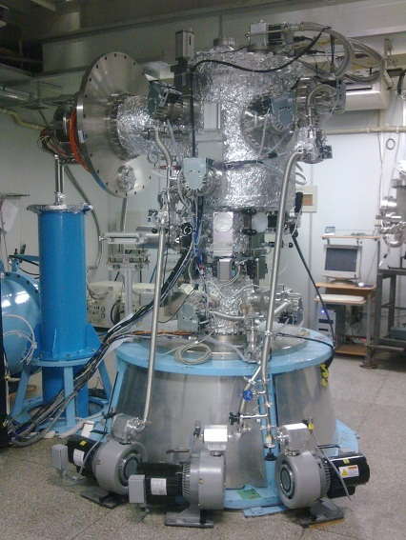
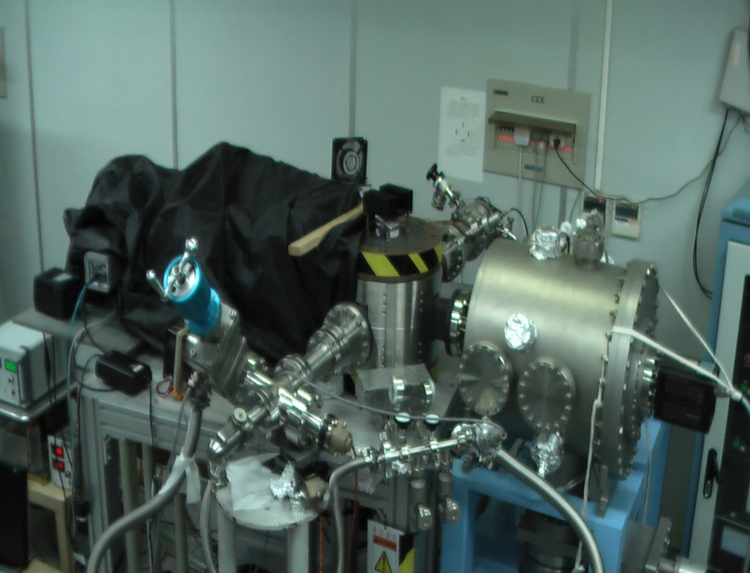
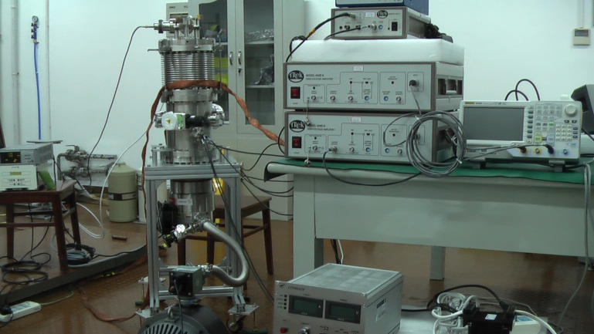
The Shanghai Electron Beam Ion Traps
The original
Permanent magnet EBIT
The new
one
High temperature superconducting
EBIT

Slide 6
超低能量EBIT
目标：为ITER
边界等离子体的分解研究服务
国家 | 名称 | 最能极限
日本 | Cobit | 150eV
德国 | FLASH-EBIT | 105eV
德国 | Berlin-EBIT | 190eV
美国 | Livermore EBIT | 140eV
中国 中国 | SH-PermEBIT SH-HtscEBIT | 60eV 30eV

Slide 7
Tungsten Spectroscopy
Why we need to worry about Tungsten spectroscopy ?
Developing an efficient cleaning method for layer removal, or trying to omit carbon as PFM.
The second approach would also be the suitable one for a future reactor, as the high C erosion itself is also not tolerable.
At the moment, the only material solutions for the first wall armor seem to be tungsten as a coating on low activation steel, or low activation steel alone.
Tungsten as a plasma facing material in fusion devices
Habilitationsschrift by Rudi Nue (2003).

Slide 8
How much is known concerning the spectroscopy of Tungsten
The figure is from 1989 and of course the situation is a little better now.

Slide 9
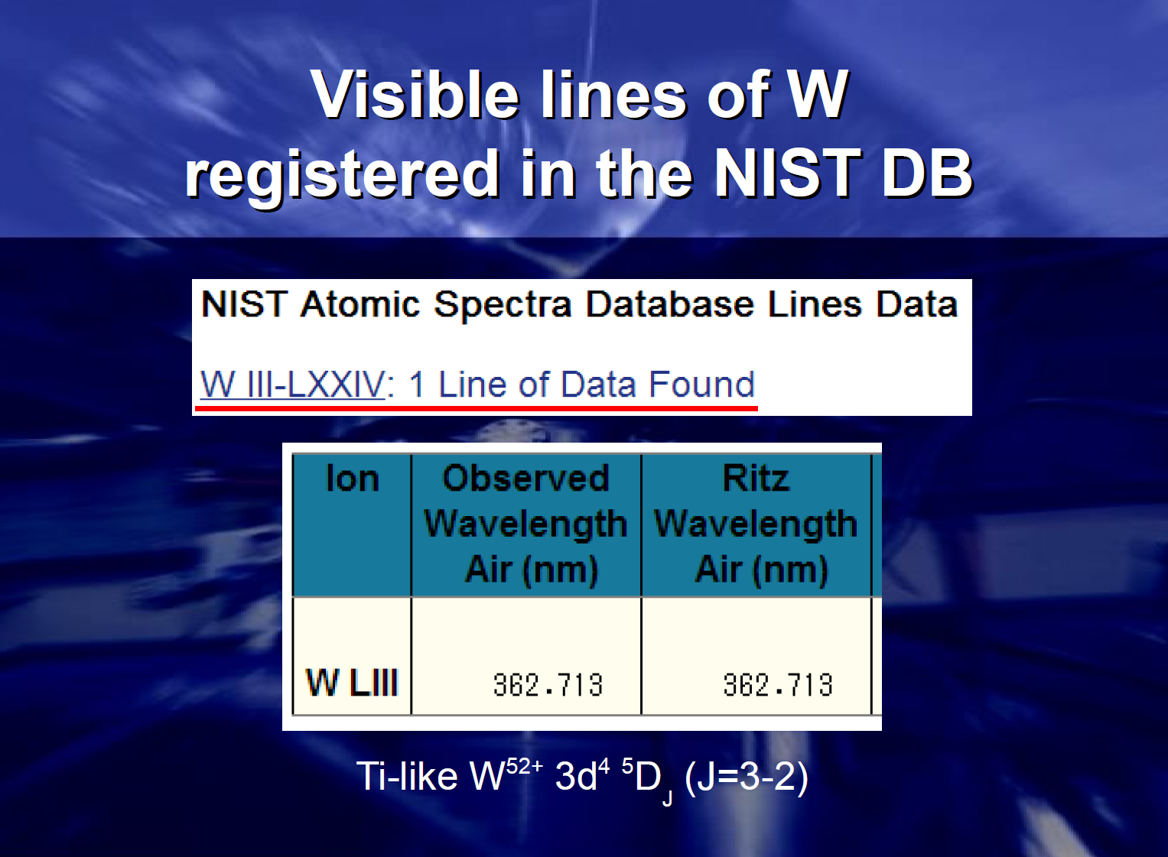
Tungsten and the NIST data tables
N. Nakamura at the International Conference on Atomic and Molecular Data, NIST, 2012
The “bottom line” is that not enough is known about
Tungsten spectroscopy

Slide 10
Our Tungsten work
So much data missing and needed, where to start ?
W²⁷⁺ (Ag-like) has a fairly simply ground state configuration 4d¹⁰4f which gives a ²F term and a magnetic dipole transition between the ²F_{5/2} and ²F_{7/2} levels.
Visible transition
b) Relatively simple atomic structure
c) Sufficient confusion in the literature and reasons to doubt the fine structure energy value quoted in the review by Kramida and Shirai

Slide 11
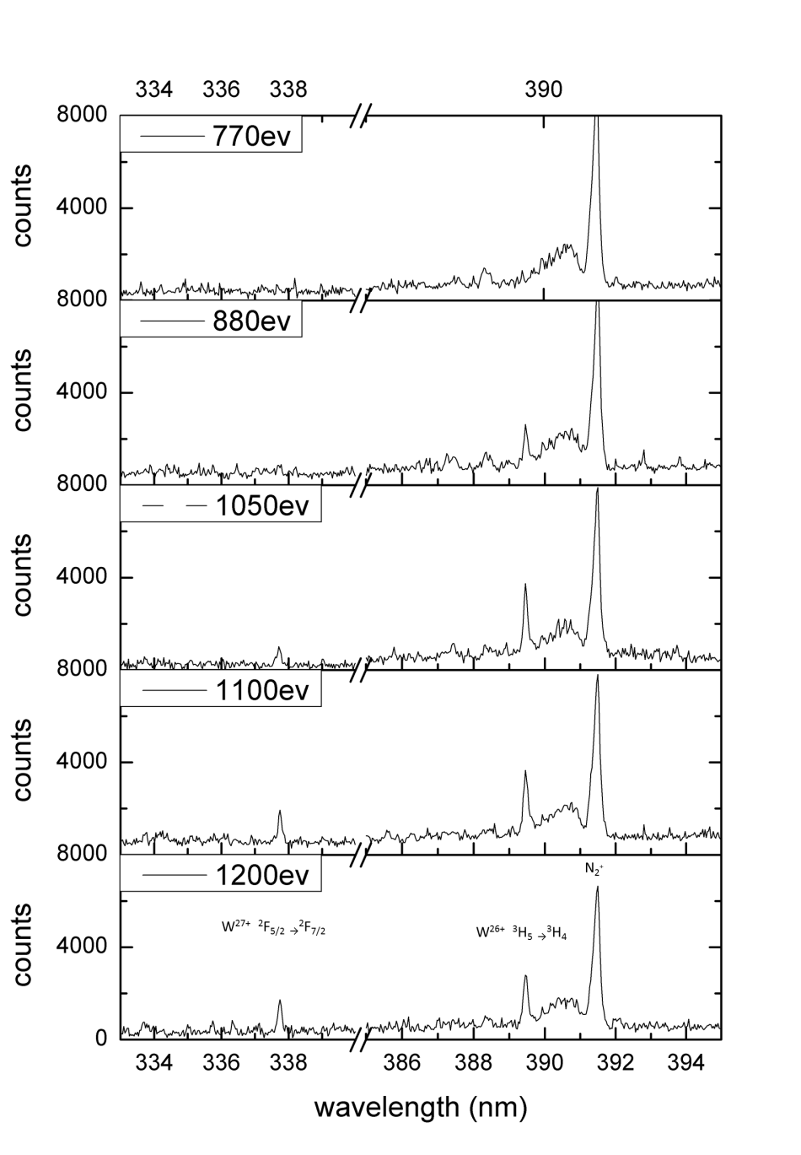
W²⁷⁺ spectroscopy
Visible spectra taken at the SH-Permanent magnet EBIT.
The electron beam energies used were 770, 880, 1050, 1100, and 1200 eV with the beam current of 5.5 mA.
W was injecting into the EBIT using the volatile compound W(CO)₆.
The W²⁷⁺ ²F_{5/2}→²F_{7/2} M1 line can be seen to appear between 337 and 338 nm.
The line between 389 and 390nm is from W²⁶⁺ and the line at 391.44 nm is a very strong N₂⁺ line, from the residual gas inside the EBIT trap.
W²⁷⁺

Slide 12
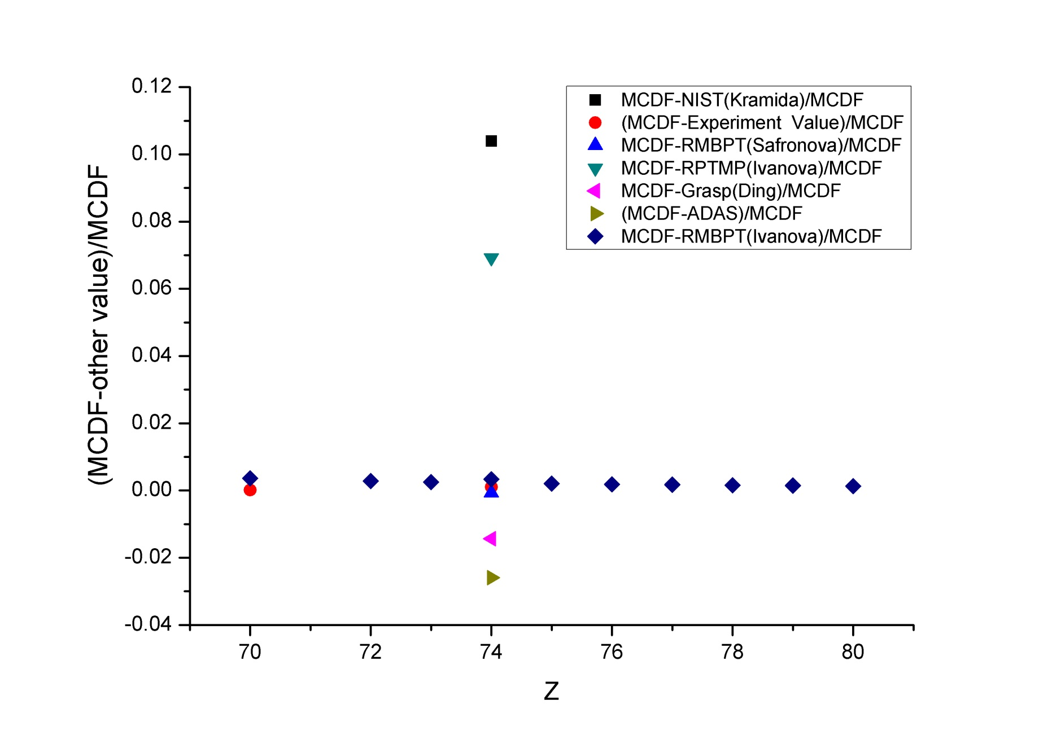
Iso-electronic study of the M1 transition in Ag-like ions

Slide 13
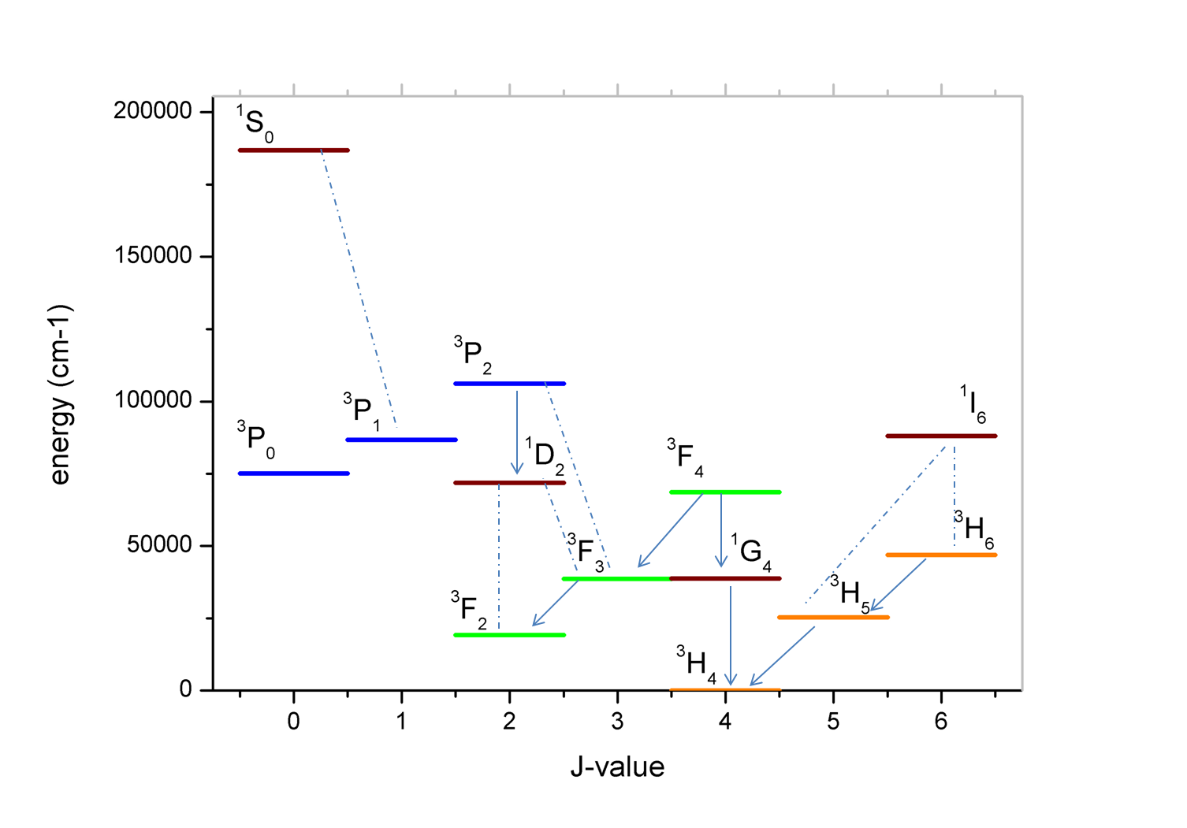
W²⁶⁺ energy levels
Based on the results for Ag-like W (W²⁷⁺) we moved our attention to W²⁶⁺(Cd –like)
MCDF calculated ground state fine structure level energies and possible transitions.

Slide 14
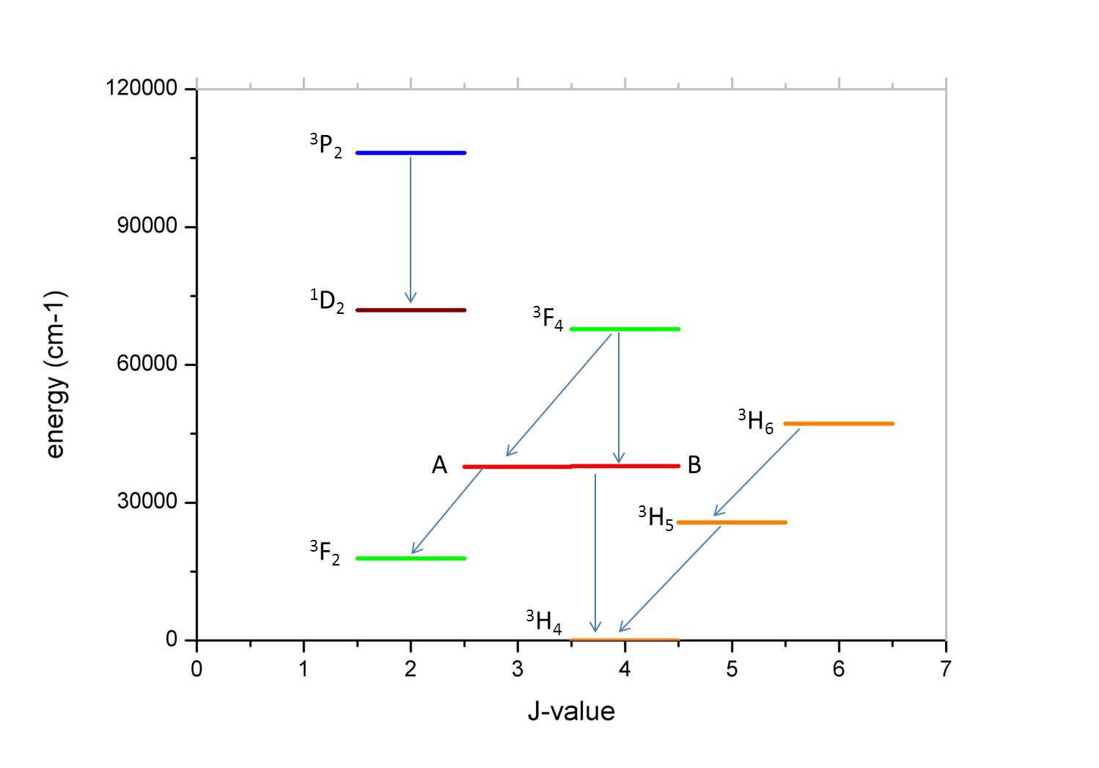
Experimentally determined W²⁶⁺ energy levels
Energy-level diagram for the Cd-like tungsten based on the wavelengths measured in our work. The level designated as A is either the ³F₃ or ¹G₄ while level B is vise-versa. Without additional spectroscopic information these two level designations cannot be made unique. The ¹D₂ level was placed according to the RMBPT-FAC energy calculation.

Slide 15
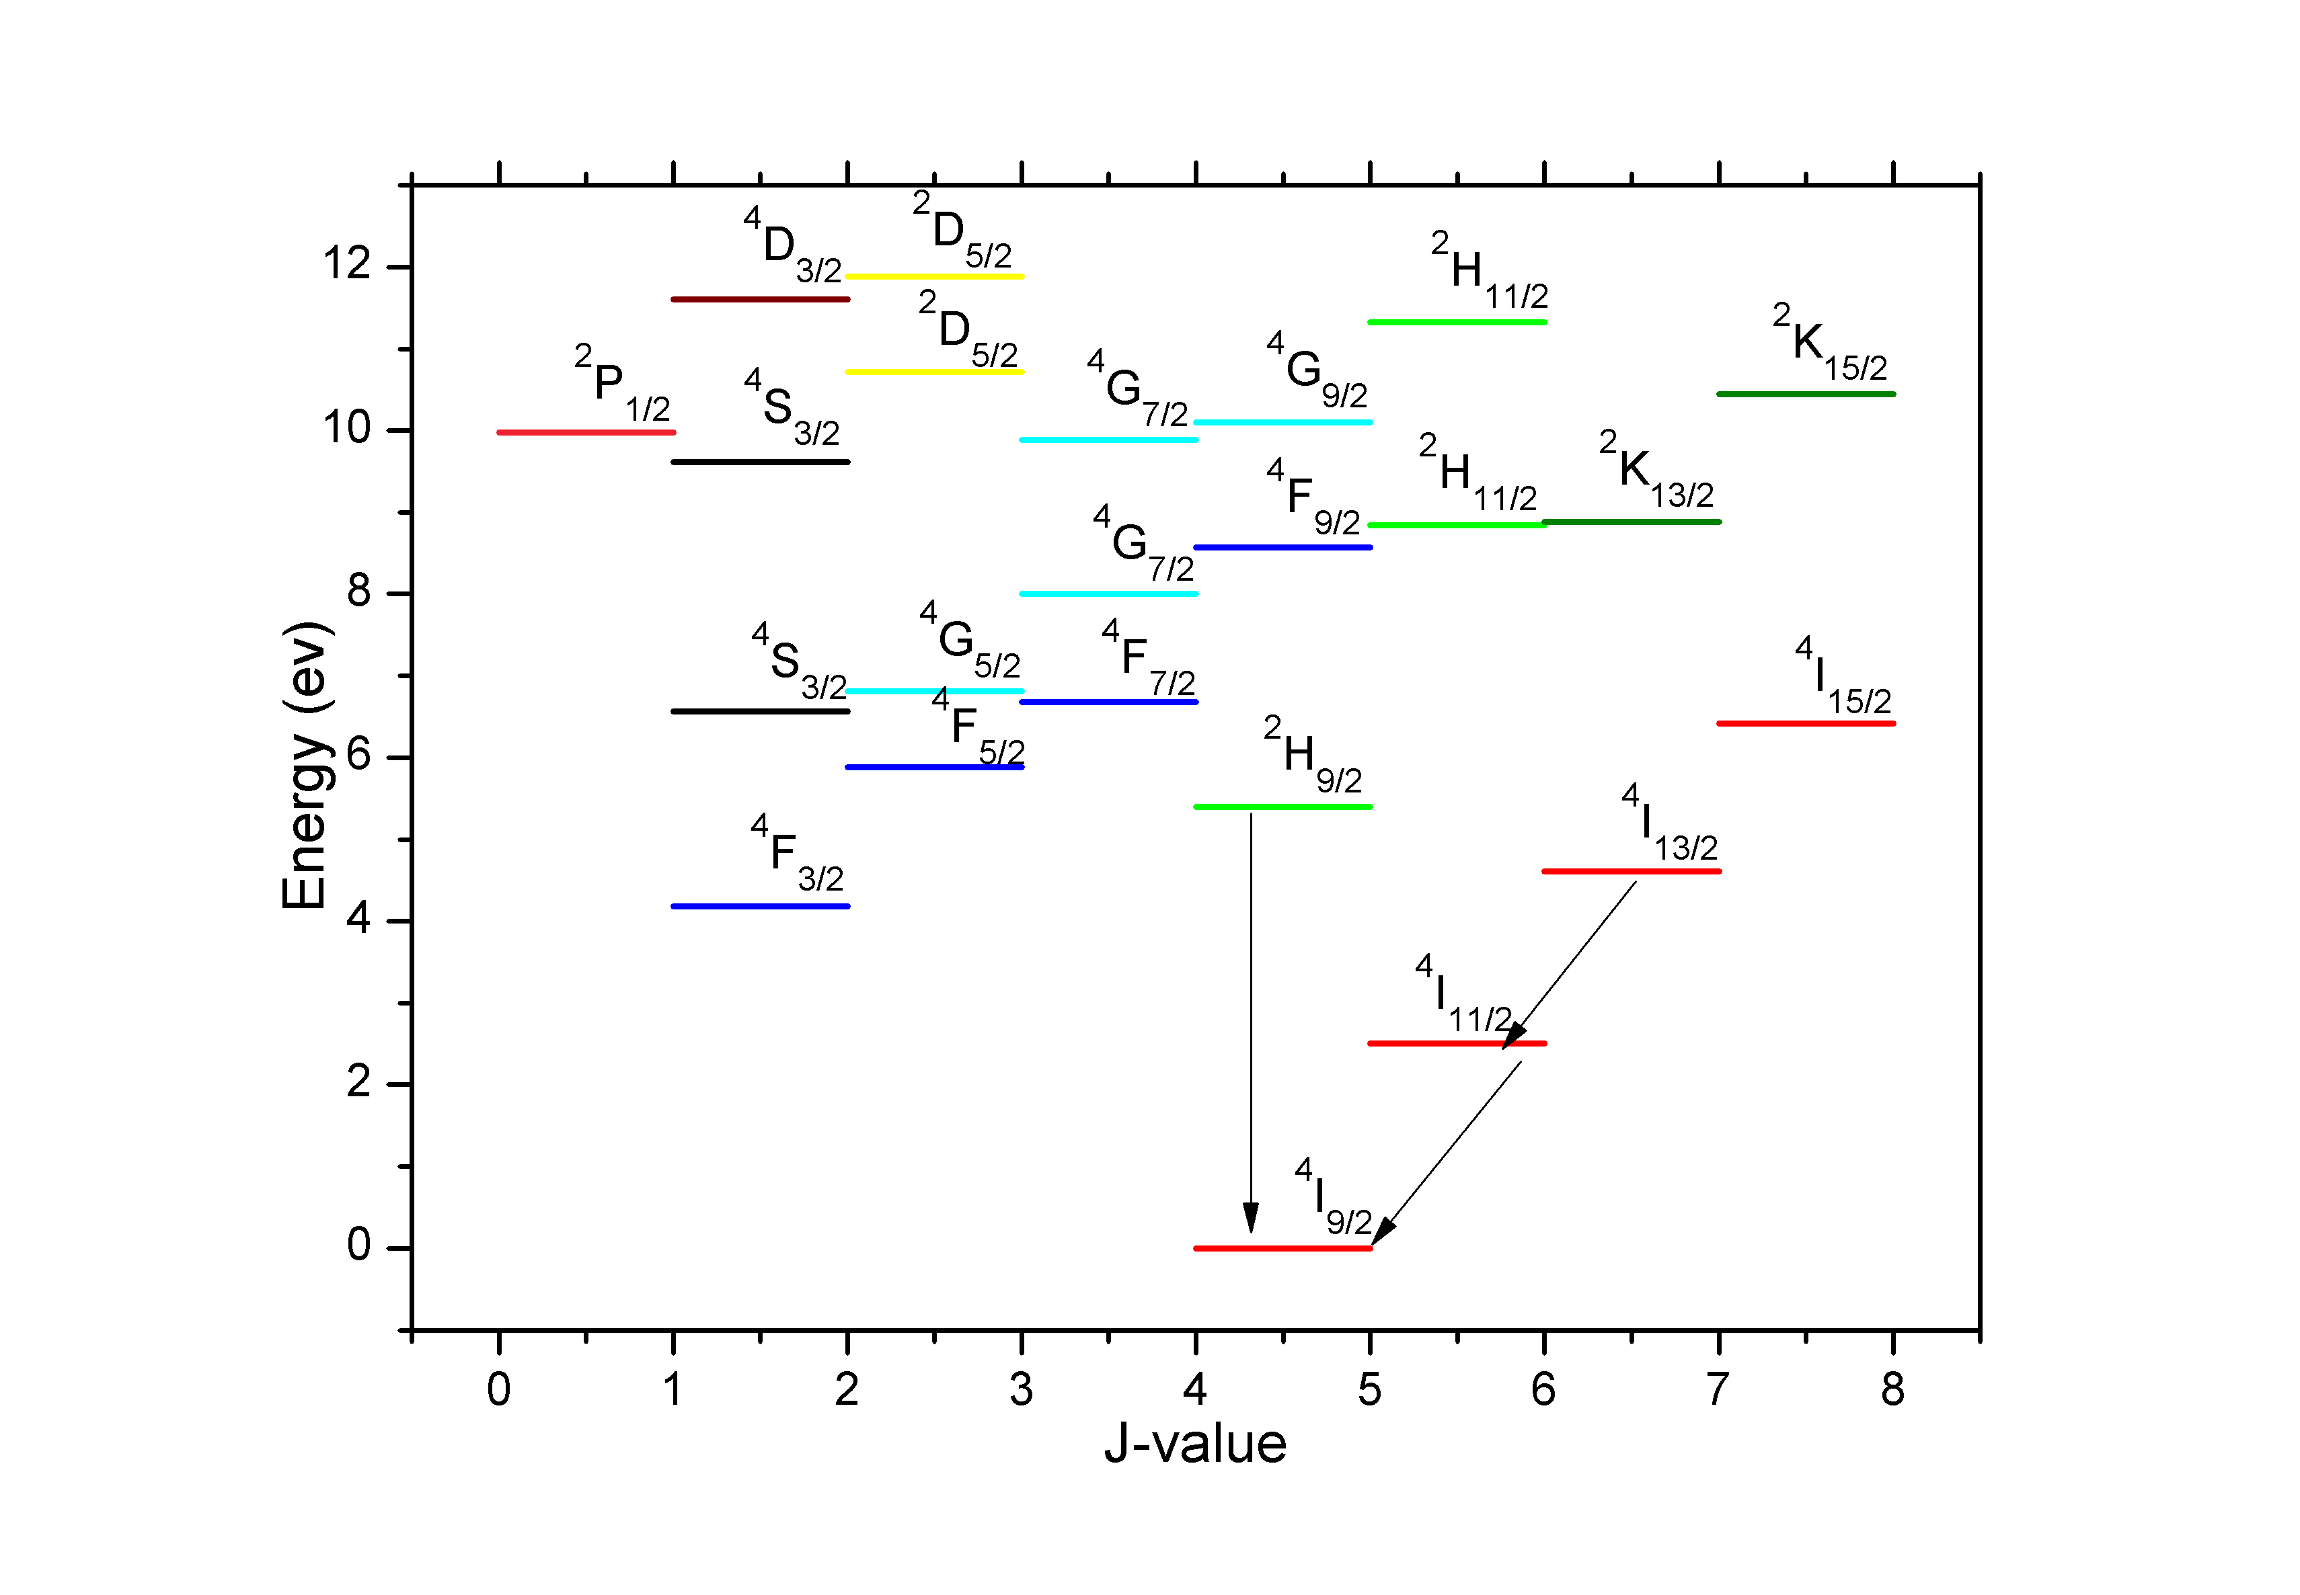
W²⁵⁺
More Complex, W²⁵⁺ , which is In-like.
There are now 41 fine structure levels belonging to the ground “state”,
A partial energy level diagram of In-like tungsten. The energy levels are taken from our RMBPT calculations. There are 41 energy levels in the ground state configuration of In-like tungsten where the highest levels are close to 28 eV. For convenience we show levels up to only 12 eV as the higher energy levels will not contribute to observable spectral lines.

Slide 16
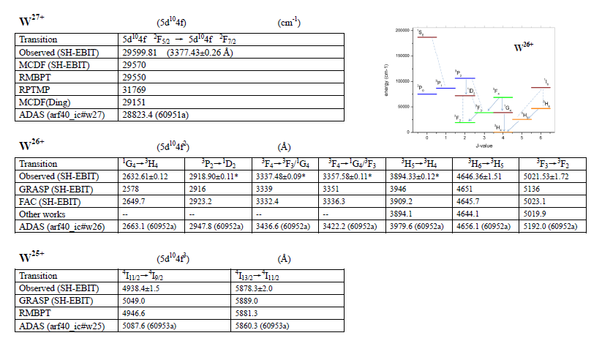
Comparison of our results with other data

Slide 17
Future tungsten work
W27+ is 1 f electron outside a closed shell, W19+ is one f hole
W26+ 2 f electrons, W18+ is 2 f holes
W25+ 3f electrons, W17+ is 3 f holes
So, similar structure is expected and W17+ electron impact data needs to think about this.

Slide 18
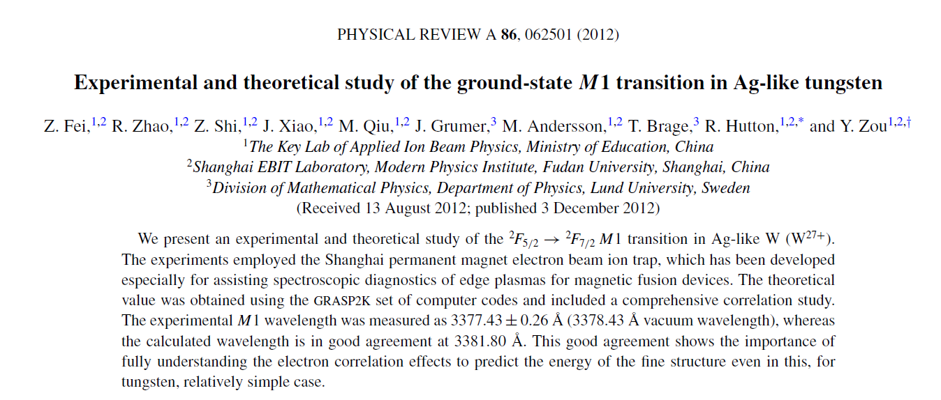
Publications:
W²⁶⁺ has been submitted to PRA and under review
W²⁵⁺ is finished and ready to be submitted, also to PRA.

Slide 19
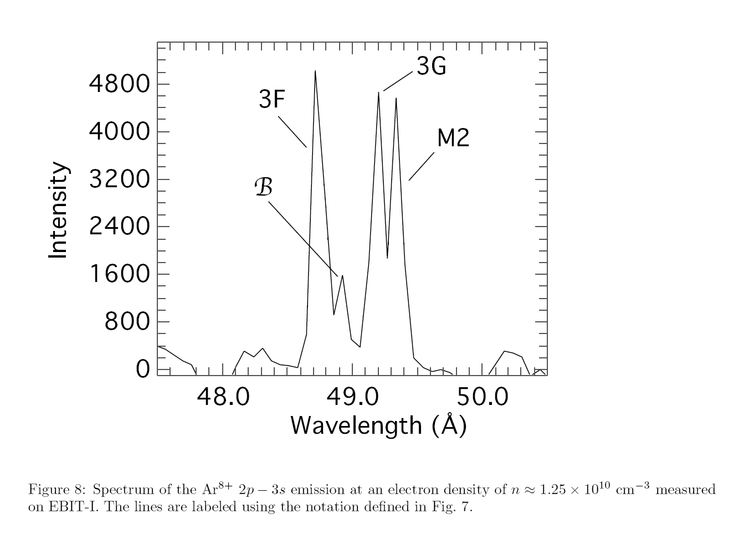
The effect of magnetic fields on atomic structure
Not only Zeeman splitting and hence broadening !
P. Beiersdorfer et al., PRL. 90, 235003 (2003)

Slide 20
Our work on this subject:
Theoretical results for magnetic-field-induced 2p⁵3s ³P_{0,2}‑2p⁶ ¹S₀ E1 transitions in Ne-like ions (zero nuclear spin) between Mg III and Zn XXI, also Ne I.
We demonstrate that it is important to include both “perturber” states 2p⁵3s ¹P₁ and 2p⁵3s ³P₁ in order to produce reliable transition rates.
For the 2p⁵3s ³P₀ state the magnetic-field-induced transition becomes the dominant decay channel for the light elements even in a relatively weak magnetic field.
For the magnetic field effect on the lifetimes of 2p⁵3s ³P_{0,2} states of neutral ²⁰Ne.
Lifetimes are drastically reduced by a magnetic field.
This may be an underlying reason for the discrepancies in the lifetime of the 2p⁵3s ³P₂ state between experiment [14.73(14) s] and theory (17.63 s).

Slide 21
Publications
Theoretical investigations on magnetic field induced 2p53s 3P0,2 − 2p6 1S0 transitions in Ne-like ions without nuclear spin
Jiguang Li, Jon Grumer, Wenxian Li, Martin Andersson, Tomas Brage, Roger Hutton,
Per Jőnsson, Yang Yang, and Yaming Zou
Phys. Rev. A88 013416,2013
The effect of an external magnetic field on the determination of E1M1 two-photon decay rates in Be-like ions
Jon Grumer, Wenxian Li, Dietrich Bernhardt, Jiguang Li, Stefan Schippers, Tomas Brage,
Per Jőnsson, Roger Hutton, and Yaming Zou
Phys Rev A, just published.

Slide 22
Summary
EBITS have important uses in assisting plasma diagnostics
Providing Atomic Data
Looking for Magnetic Sensitive Lines

Slide 23
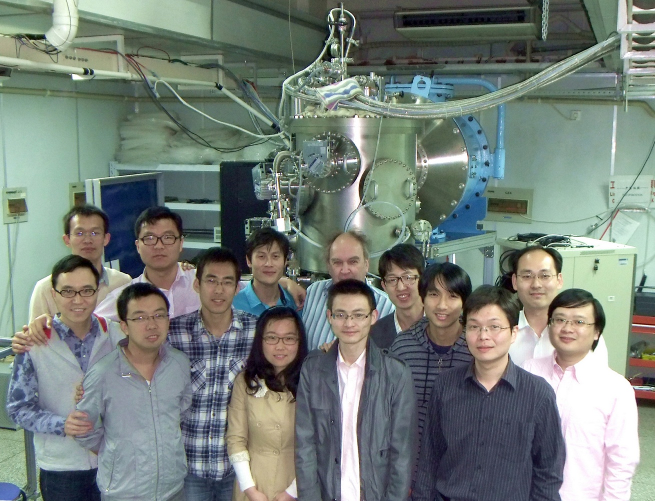
Thank you for attention!

