Slide 1
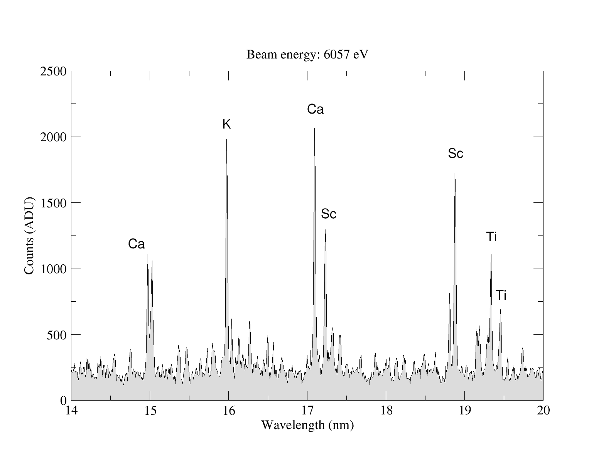
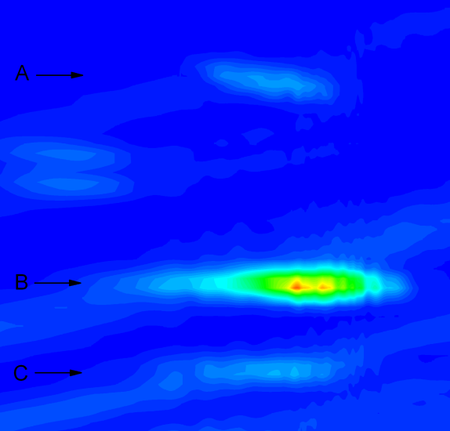

Anisotropic dielectronic resonances from magnetic-dipole lines
Yuri Ralchenko
National Institute of
Standards and Technology
Gaithersburg, MD, USA
ADAS Workshop, 2013
Supported in part by the Office of Fusion Energy Sciences, U.S. DoE

Slide 2
Analyzing
10,000-eV dielectronic resonances with
80-eV forbidden lines
Yuri Ralchenko
National Institute of
Standards and Technology
Gaithersburg, MD, USA
ADAS Workshop, 2013
Supported in part by the Office of Fusion Energy Sciences, U.S. DoE

Slide 3
Yu. Ralchenko & J.D. Gillaspy
Physical Review A 88, 012506 (2013)

Slide 4

Radiative recombination
Continuum
ΔΕ
Bound states
$$A^{\left(Z+1\right)+}+e→A^{Z+}+hν$$
Ion recombined

Slide 5

DR step 1: dielectronic capture
Continuum
ΔΕ
Bound states
$$A^{\left(Z+1\right)+}+e→A^{Z+∗∗}$$
Resonant process!
ΔΕ

Slide 6

Dielectronic capture + autoionization
= no recombination
DC and AI are
direct and inverse
Continuum
Bound states
$A^{\left(Z+1\right)+}+e→A^{Z+∗∗}→$ $A^{\left(Z+1\right)+}+e$

Slide 7

DR step 2: radiative stabilization
Continuum
Bound states
Stabilizing transition:
Mostly x-rays
$$A^{\left(Z+1\right)+}+e→A^{Z+∗∗}→A^{Z+∗}+hν$$
ΔΕ

Slide 8
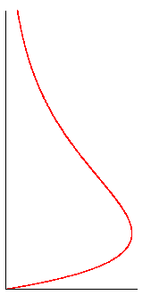
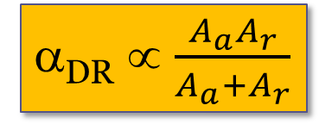
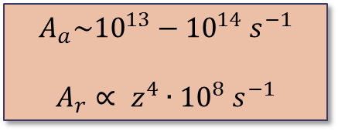
Dielectronic recombination in plasmas
Maxwellian
Electrons are present
at all energies
Z+1
…
(Infinite) Series of
transitions are
to be accounted for
α_{DR} ∝ $\frac{A_{a}A_{r}}{A_{a}+A_{r}}$
$$A_{a}\sim {10}^{13}−{10}^{14} s^{−1}$$
$$A_{r}∝ z^{4}∙{10}^{8} s^{−1}$$
Z

Slide 9
DR measurements on EBITs
Beam
energy
EBIT
electron
beam
Fast beam ramping
extracted
ions
Extract ions
Measure ionization distribution
E_{R}
E_{R}
E_{R}
Is ionization distribution the same
inside and outside the trap?..
NO!
time
DR energy generally does not coincide
with the energy of max abundance

Slide 10
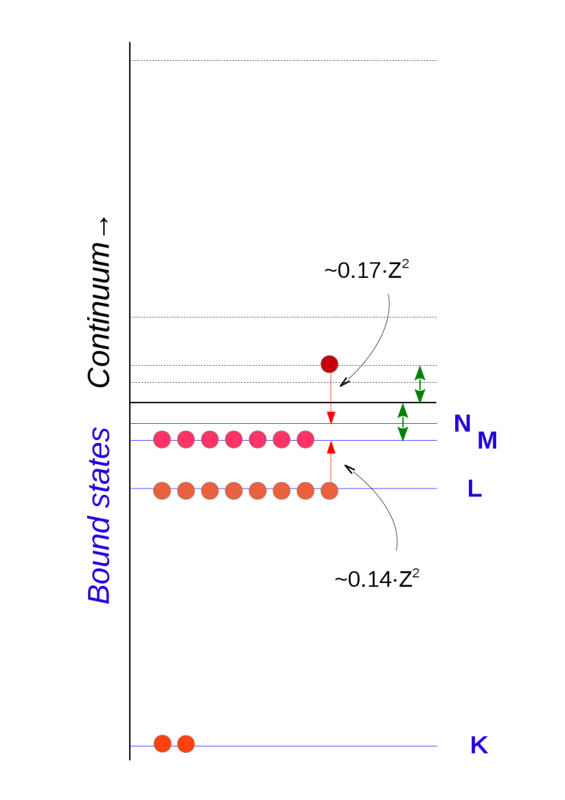
DR resonances with M-shell (n=3) ions
1s²2s²2p⁶3s²3p⁶3d^{n}
LMN resonances:
L electron into M,
free electron into N

Slide 11
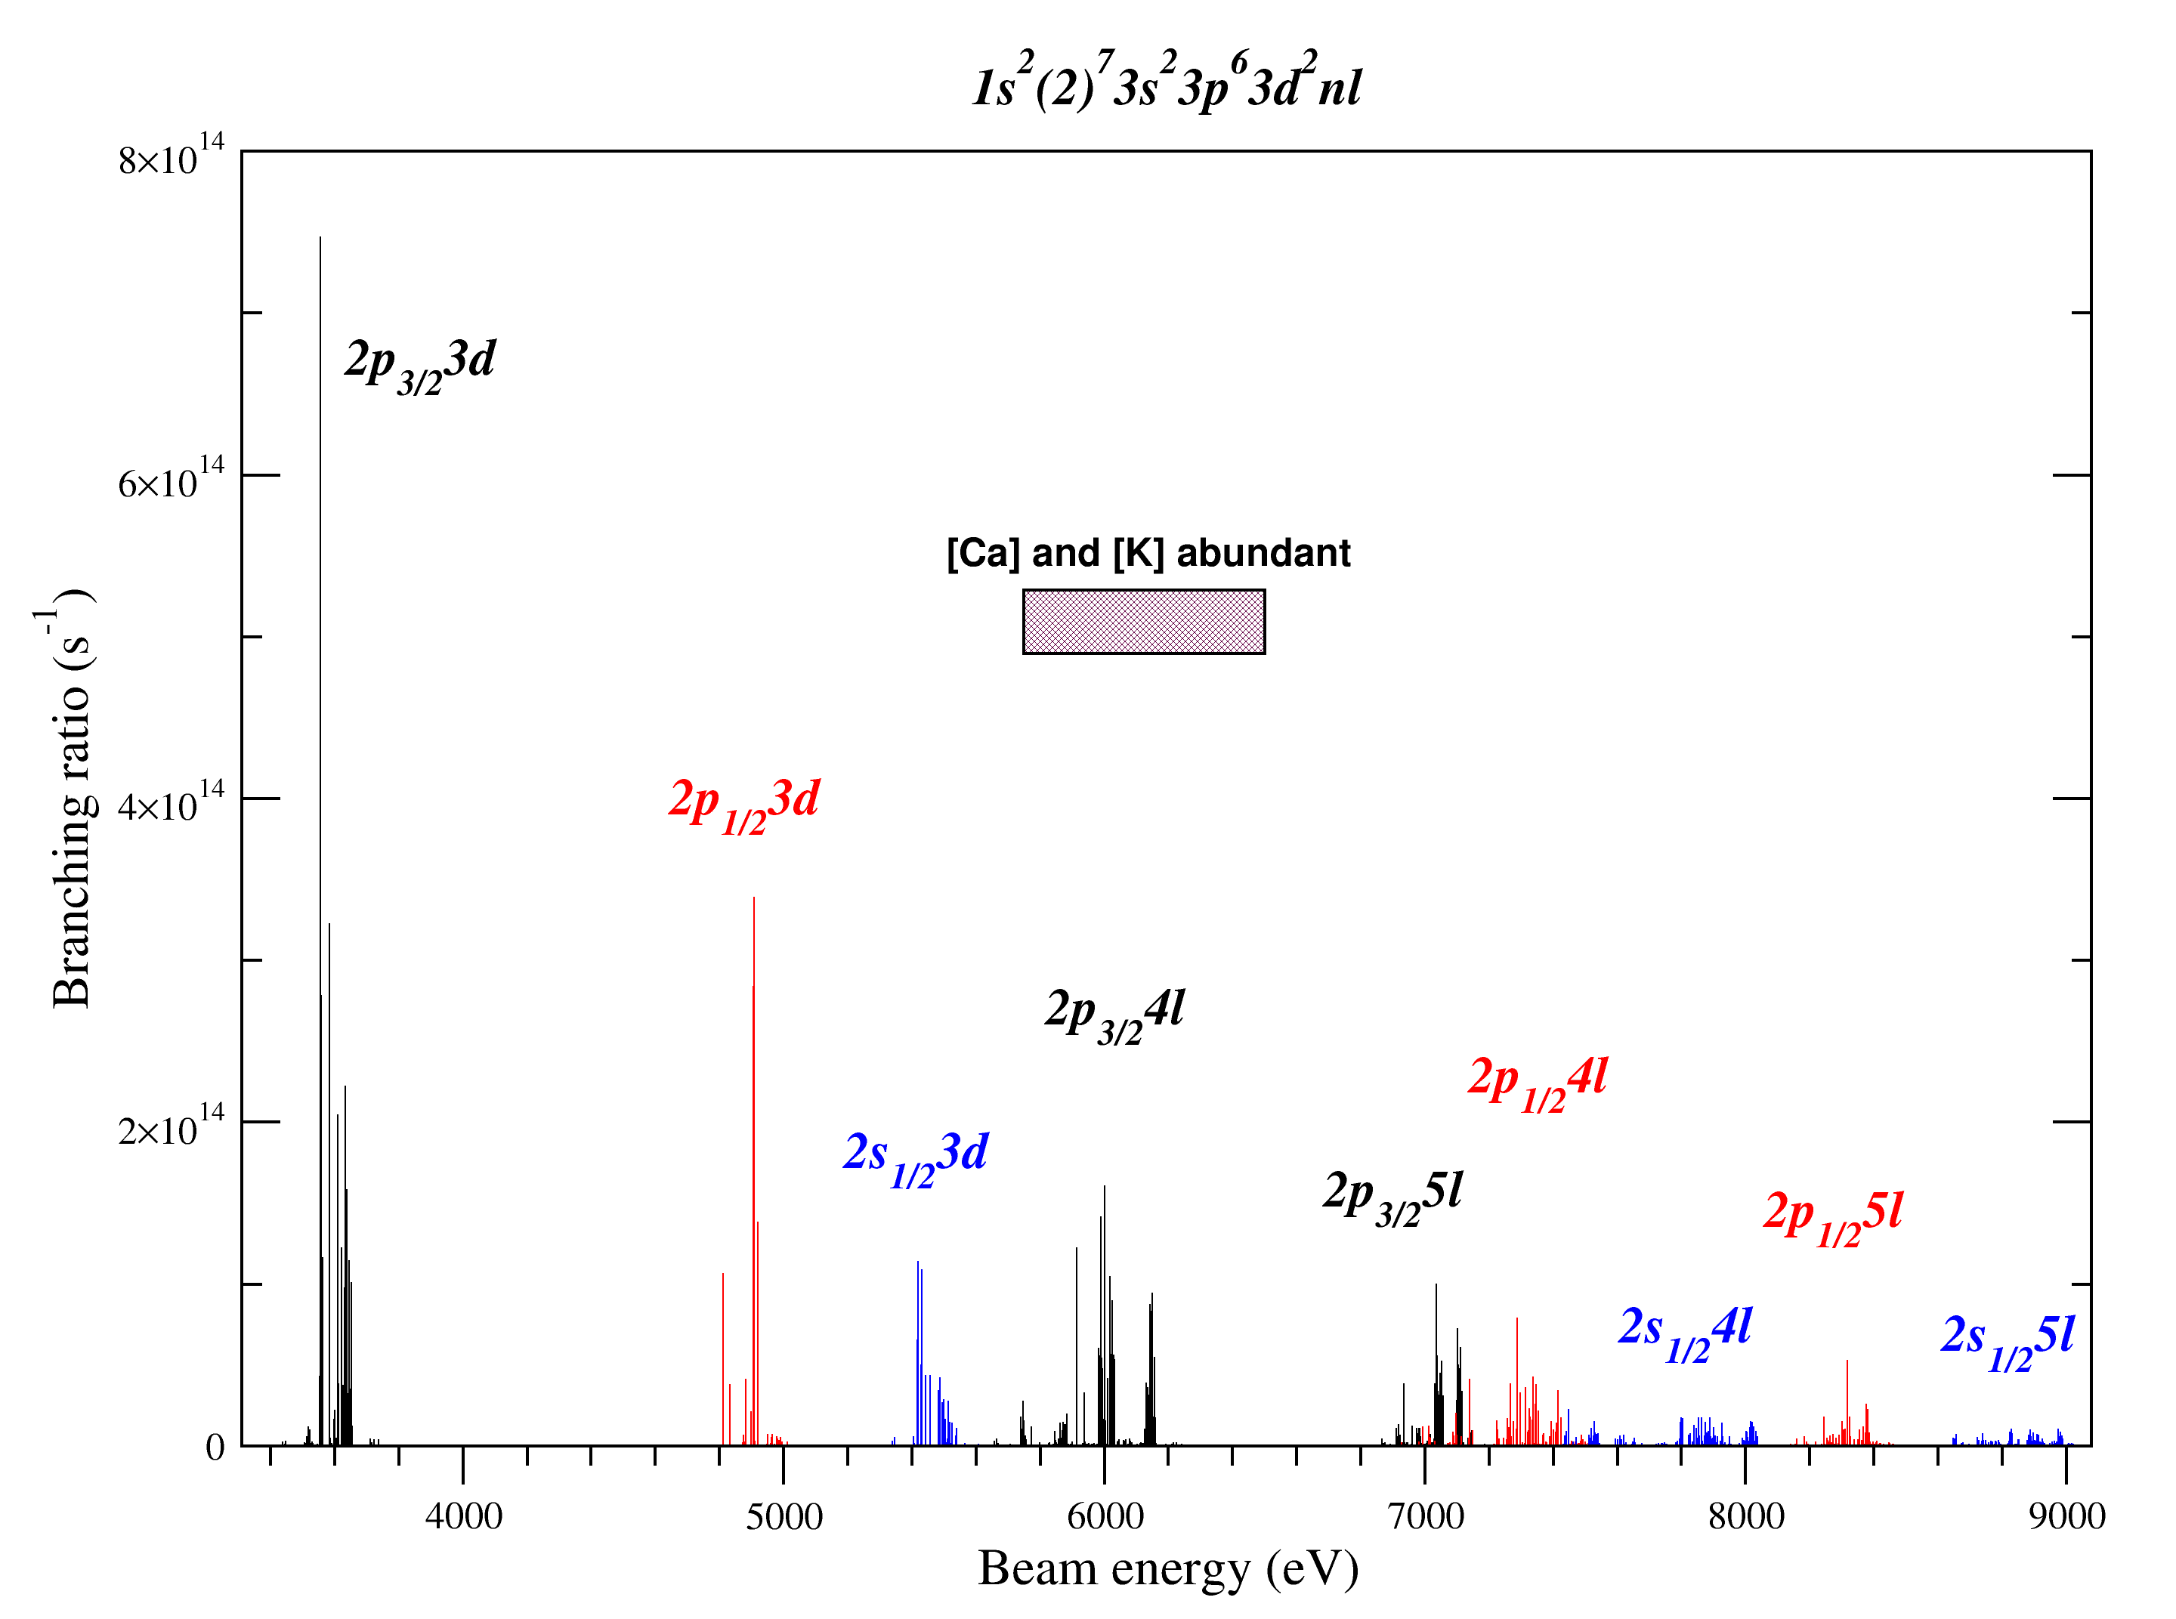
Calculation of LMn DR strength: Ca-like 3d² W⁵⁴⁺
1s²(2s2p)⁸3s²3p⁶3d + e → 1s²(2s2p)⁷3s²3p⁶3d²nl
2s_{1/2} → 3d
2p_{1/2} → 3d
2p_{3/2} → 3d
e → 3d
e → 4l
e → 5l
Relativistic model potential
+ QED corrections
(Flexible Atomic Code, Gu 2008)
Notes:
More accurate knowledge of what to expect

Slide 12
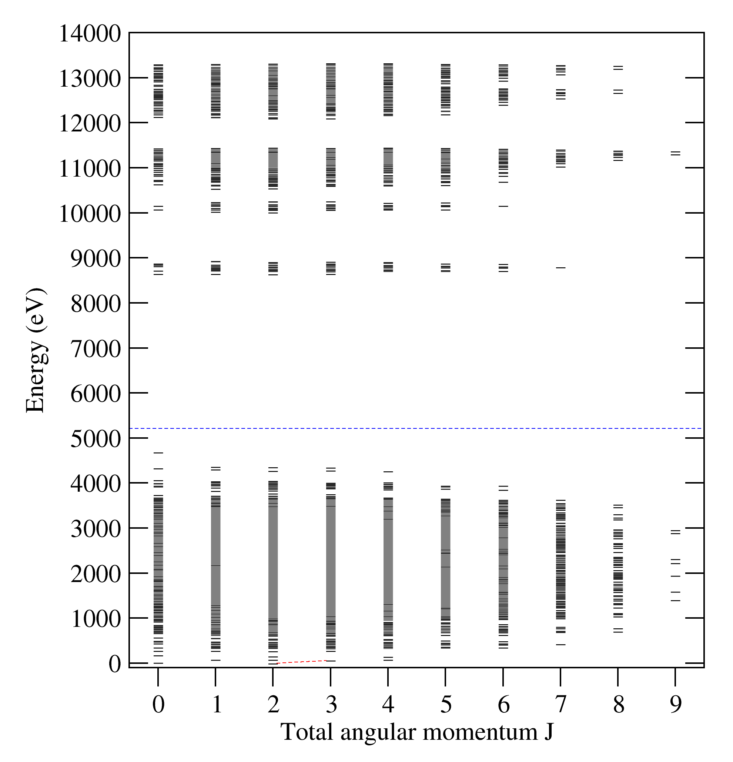
Strategy
Ca-like W⁵⁴⁺
Scan electron beam energy with a small step (a few eV)
When a beam hits a DR, ionization balance changes
Both the populations of all levels within an ion and the corresponding line intensities change as well
Measure line intensity ratios from neighbor ions and look for resonances
EUV lines: forbidden magnetic-dipole lines within the ground configuration
Ionization potential
A(E1) ~ 10¹⁵ s⁻¹
A(M1) ~ 10⁵-10⁶ s⁻¹
I = N⋅A⋅E (intensity)

Slide 13
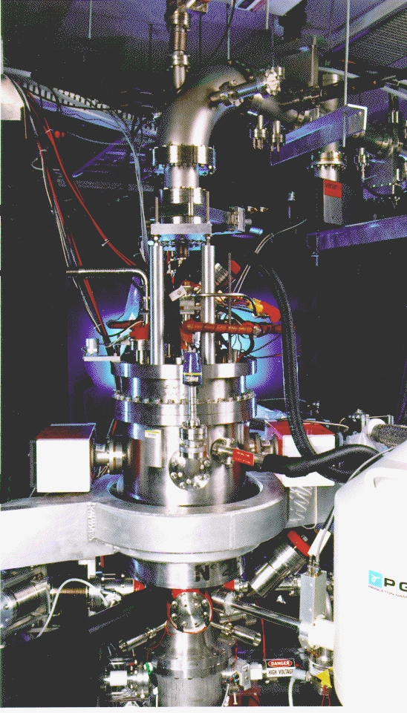
NIST Electron Beam Ion Trap
Beam energy: 0.1 keV – 30 keV
Beam resolution: ~50 eV
Beam current: ≤ 150 mA
Beam radius: ~30 μm
Electron density: ~10¹² cm⁻³
Can produce > 60-times
ionized atoms
Ar, Kr, Xe, Sn, Ti, Sm, Gd, Dy,
Er, Hf, Ta, W, Pt, Au, Bi,…
x10
Monoenergetic beam allows one to “touch” dielectronic resonances

Slide 14
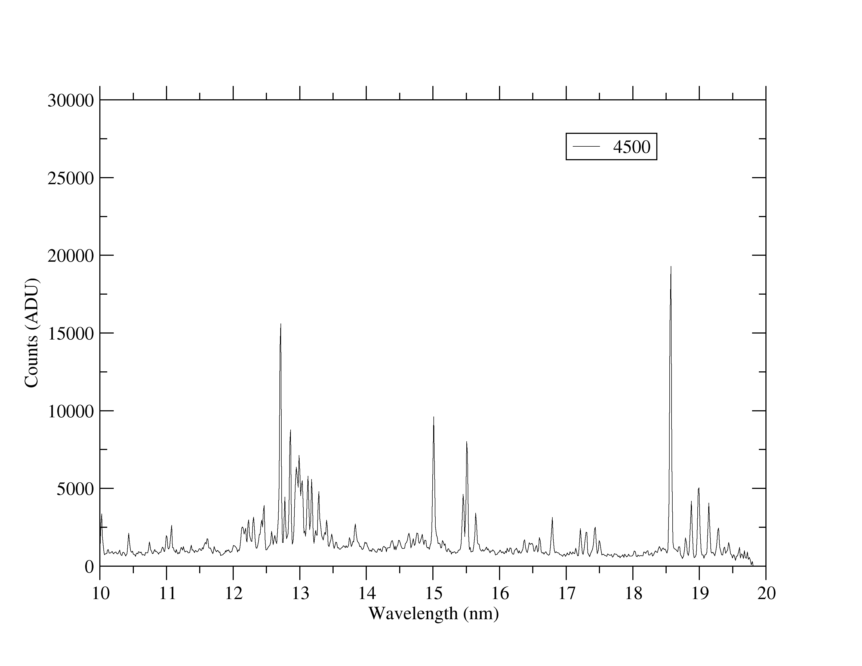
EUV spectrum of W⁴⁷⁺-W⁵⁶⁺: M1 lines within 3d^{n} ground configurations
Almost all lines are M1
Good statistics
Isolated lines
Pair of lines:
(a) within 3d in K-like W⁵⁵⁺
(b) within 3d² in Ca-like W⁵⁴⁺
Yu. Ralchenko et al, Phys. Rev. A 83, 032517 (2011)

Slide 15
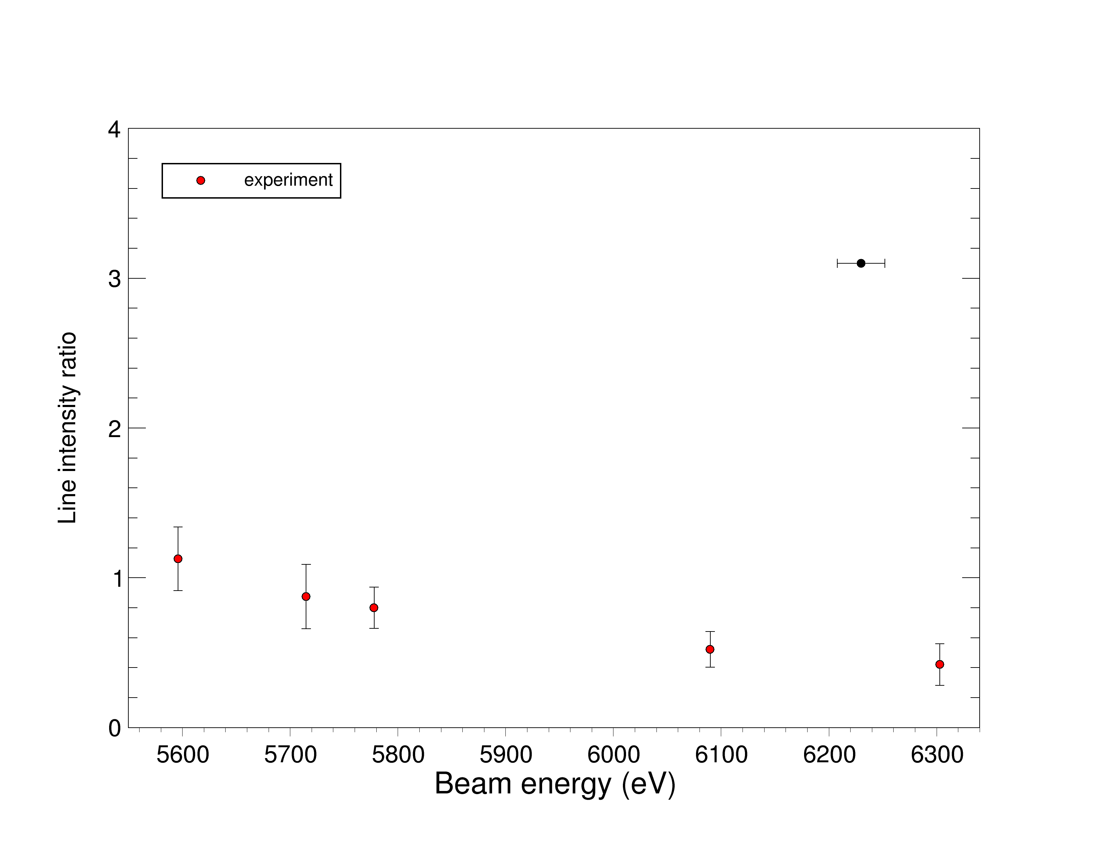
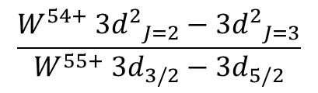
[Ca]/[K]
$$\frac{W^{54+} {3d^{2}}_{J=2}−{3d^{2}}_{J=3}}{W^{55+} {3d}_{3/2}−{3d}_{5/2}}$$

Slide 16
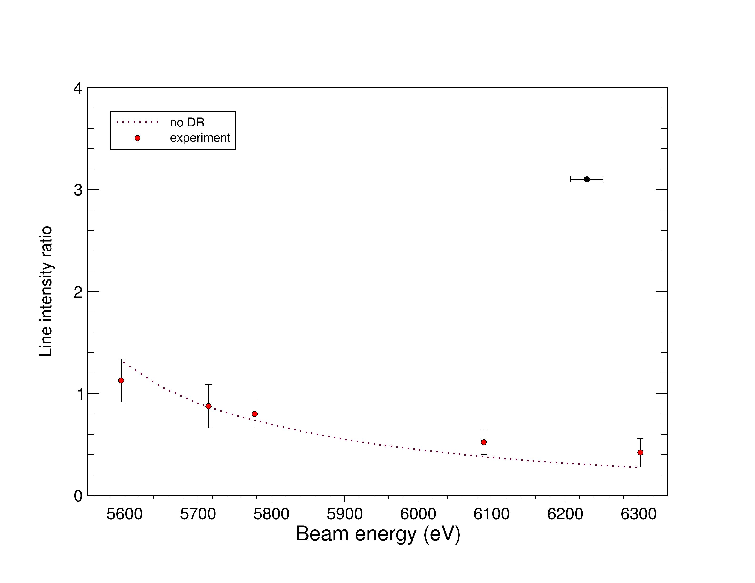
[Ca]/[K]:
$$\frac{W^{54+} {3d^{2}}_{J=2}−{3d^{2}}_{J=3}}{W^{55+} {3d}_{3/2}−{3d}_{5/2}}$$
THEORY:
no DR
Modeling: CR code NOMAD, atomic data from FAC

Slide 17
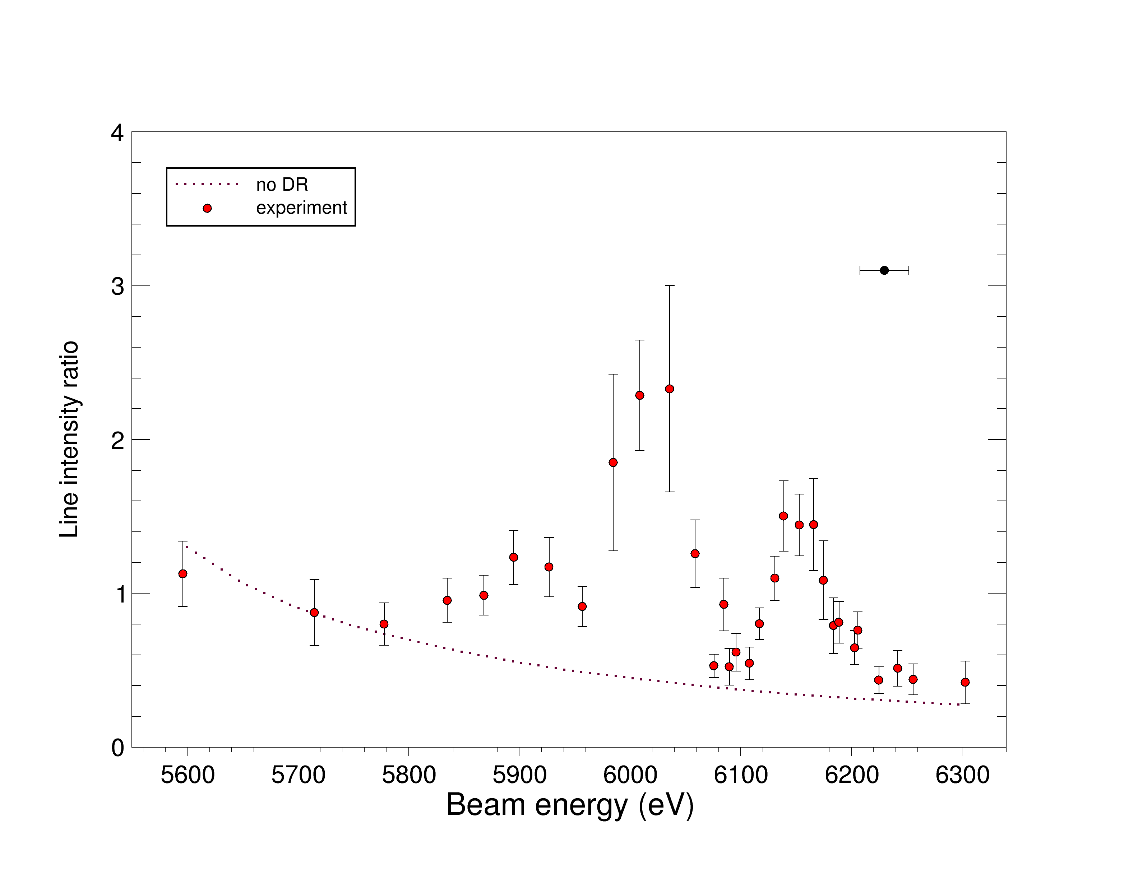
[Ca]/[K]
$$\frac{W^{54+} {3d^{2}}_{J=2}−{3d^{2}}_{J=3}}{W^{55+} {3d}_{3/2}−{3d}_{5/2}}$$
THEORY:
no DR

Slide 18
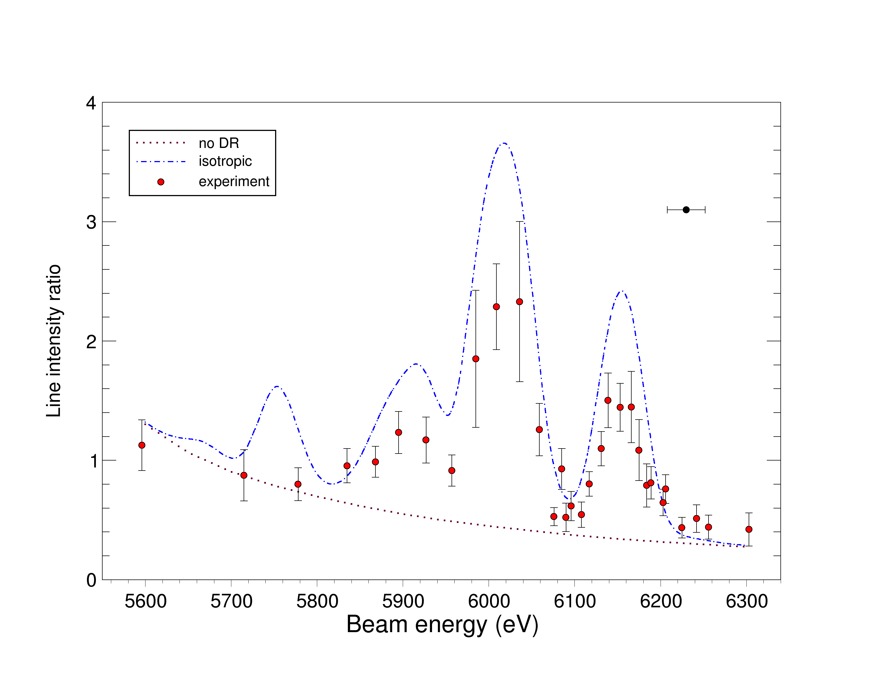
[Ca]/[K]
$$\frac{W^{54+} {3d^{2}}_{J=2}−{3d^{2}}_{J=3}}{W^{55+} {3d}_{3/2}−{3d}_{5/2}}$$
THEORY:
no DR
isotropic DR
Non-Maxwellian (40-eV Gaussian)
collisional-radiative model: ~10,500 levels

Slide 19
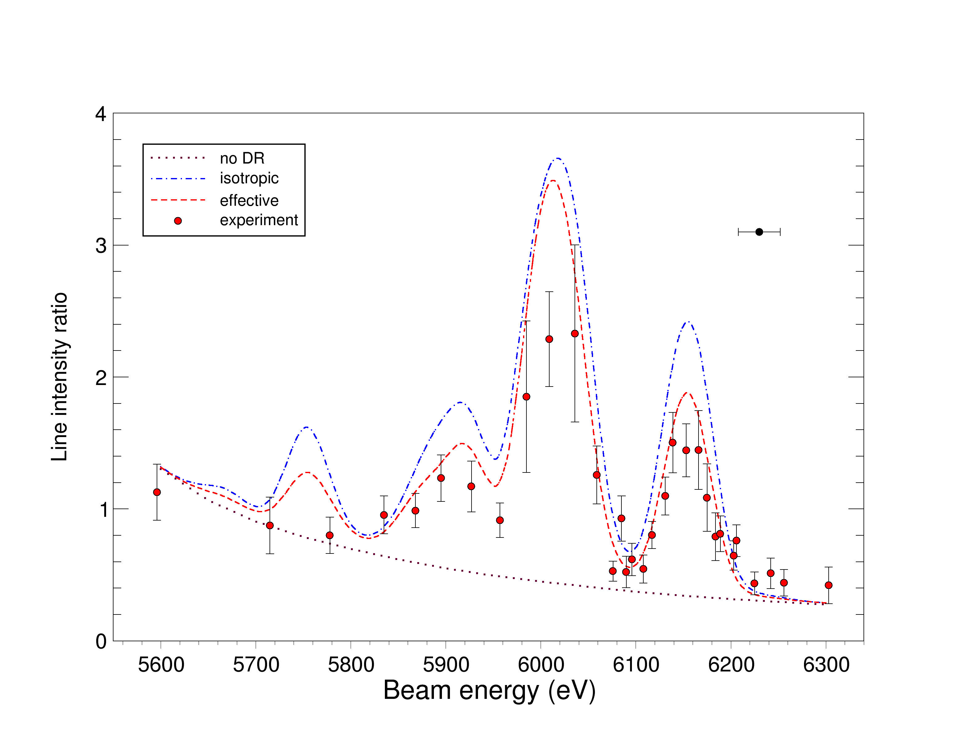
[Ca]/[K]
Non-Maxwellian (40-eV Gaussian)
collisional-radiative model: ~10,500 levels
$$\frac{W^{54+} {3d^{2}}_{J=2}−{3d^{2}}_{J=3}}{W^{55+} {3d}_{3/2}−{3d}_{5/2}}$$
THEORY:
no DR
isotropic DR
anisotropic DR
J
m=+J
atomic
level
m=-J
degenerate
magnetic
sublevels
Impact beam electrons are monodirectional

Slide 20
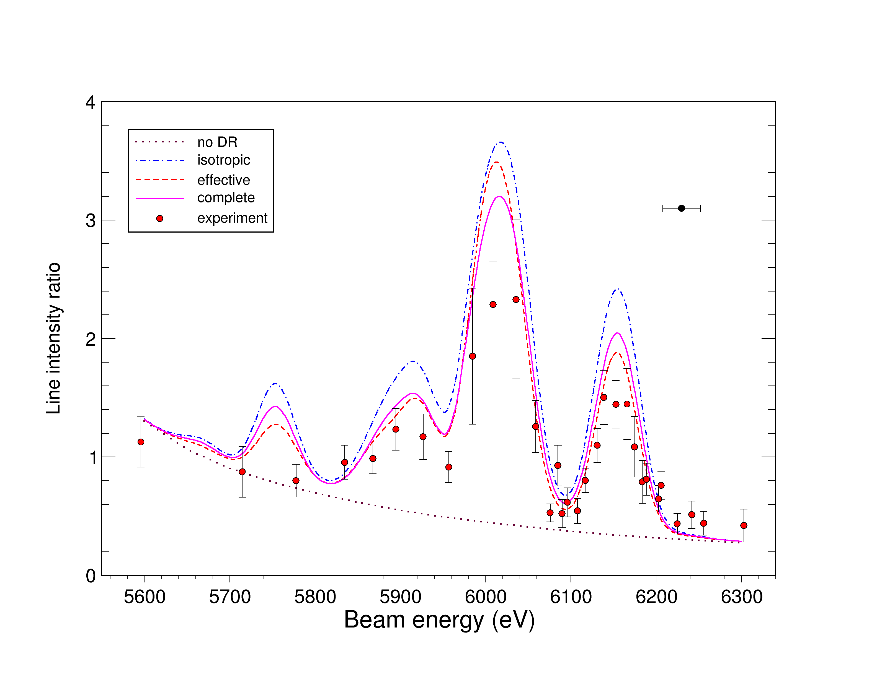
[Ca]/[K]
Non-Maxwellian (40-eV Gaussian)
collisional-radiative model: ~18,500 levels
$$\frac{W^{54+} {3d^{2}}_{J=2}−{3d^{2}}_{J=3}}{W^{55+} {3d}_{3/2}−{3d}_{5/2}}$$
THEORY:
no DR
isotropic DR
anisotropic DR
J
m=+J
atomic
level
m=-J
degenerate
magnetic
sublevels
Impact beam electrons are monodirectional

Slide 21
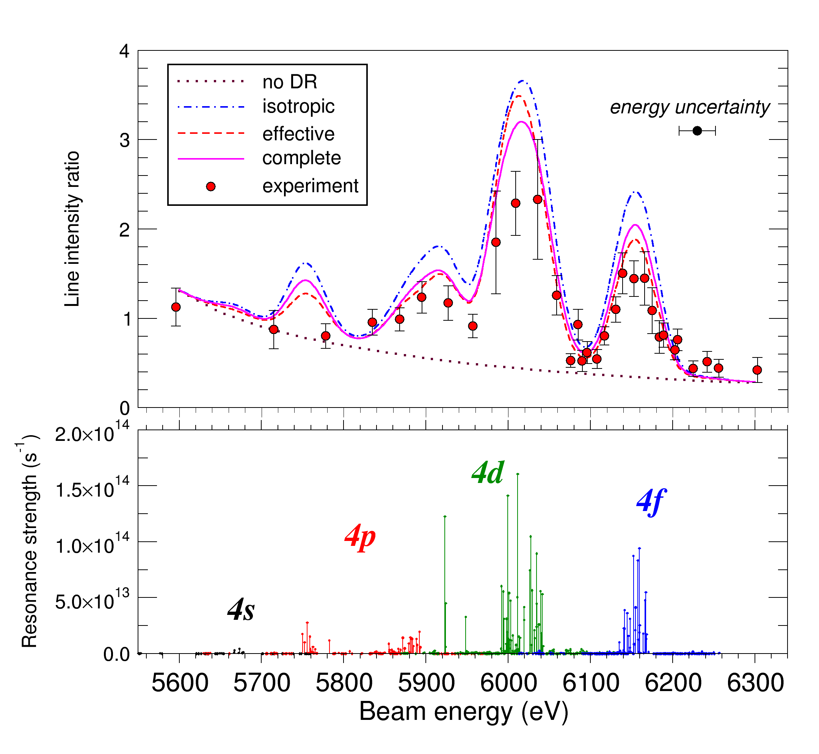
[Ca]/[K]
$$\frac{W^{54+} {3d^{2}}_{J=2}−{3d^{2}}_{J=3}}{W^{55+} {3d}_{3/2}−{3d}_{5/2}}$$
2p_{3/2} → 3d
e → 4l

Slide 22
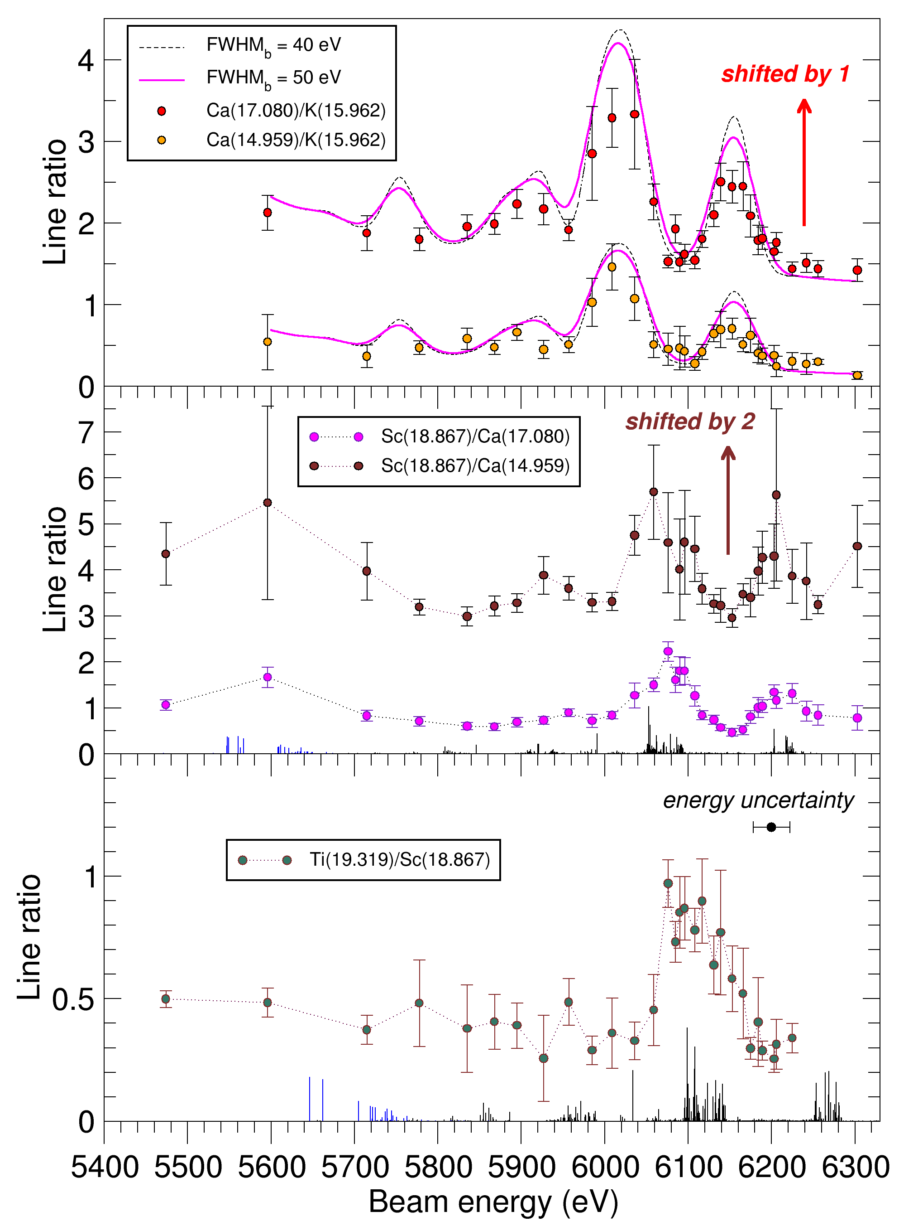
One EBIT run, several ions…
n=4
Sc
Ti
Ca

Slide 23
Where are the 10-keV photons?..
2p⁵3s²3p⁶3d^{n+1}4l
4d
4f
4s
4p
3d
3p
3s
~11keV
~9keV
~8keV
2p_{1/2}
2p_{3/2}
2s_{1/2}

Slide 24
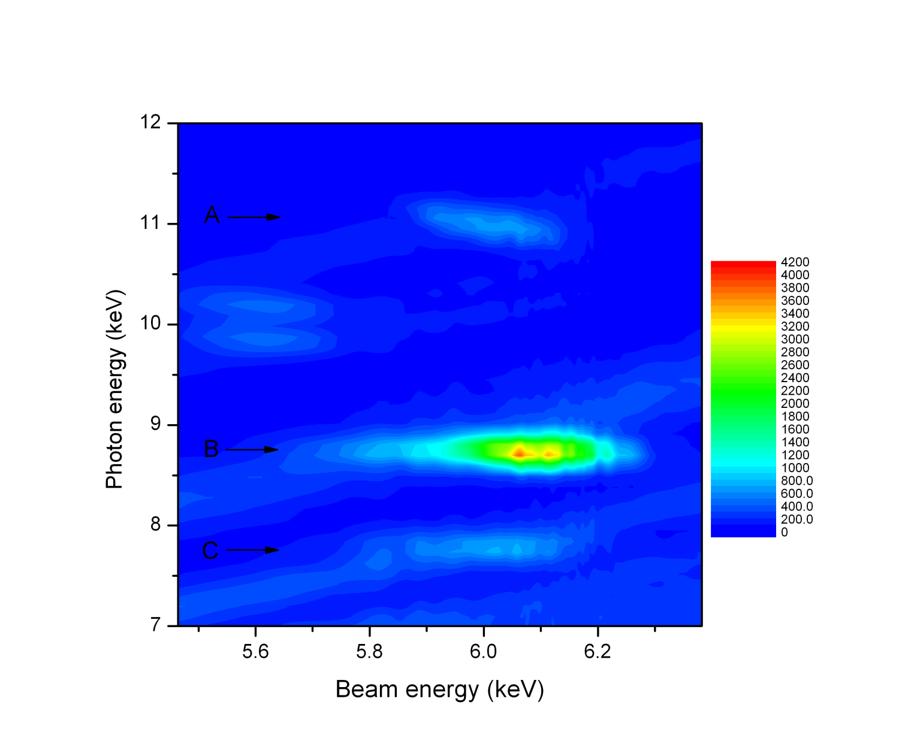
X-ray emission (Ge detector)
Δn>0 transitions into the 2p_{3/2} hole
2p⁵_{3/2}-4l
B and C: horizontal
A: slant
2p⁵_{3/2}-3d
2p⁵_{3/2}-3s

Slide 25
Conclusions
A new in situ method to measure multi-keV dielectronic resonances in 3d^{n} ions using ratios of EUV magnetic-dipole lines
First resolved measurements of LMN resonances in ~55-times ionized W
CR modeling shows importance of anisotropic effects on ionization balance
Isolated resonances allow determination of the beam width

Slide 26

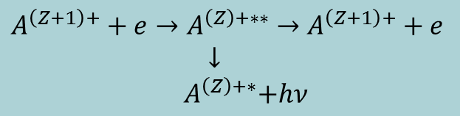
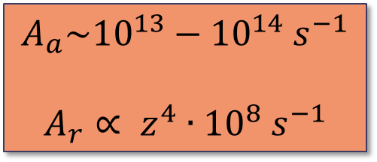
Probability of dielectronic recombination
$A^{\left(Z+1\right)+}+e→A^{\left(Z\right)+∗∗}→$ $A^{\left(Z+1\right)+}+e$
$↓$
${ A}^{\left(Z\right)+∗}+hν$
dielectronic capture ∝ A_{a}
autoionization A_{a}
radiative decay A_{r}
…
Z+1
$$A_{a}\sim {10}^{13}−{10}^{14} s^{−1}$$
$$A_{r}∝ z^{4}∙{10}^{8} s^{−1}$$
α_{DR} ∝ $\frac{A_{a}A_{r}}{A_{a}+A_{r}}$
Z

Slide 27
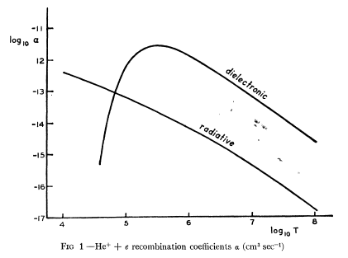
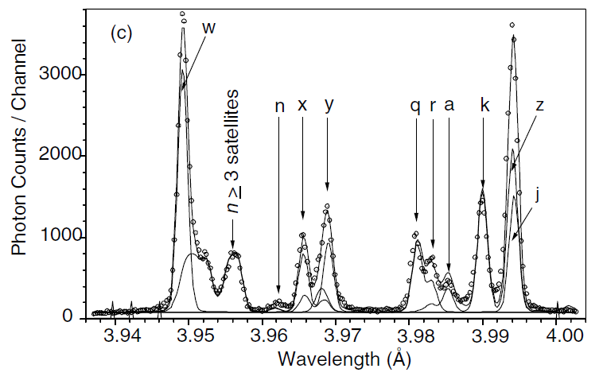
Examples of dielectronic recombination & resonances
Dielectronic satellites are
important for plasma diagnostics
(e.g., He- and Li-like ions)
Ar at NSTX, Bitter et al (2004)
A. Burgess, ApJ 139, 776 (1964)
BUT: DR for high-Z multi-electron ions
is barely known!
This work solved the ionization balance
problem for solar corona

Slide 28
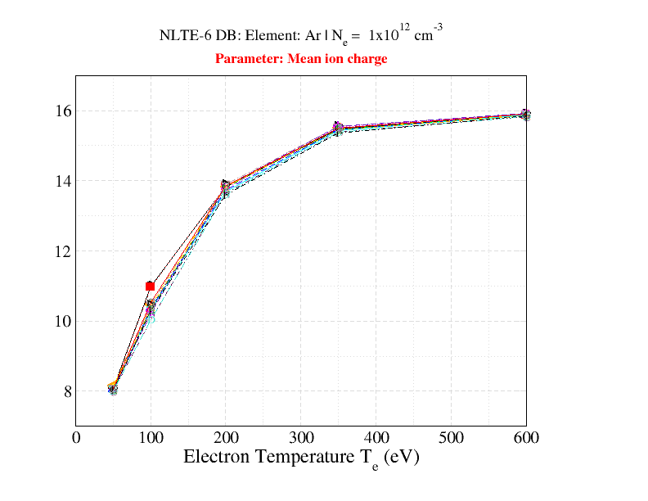
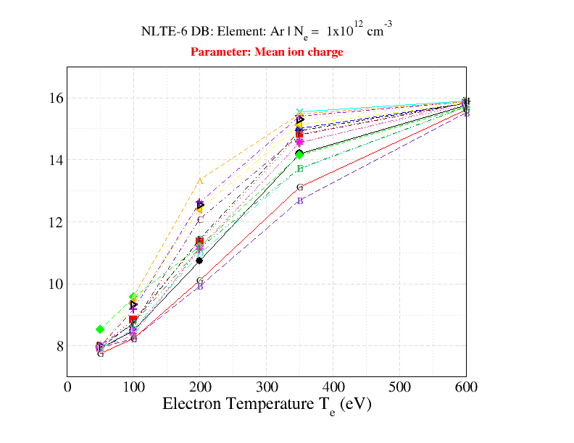
Why is DR analysis still important?
Example: NLTE-6 Code Comparison Workshop, 2009; Ar at 10¹² cm⁻³
Without DR
With DR

Slide 29
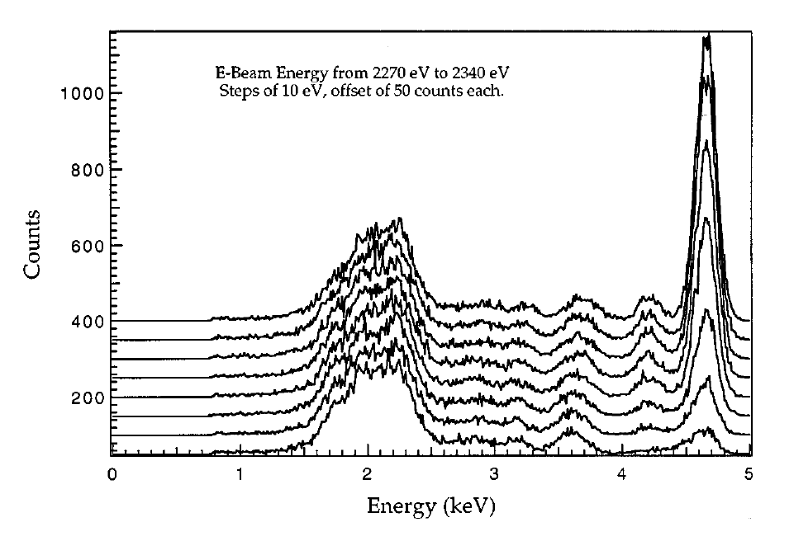
LMM resonances in Ti-like Ba³⁴⁺
McLaughlin et al, Phys. Rev. A 54, 2040 (1996)
One of the
first NIST EBIT
papers

Slide 30
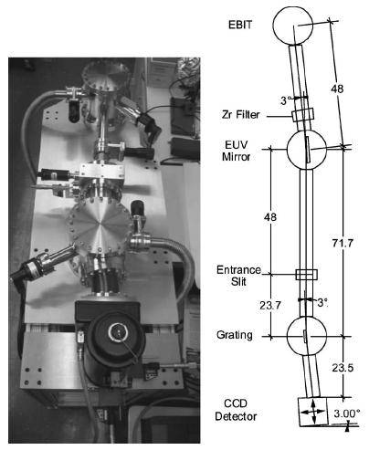
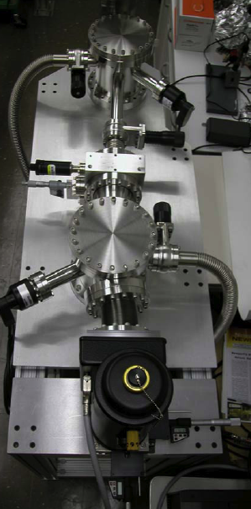
EUV spectrometer
Grazing incidence diffraction grating
Resolving power R=350
Optimized for weak signals
B. Blagojevic et al,
Rev. Sci. Instrum., 76, 83102 (2005).
Notes:
Point out Zr foil separates vacuum: 1.e-8 warm (into 9’s cold?), EBIT <1.e-9.
Back illuminated
Final uncertainty: 0.003 nm
(3º),
Developed by NIST for Lithography work for SEMATECH.

